Slide 1
ThalamusT
Anatomy of the
Diencephalon
N. Zecevic, March 4, 2013

Slide 2
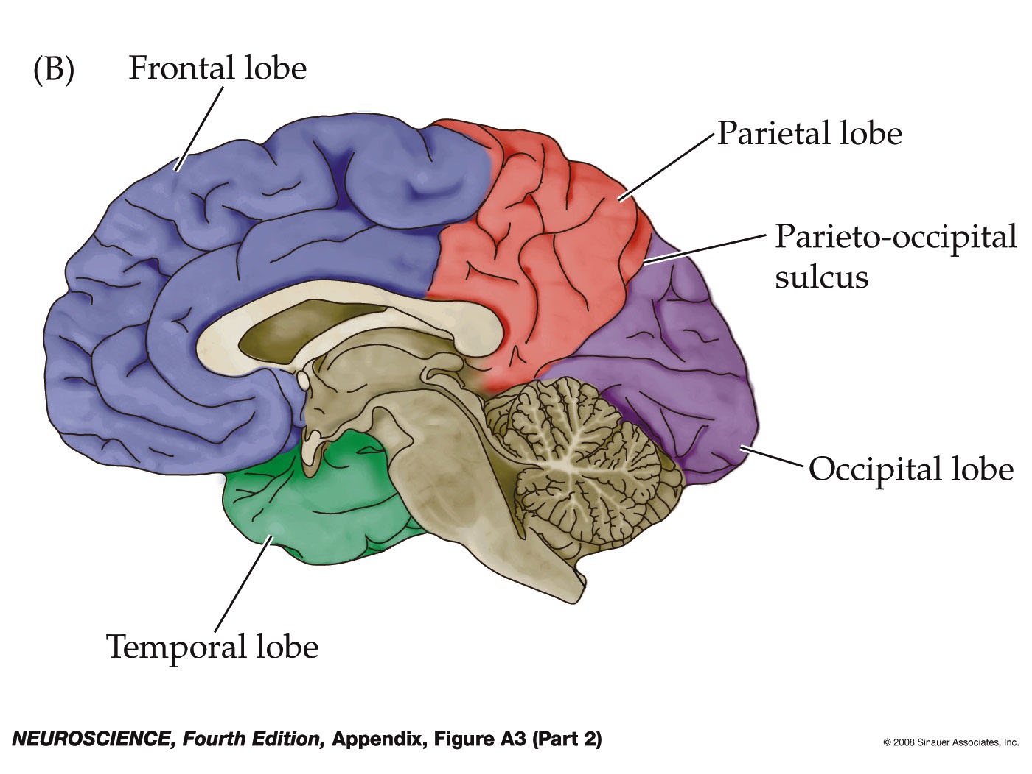
Figure A3 Surface anatomy of the cerebral hemisphere (Part 2)
Notes:
neuro4e-app-fig-a-03-2r.jpg

Slide 3
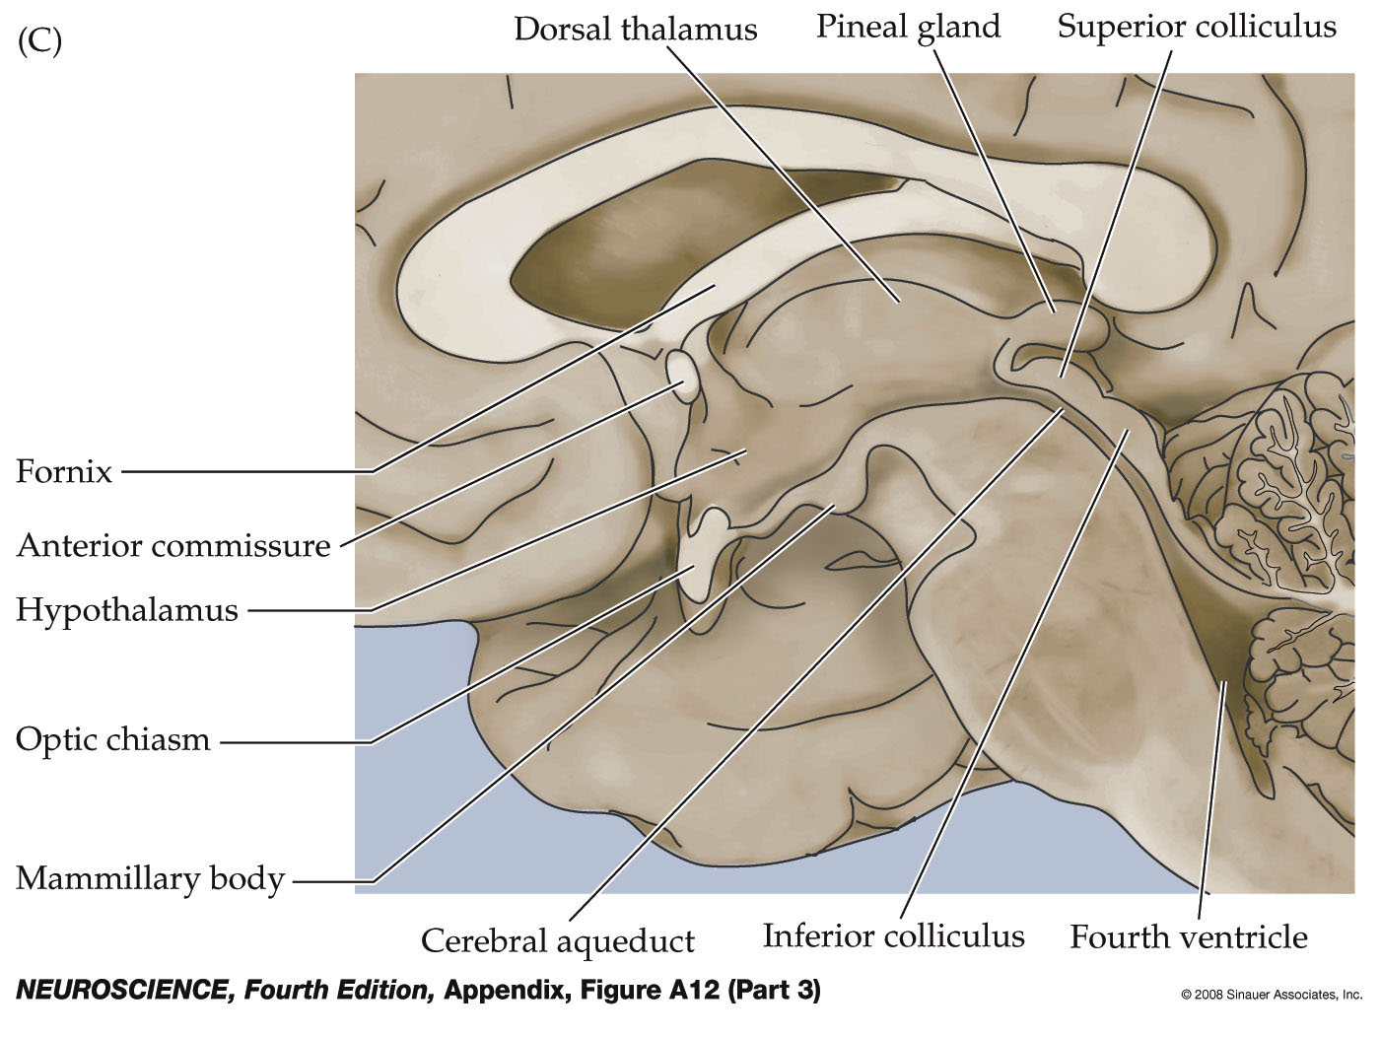
Figure A12 Midsagittal view of the human brain (Part 3)
Notes:
neuro4e-app-fig-a-12-3r.jpg

Slide 4
MRI-midline

Slide 5
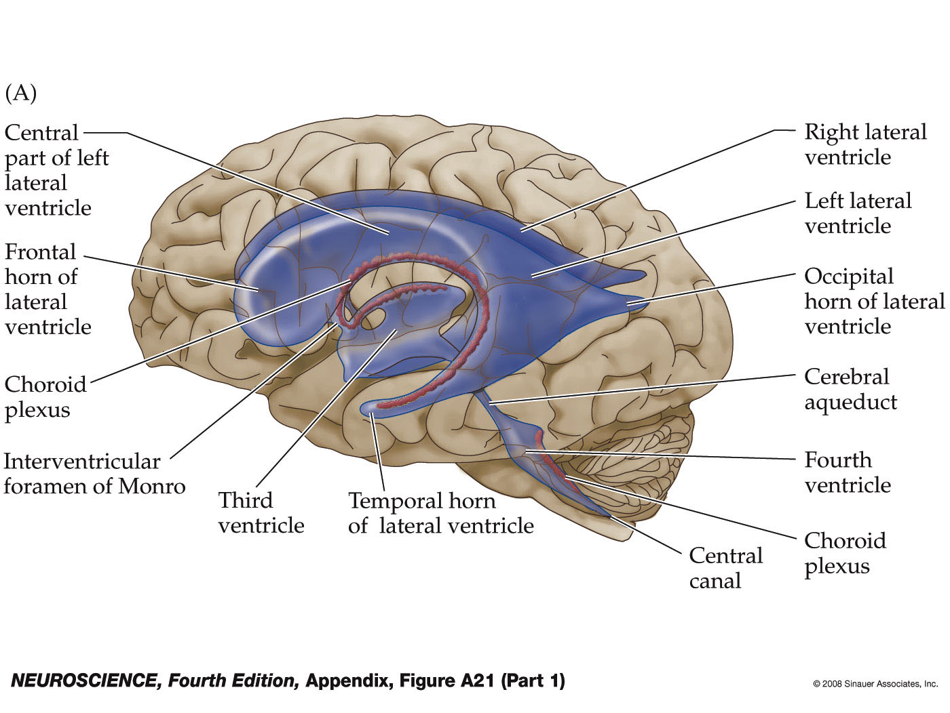
Figure A21 The ventricular system of the human brain (Part 1)
Notes:
neuro4e-app-fig-a-21-1r.jpg

Slide 7
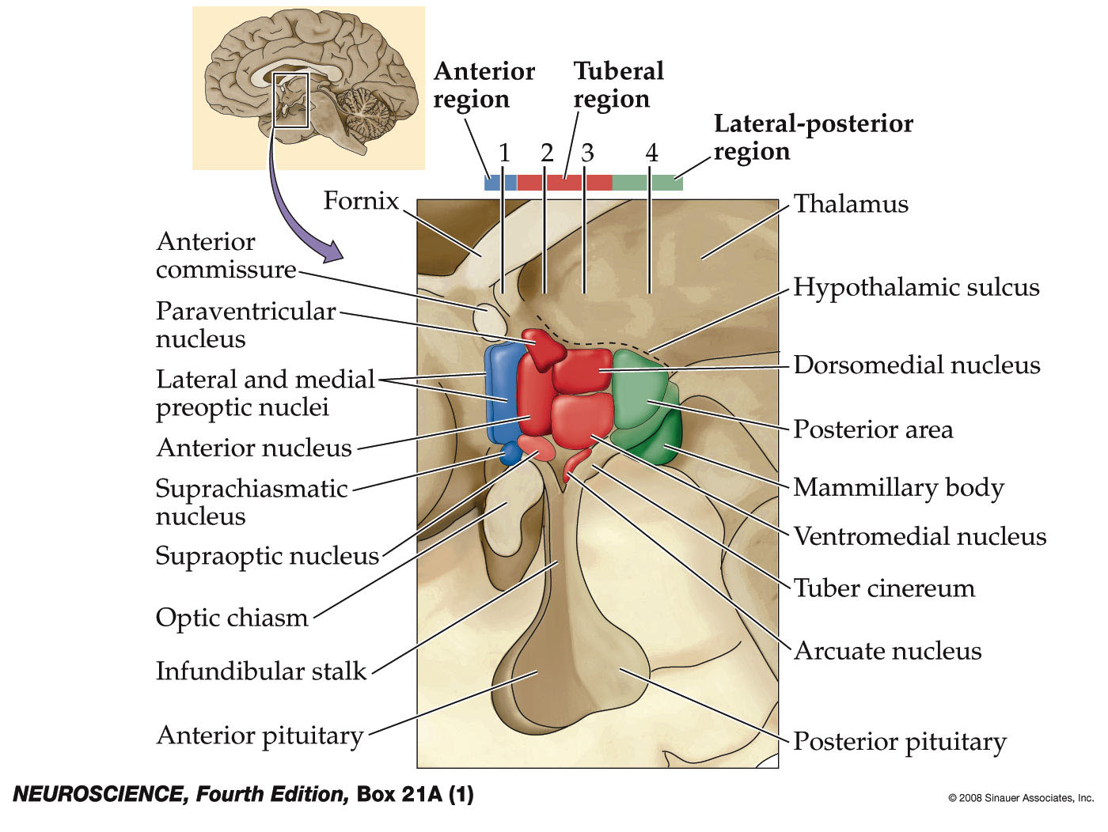
Box 21A(1) The Hypothalamus
Notes:
neuro4e-box-21-a(1)-0.jpg

Slide 8
Epithalamus

Slide 9
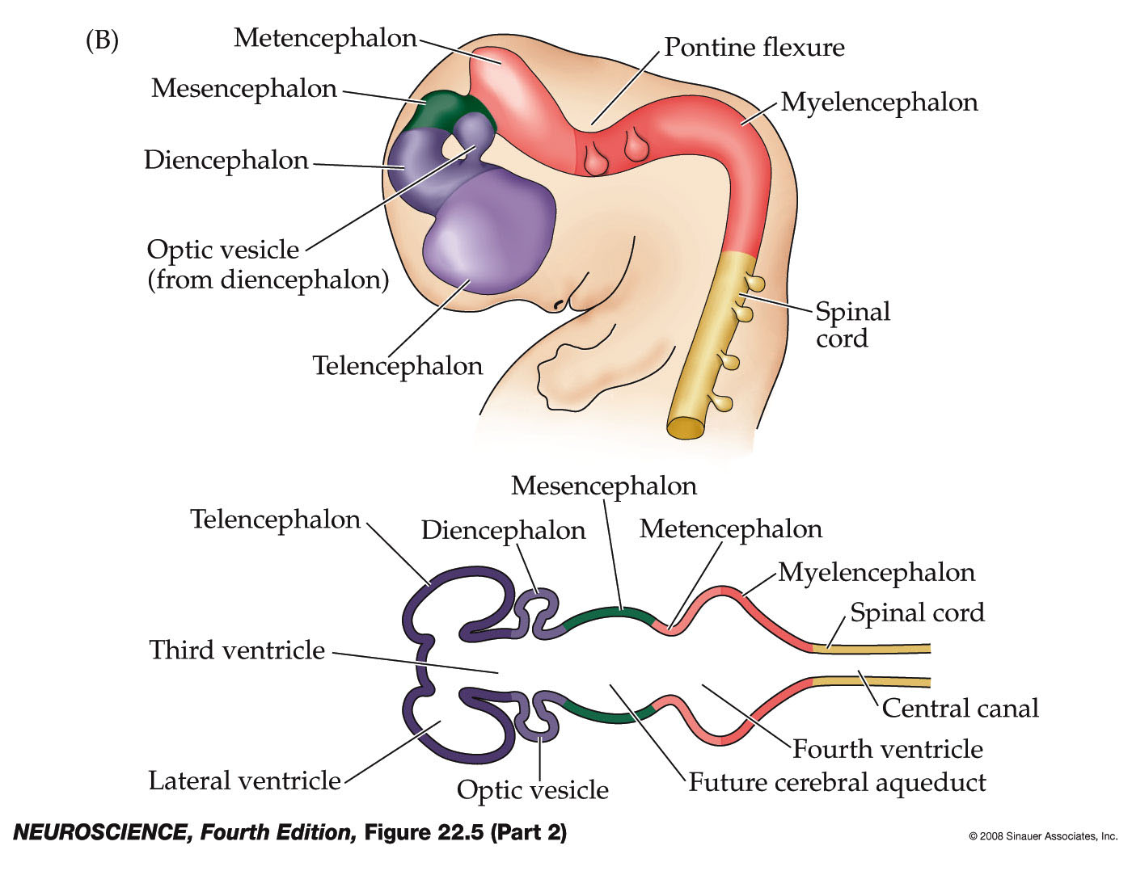
Figure 22.5 Regional specification of the developing brain (Part 2)
Notes:
neuro4e-fig-22-05-2r.jpg

Slide 10
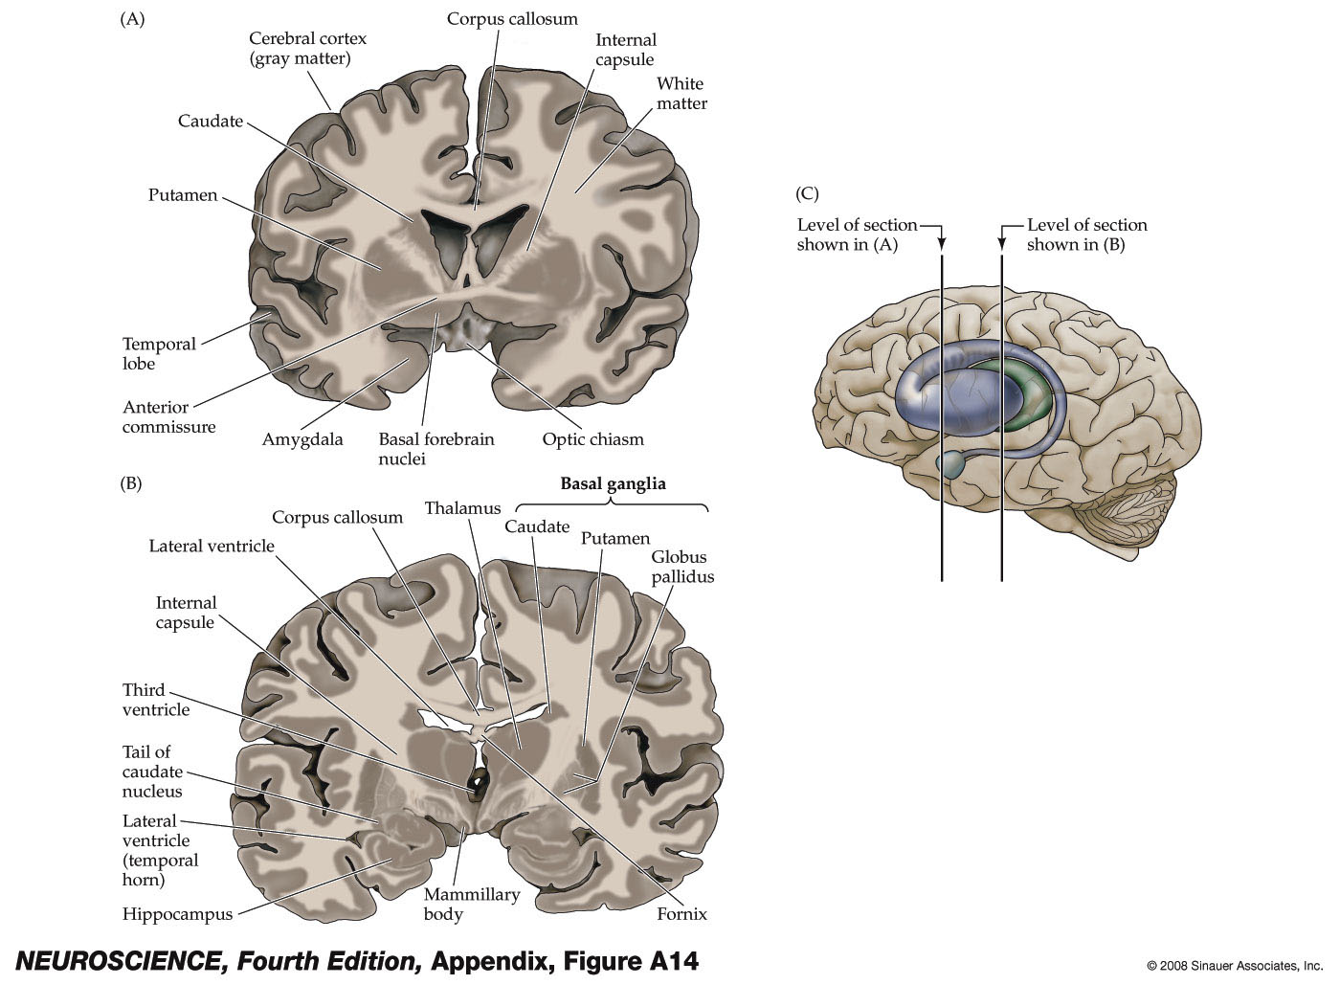
Figure A14 Internal structures of the brain seen in coronal section
Notes:
neuro4e-app-fig-a-14-0.jpg

Slide 12
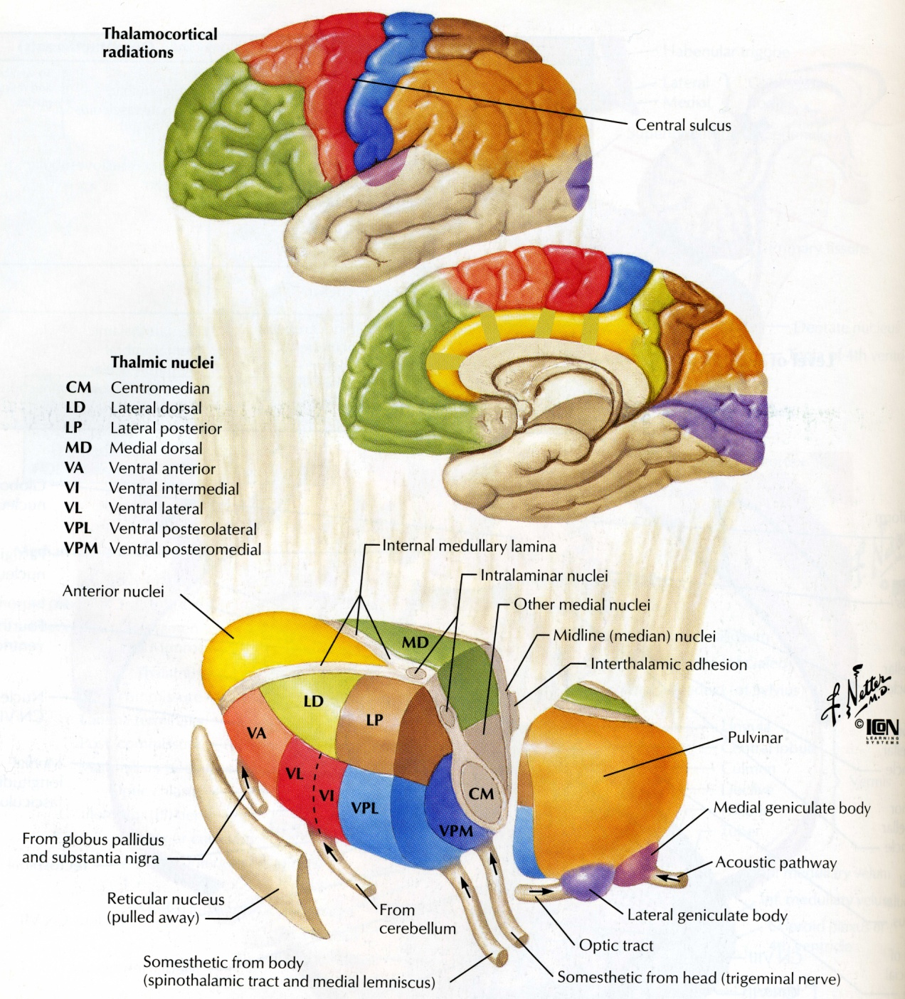

Slide 13
Anterior Nucleus- inputs from mammilary bodies; outputs to prefrontal cortex, cingulum > limbic system
MD- medio-dorsal > part of limbic system to prefrontal cortex; memory function
VA, VL- in motor function, inputs from BG and Cerebellum, outputs to motor cortex
VPL, VPM- sensory inputs from periphery to somatosensory cortex
CM- centrum medianum- from Globus Pallidus to Motor cortex
Pulvinar- inputs- auditory, somatosensory and visual cortex (visual attantion)
MGB- from lateral lemniscus to auditory cortex
LGN- from optic tract to visual cortex

Slide 14
Barr’s The Human Nervous System, 8th Ed.

Slide 15
Internal capsule and corona radiata
Haines, Fund. Neuro., Fig 16-17
Notes:
Fibers coming to and going from Cer Cx
Thalamic radiation- radiating from the Th-. Many fibers are ncluded in both, but for example pyramidal tr. Does not stop in TH, or cortico-strate fibers.

Slide 16
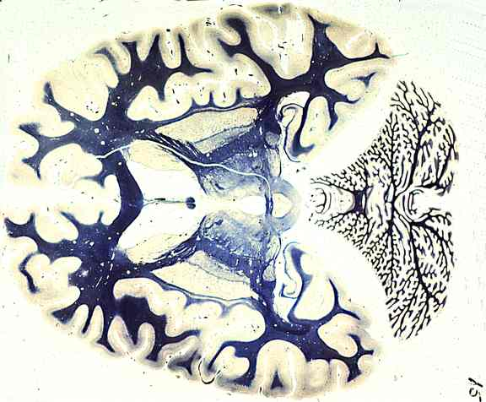

Slide 17
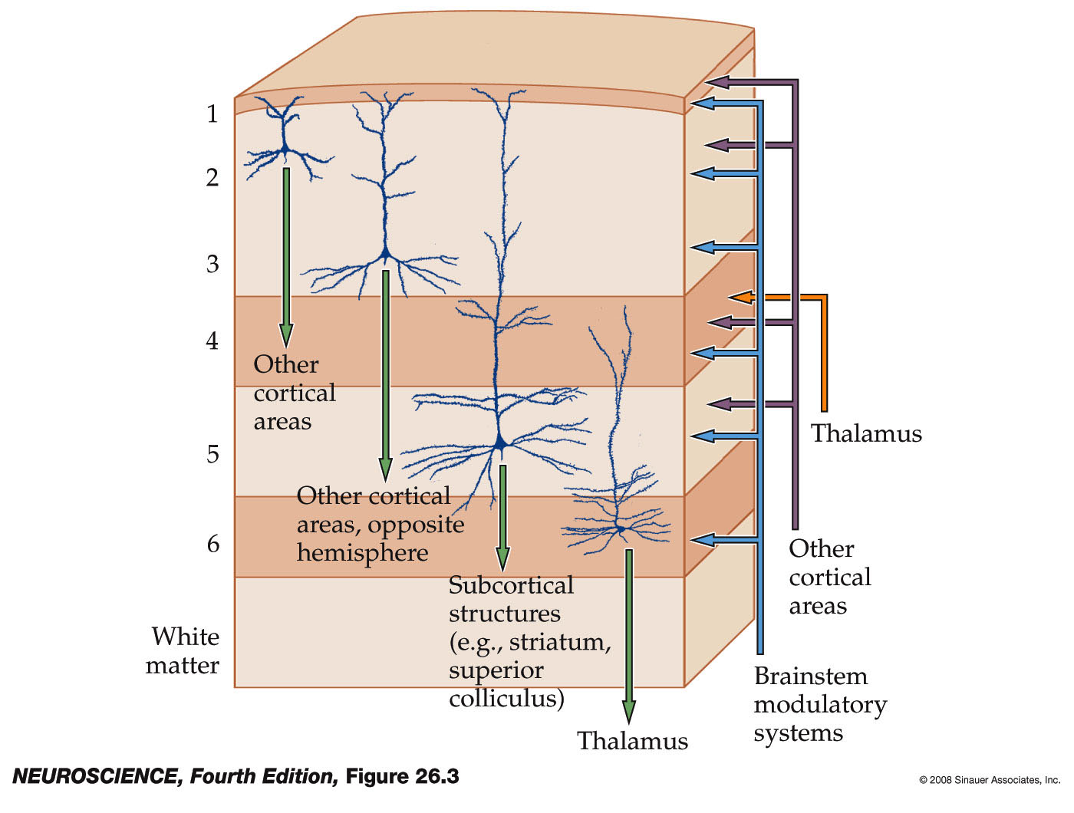
Figure 26.3 Canonical neocortical circuitry
Notes:
neuro4e-fig-26-03-0.jpg

Slide 18
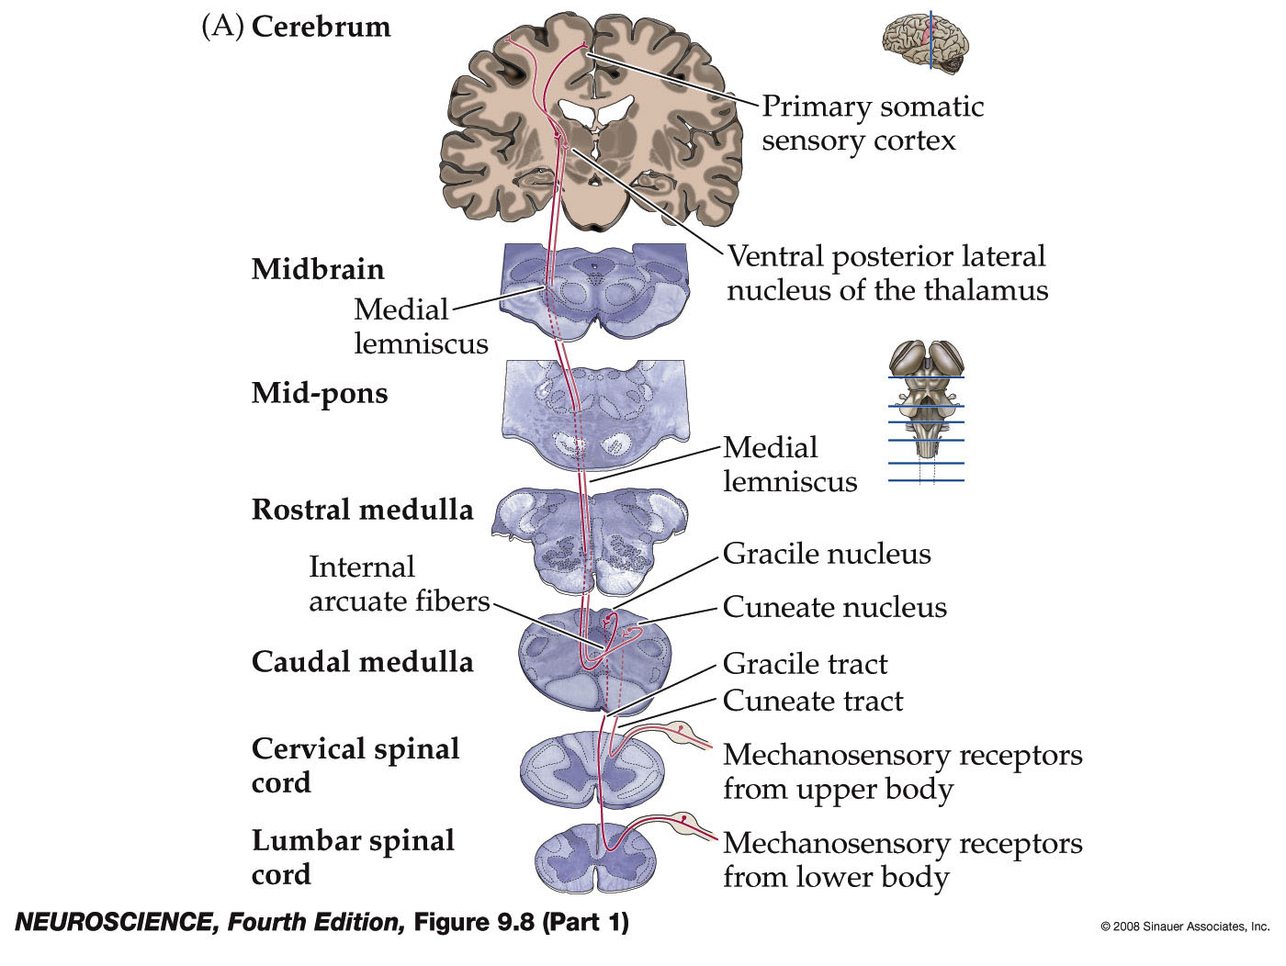
Figure 9.8 Schematic representation of the main mechanosensory pathways (Part 1)
Notes:
neuro4e-fig-09-08-1r.jpg

Slide 19
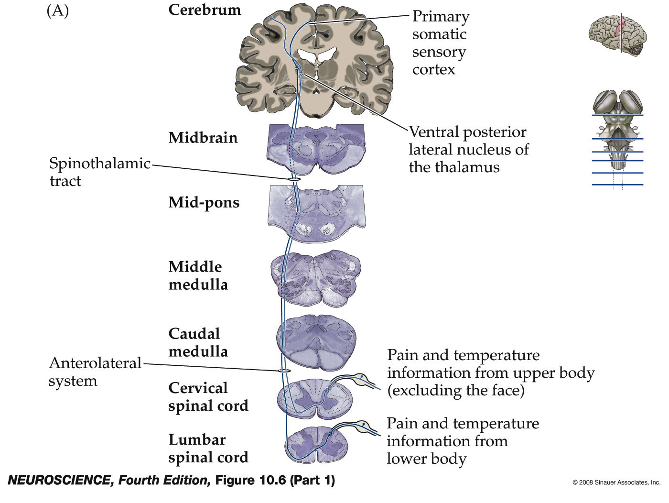
Figure 10.6 Pathways mediating discriminative aspects of pain/temperature for body & face (Part 1)
Notes:
neuro4e-fig-10-06-1r.jpg

Slide 20
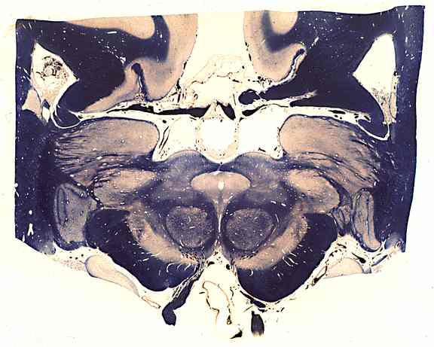

Slide 22
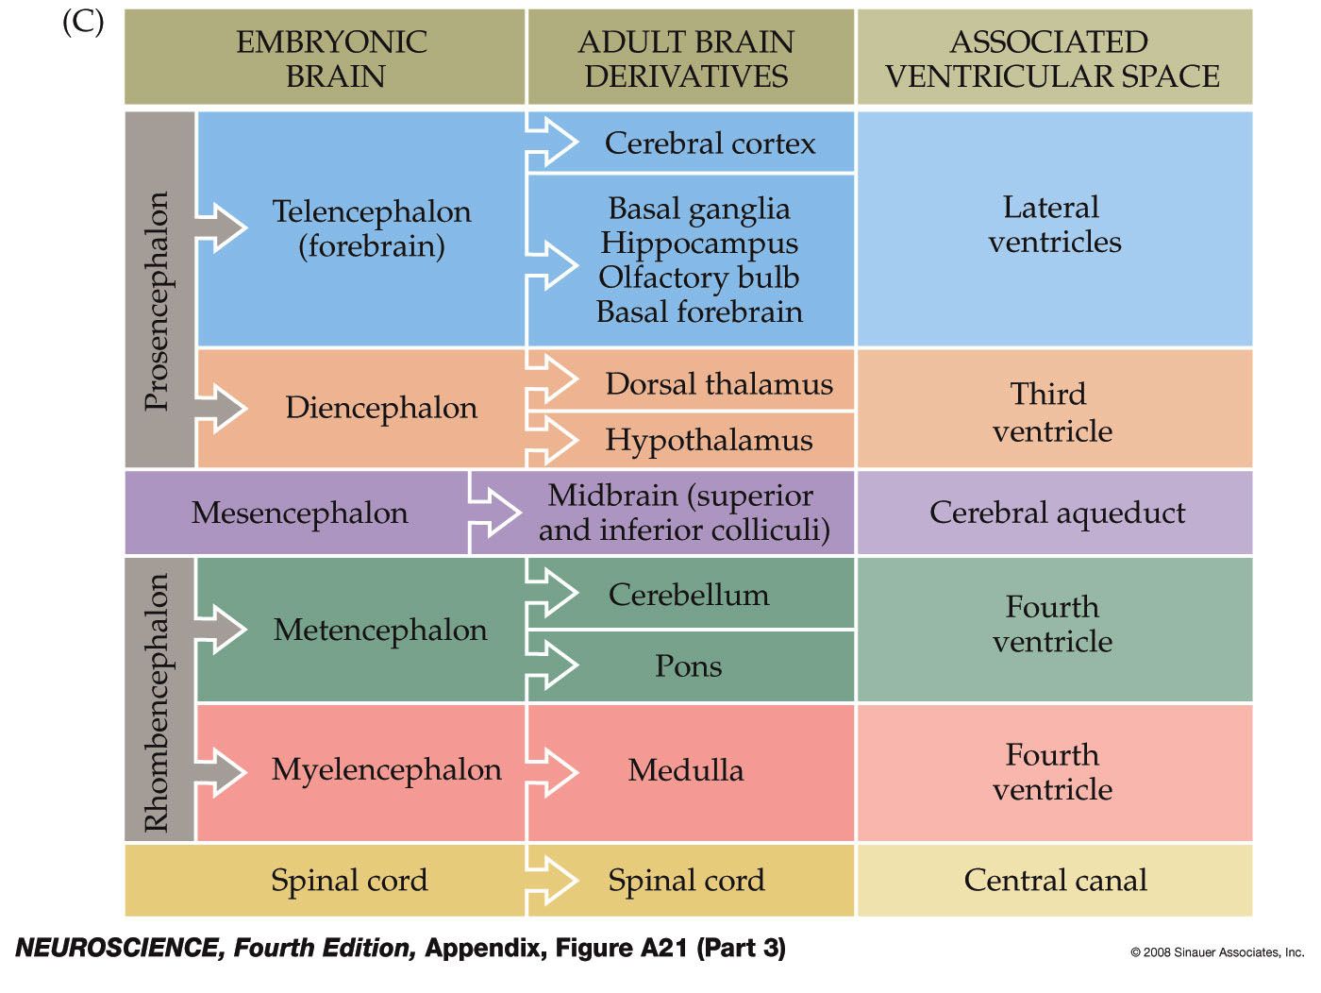
Figure A21 The ventricular system of the human brain (Part 3)
Notes:
neuro4e-app-fig-a-21-3r.jpg

Slide 23
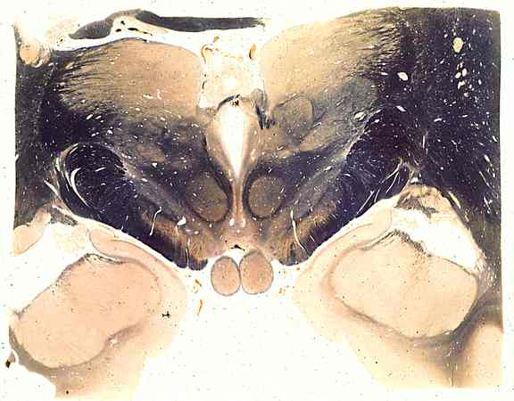

Slide 24
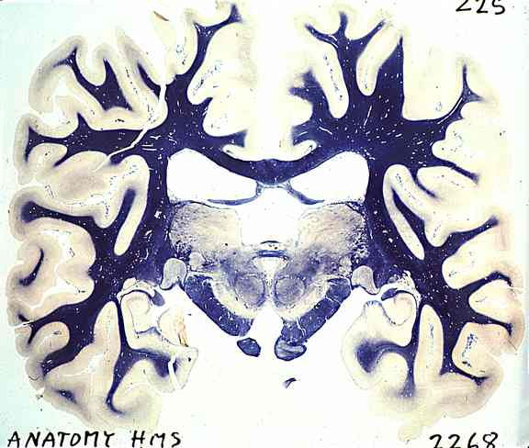

Slide 25
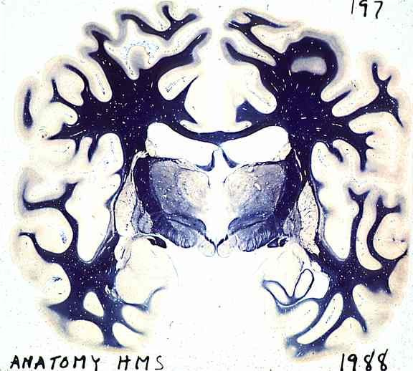

Slide 26
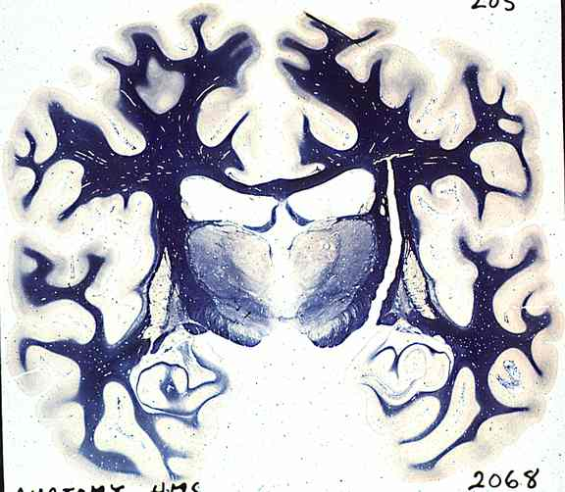

Slide 27
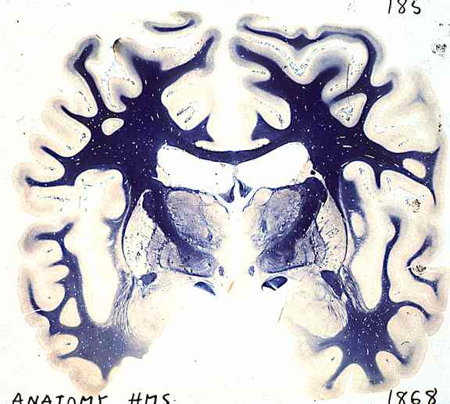

Slide 28
