Slide 1
Telencephalon & Cerebral Cortex: Gross Anatomy
S. J. Potashner
sjp9713@neuron.uchc.edu

Slide 2
Cerebrum or Telencephalon
Cerebral cortex
Cerebral white
matter
Basal ganglia
Claustrum
Notes:
Gray matter on the surface and inside- Basal ganglia. White matter- axons.

Slide 3
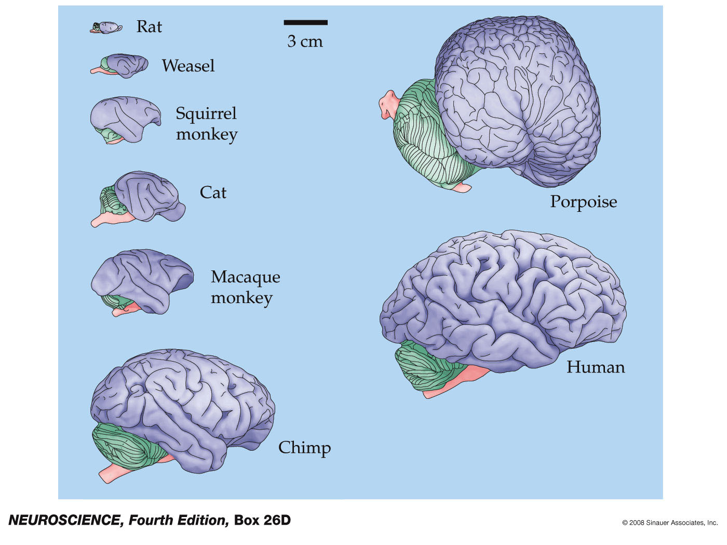
video
Notes:
Brain size, and particularly size of the cer cx increase during evolution. Size of the brain in man is not related to intelligence (complex cognitive functions)- for example race or geneder issues.

Slide 4
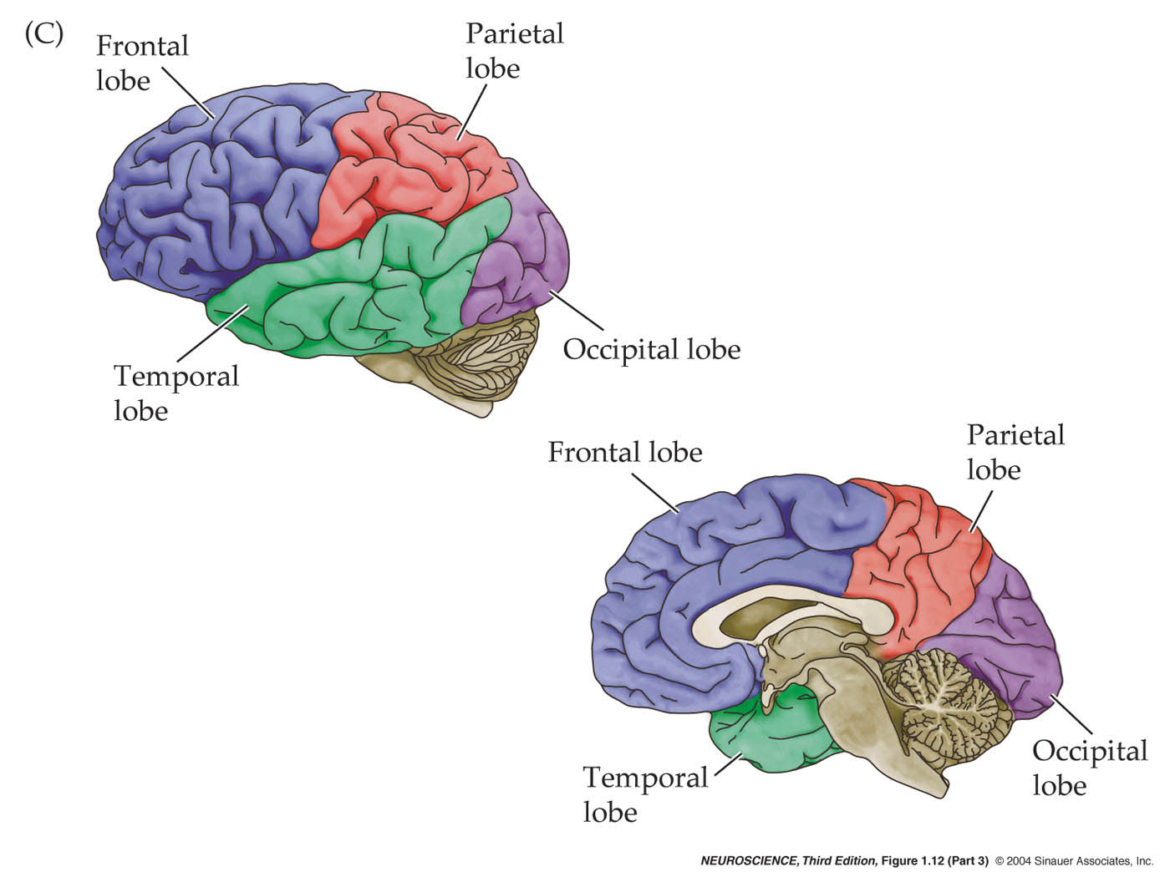
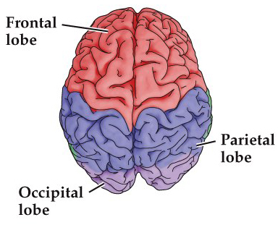
The Cerebral Cortex - Lobes

Slide 5
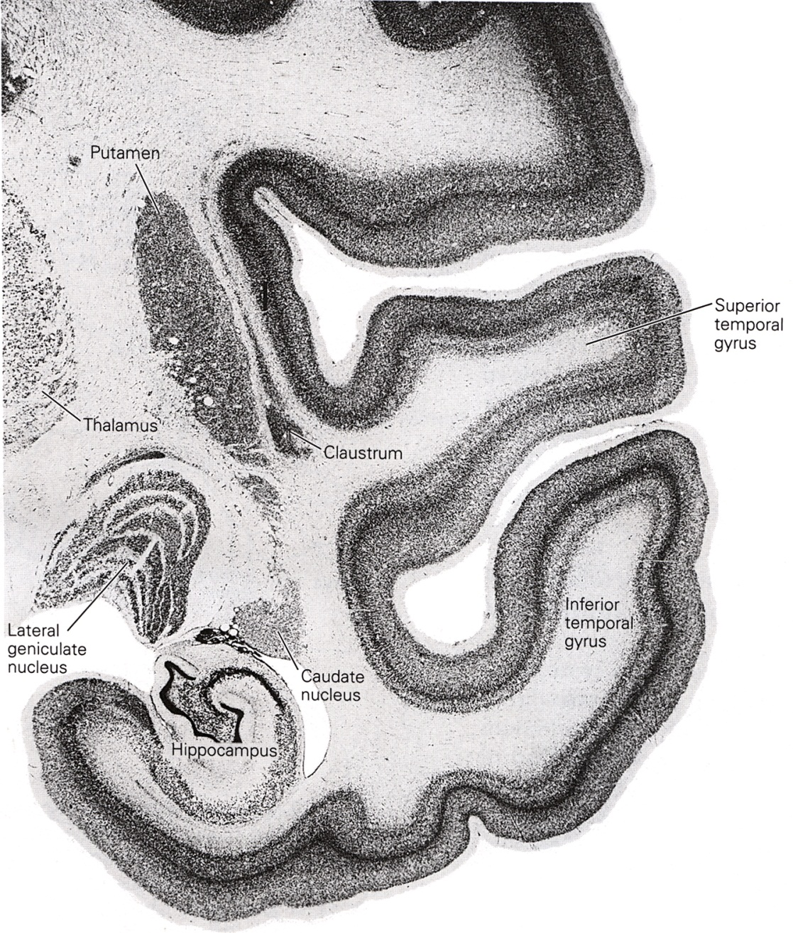
The Cerebral Cortex – Cell Layers
Neocortex
Paleocortex
Archicortex
Notes:
Different types of cortices

Slide 6
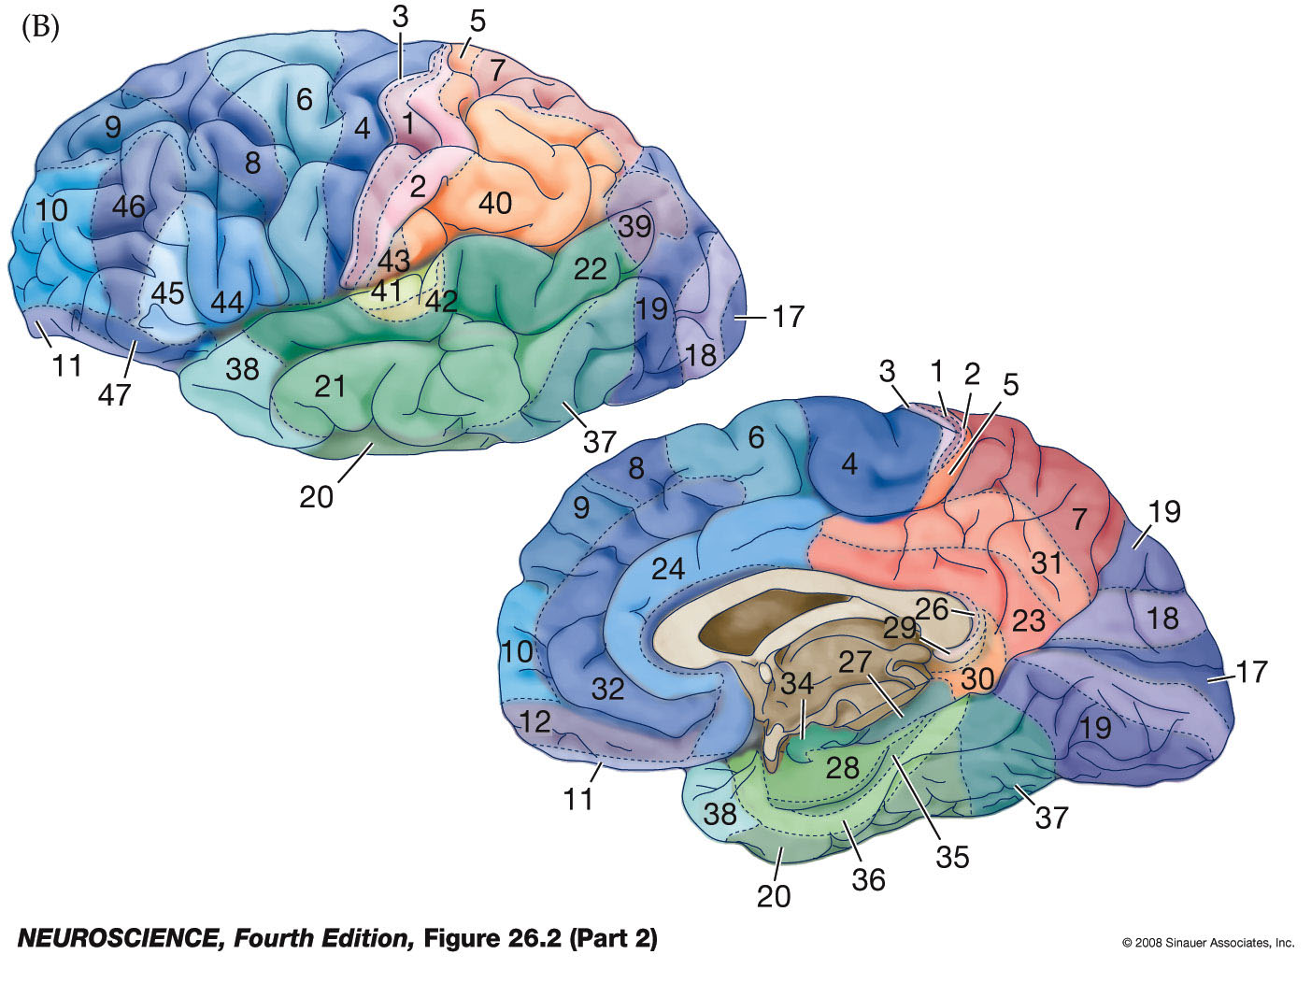
The Cerebral Cortex – Cell Architectonics
Primary Somatosensory ctx.
Brodmann
Primary
Motor ctx.
Primary
Auditory ctx.
Primary
Visual ctx.
Notes:
47 Brodmann’s areas

Slide 7
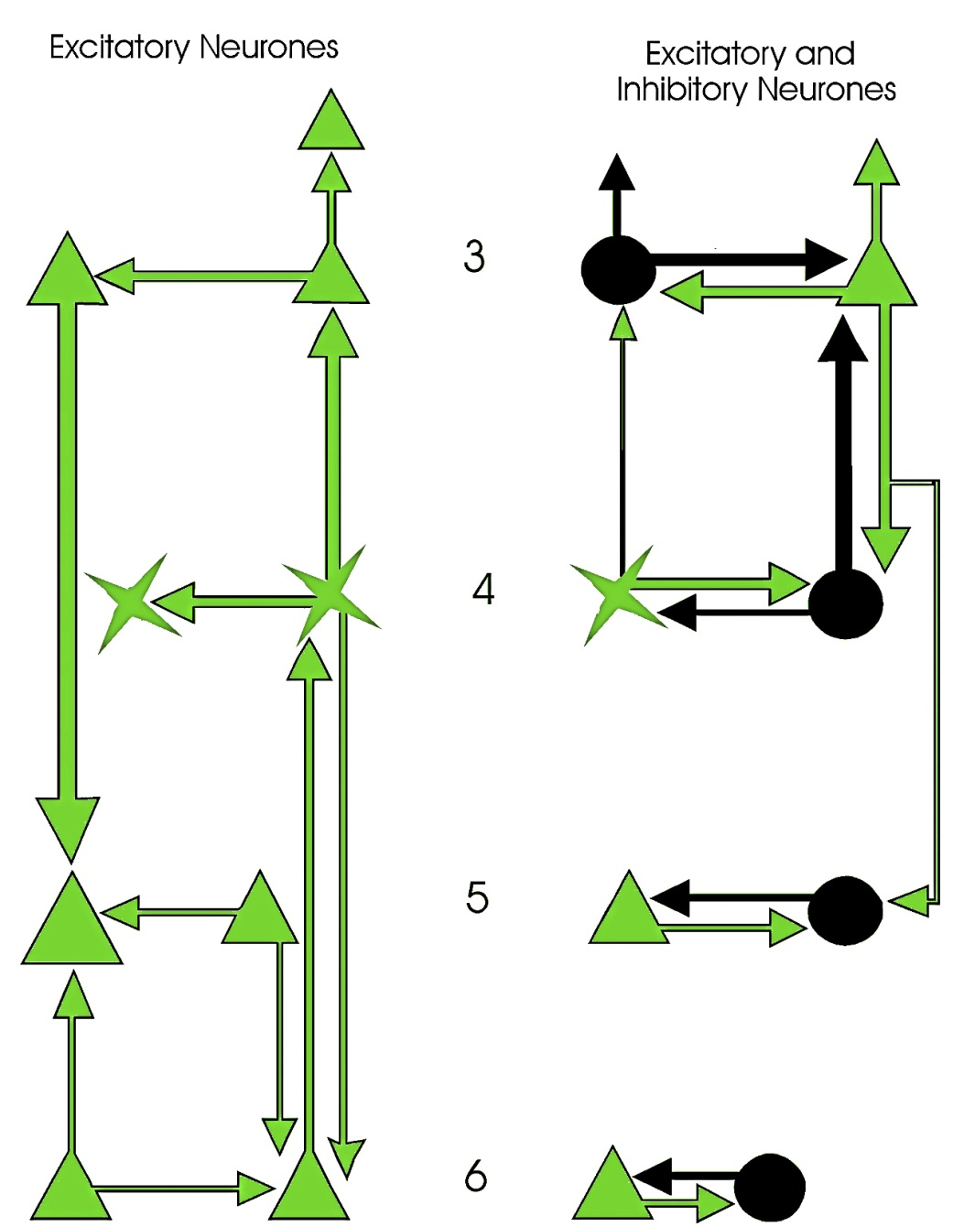
The Cerebral Cortex – Functional Columns

Slide 8
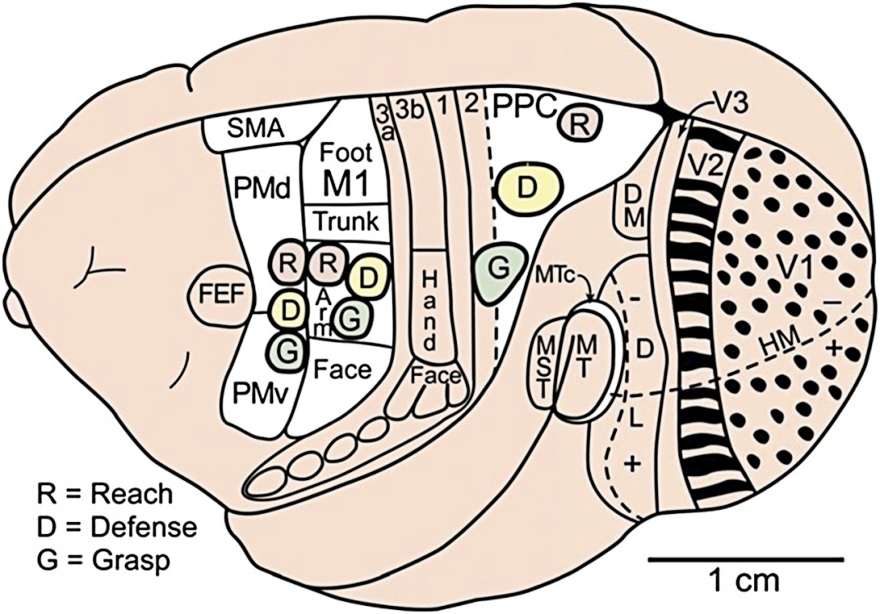
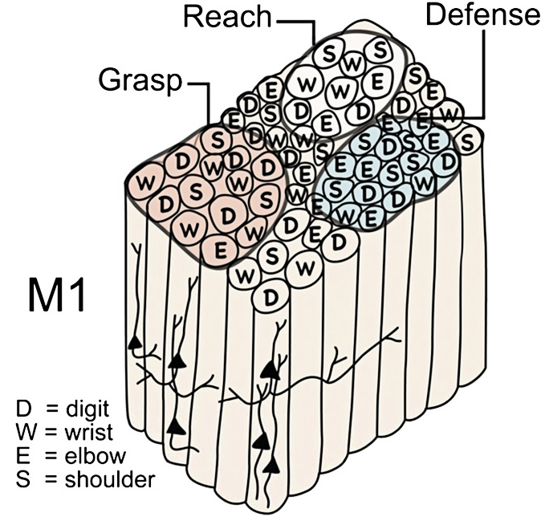
The Cerebral Cortex – Functional Columns

Slide 9
The Cerebral Cortex – Functional Organization
The cortex of each hemisphere is a continuous sheet of gray matter.
It has been subdivided using anatomical, histological and
physiological criteria.
Using physiological criteria, it can be subdivided into functionally
defined areas.
Functional areas fall into a few major categories.
Areas in a category occupy a discrete, continuous part of the cortex.
Functionally related areas occupy neighboring sites.

Slide 10
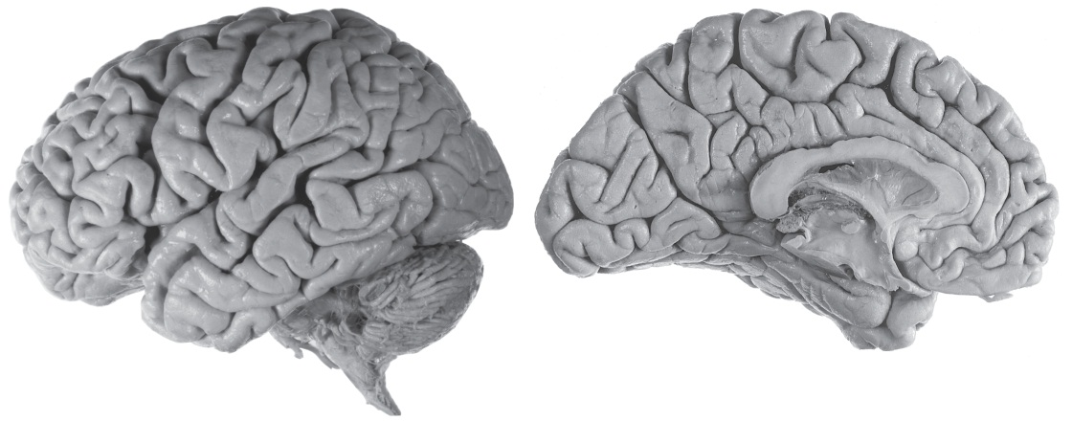
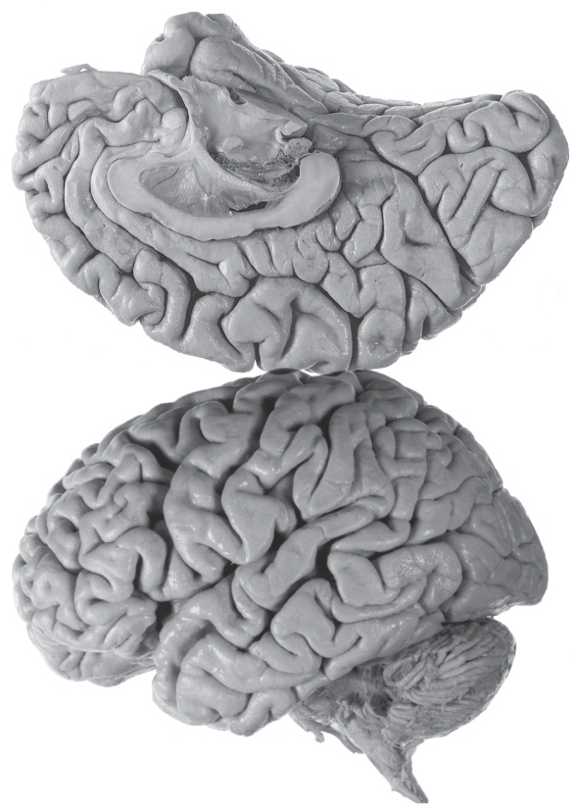
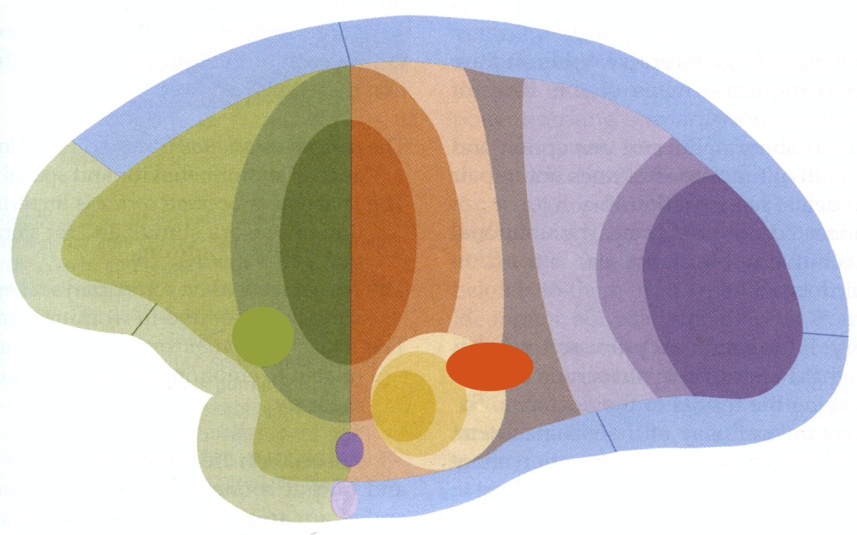
The Cerebral Cortex –
Functional Organization

Slide 11
The Cerebral Cortex – Functional Organization
Primary
Motor
Higher Sensory
Functions
Emotions
Primary
Sensory
Motor
Planning
Higher Mixed
Sensory Functions
Executive
Control of
Behavior
Higher Visual
Functions
Primary
Visual
Speech
Language
Comprehension
Emotional
Control of
Behavior
Primary
Gustatory
Memory
Higher Auditory
Functions
Primary
Olfactory
Primary
Auditory
Black = Input or Output Functions Red = Cognitive Functions

Slide 12
Sensory Areas
Primary sensory areas:
Receive input from specific thalamic nuclei
Topographically organized
Injury results in a sensory loss
Send information to higher order sensory area of the same modality
Higher order sensory areas:
Receive input from lower order sensory areas of the cortex and non-specific thalamic nuclei.
Not topographically organized
Injury results in a loss of perception
Send information to higher order sensory, emotion, memory and executive cortical areas
Mixed sensory areas:
Receive inputs from higher order sensory areas of various modalities
Not topographically organized
Injury results in loss of perception and motor deficits
Send information to emotion, memory and executive cortical areas
Simple
Complex

Slide 13
The Cerebral Cortex – Functional Organization
Primary
Motor
Higher Sensory
Functions
Emotions
Primary
Sensory
Motor
Planning
Higher Mixed
Sensory Functions
Executive
Control of
Behavior
Higher Visual
Functions
Primary
Visual
Speech
Language
Comprehension
Emotional
Control of
Behavior
Primary
Gustatory
Memory
Higher Auditory
Functions
Primary
Olfactory
Primary
Auditory
Black = Input or Output Functions Red = Cognitive Functions

Slide 14
Motor Areas
Executive areas:
Receive input from other areas of cortex and non-specific thalamic nuclei
Organize behavior in accordance with goals, conventions, emotions and current conditions.
Choose behavior and motor strategy to navigate current situation
Send output to motor planning cortex and other cortical areas
Motor planning areas:
Receive input from executive and other cortical areas
Activate cortical, brain stem and spinal motor neurons representing various muscle groups
Primary motor area:
Receive input from motor planning areas
Activate brain stem and spinal motor neurons to provide the strength and direction for movement
Complex
Simple

Slide 15
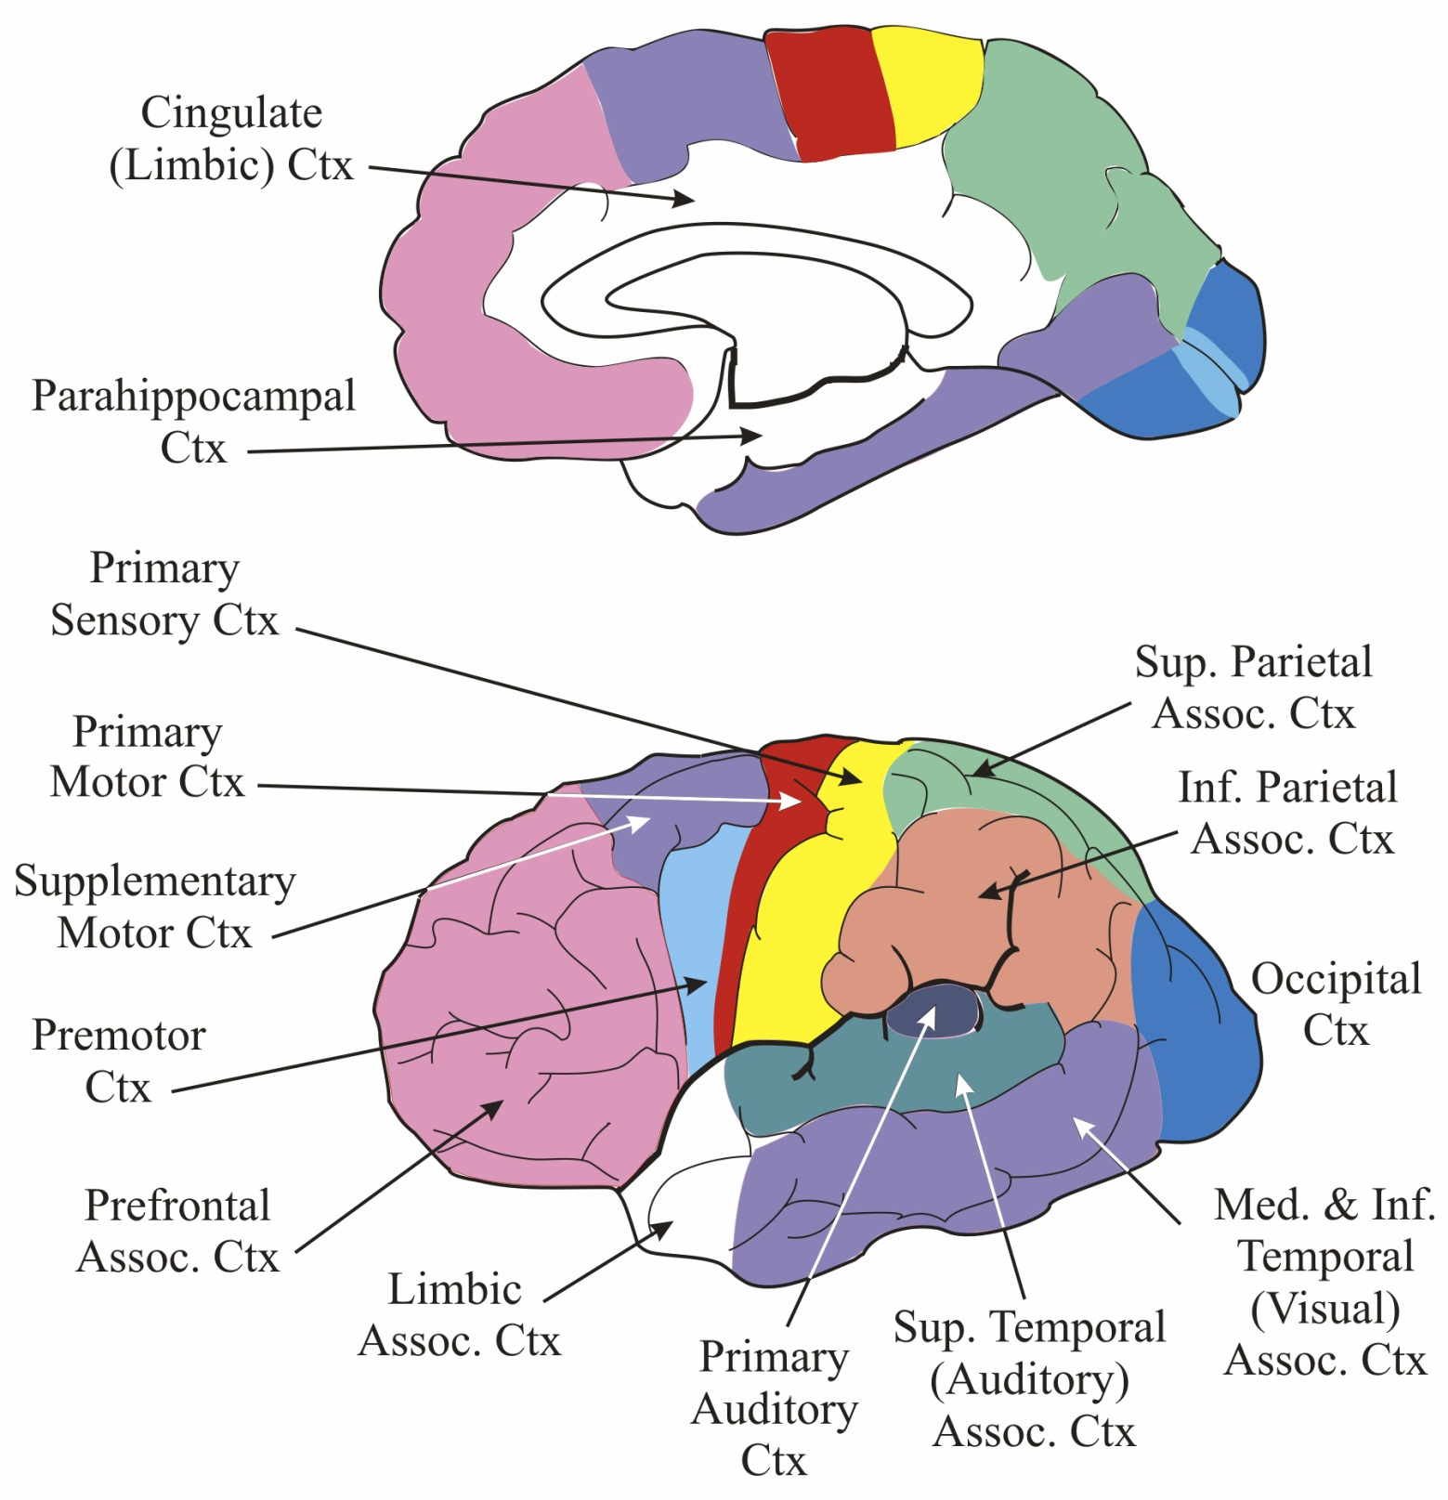
Cerebral
Cortex
Correlations
Wernicke’s
Area
Broca’s
Area

Slide 16
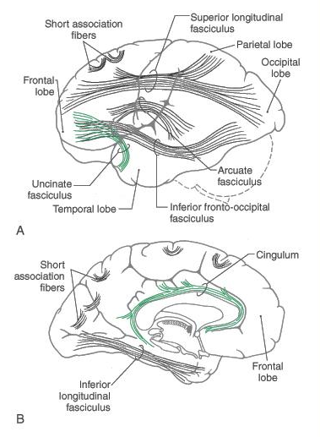
The Cerebral Cortex – Association Bundles
lateral view
medial view
Haines: Fundamental Neuroscience
Fig 16-13

