Slide 1
MOTOR CONTROL

Slide 2
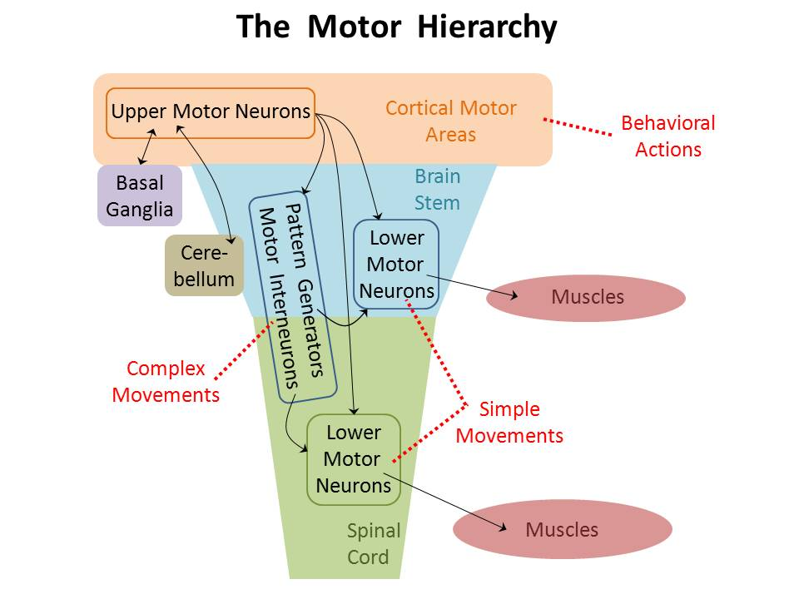
Head
Body

Slide 3
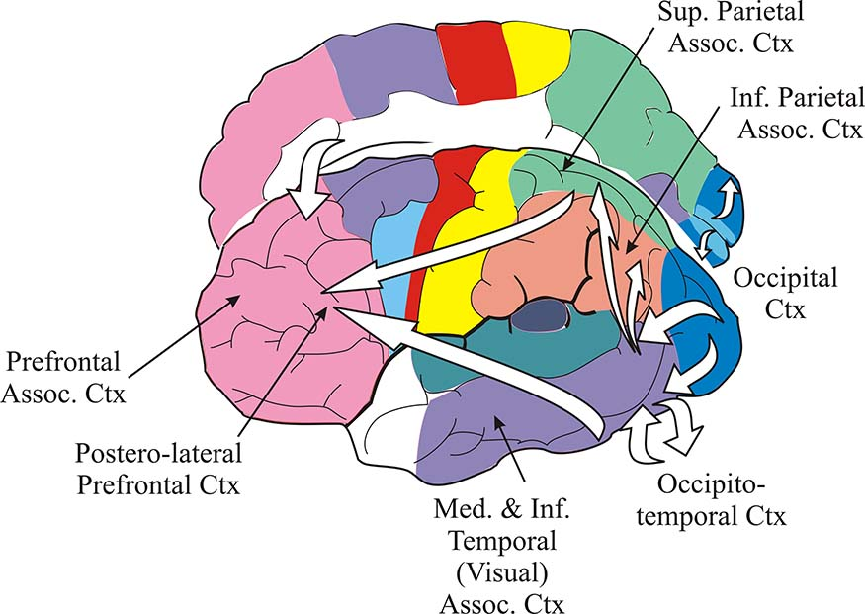

Slide 4
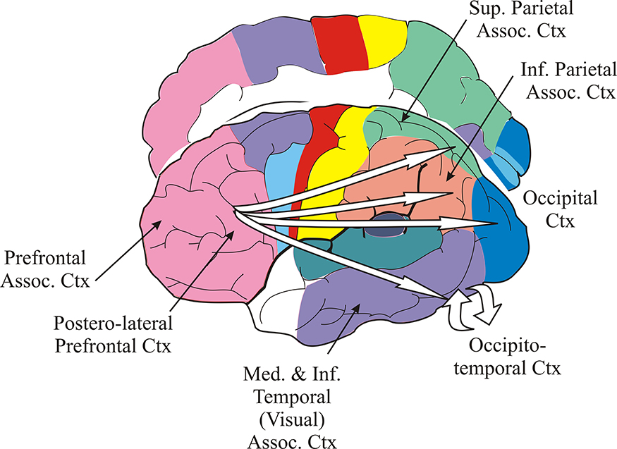

Slide 5
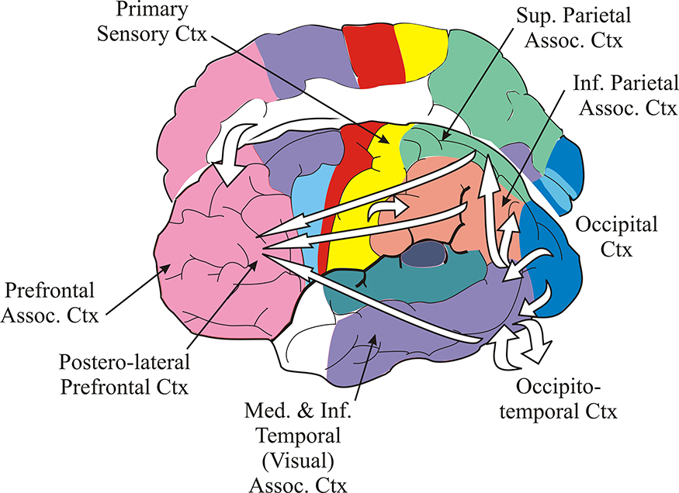

Slide 6
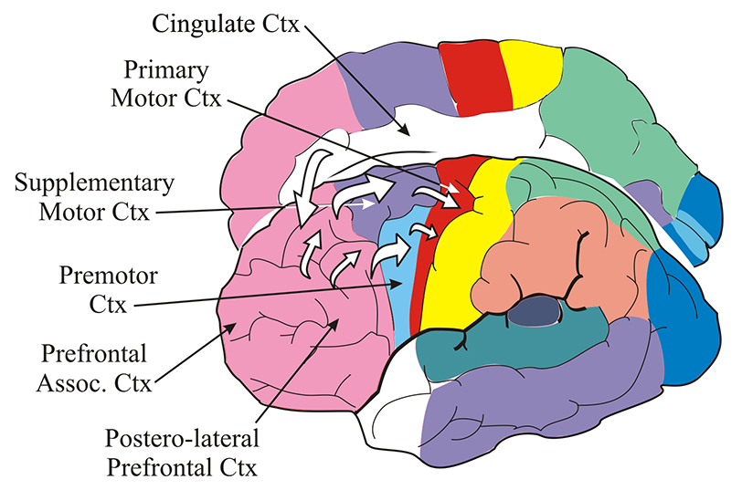

Slide 7
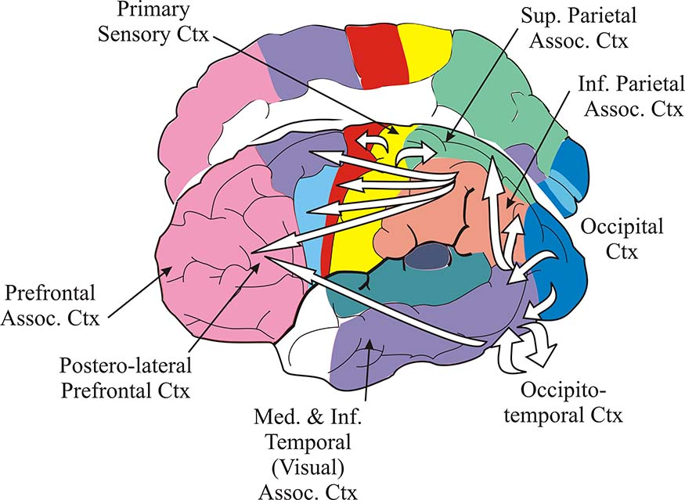

Slide 8
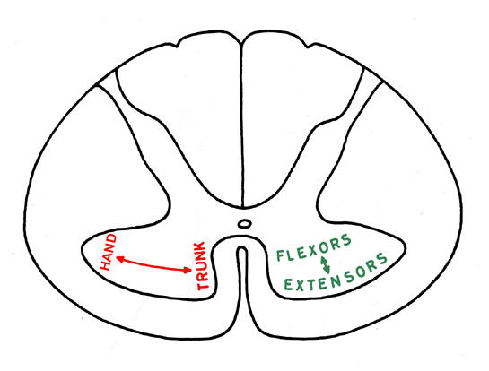
2
Lateral
Pathways
Medial
Pathways

Slide 9
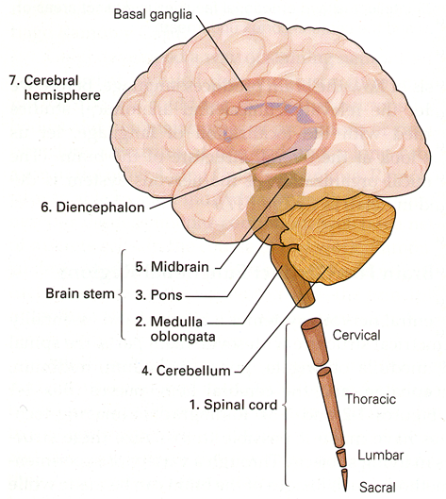
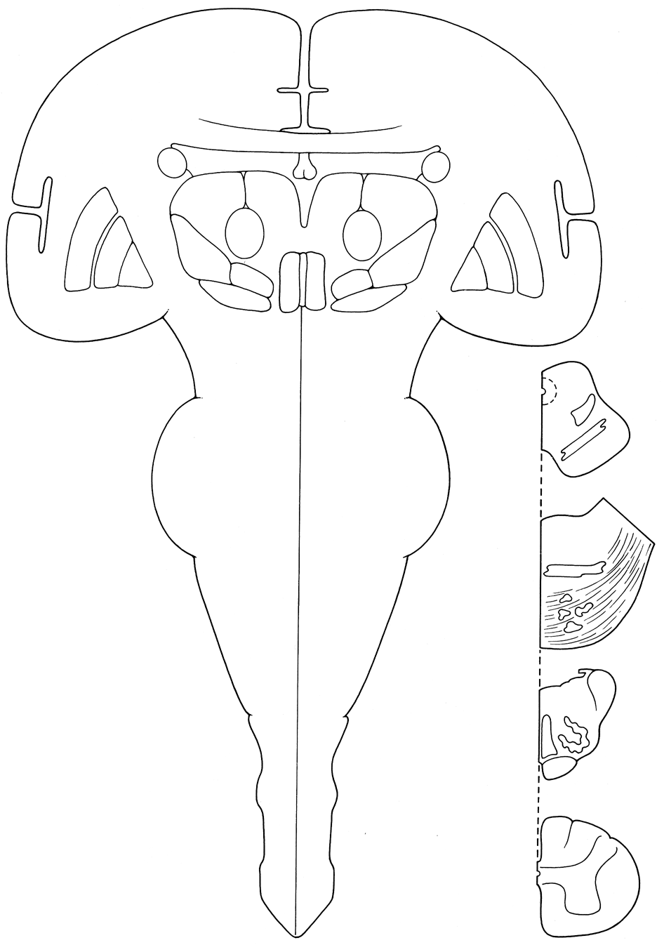
3
Adapted from Haines, ‘Neuroanatomy, An atlas
of structures, sections and systrems,’ p.179. Copyright 2000, Lippicott Williams & Wilkins

Slide 10
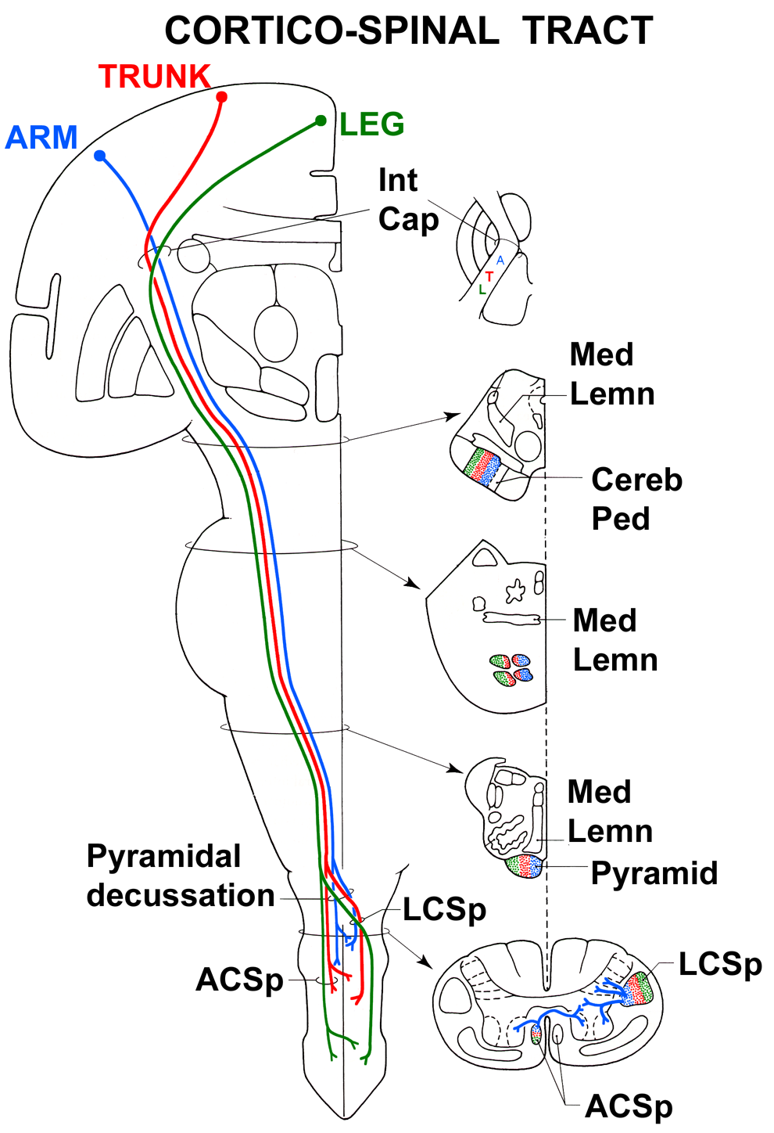
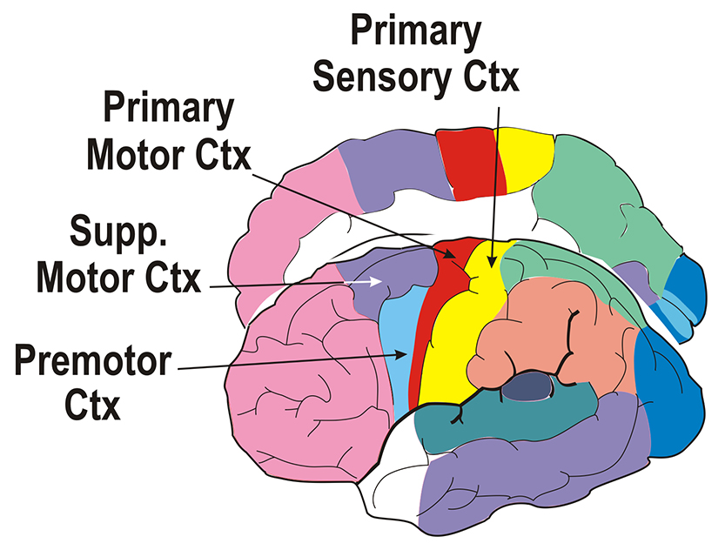
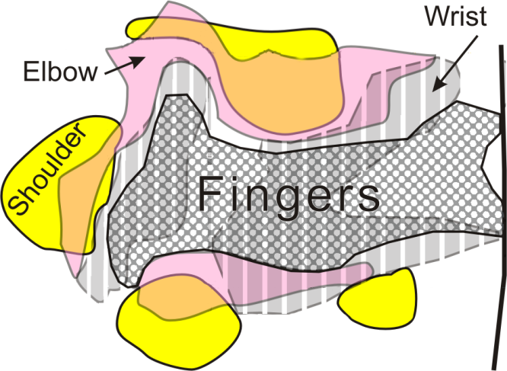
4
CORTICO-SPINAL
TRACT
Arm Representation
Adapted from Haines, ‘Neuroanatomy, An atlas
of structures, sections and systrems,’ p.181. Copyright 2000, Lippicott Williams & Wilkins

Slide 11
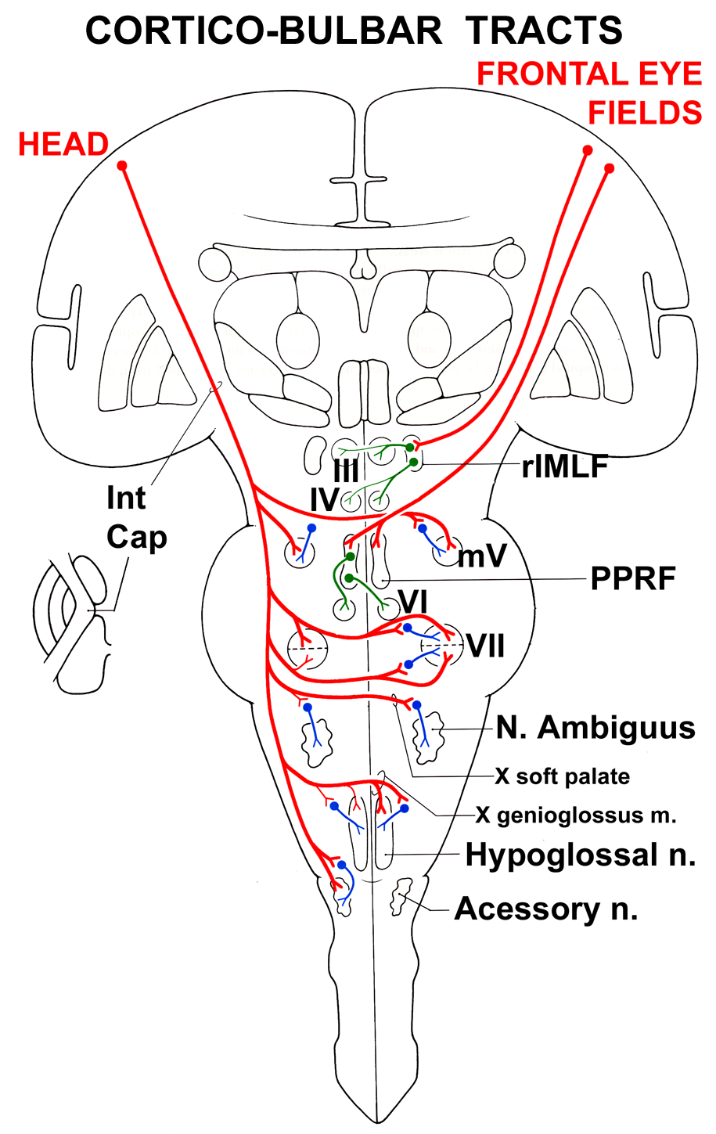
5
CORTICO-BULBAR
TRACTS
III-VI bilateral
VII-XII crossed, with small
uncrossed components
XI uncrossed
Adapted from Haines, ‘Neuroanatomy, An atlas of structures, sections and systrems,’ p.183. Copyright 2000, Lippicott Williams & Wilkins

Slide 12
6
CORTICO-SPINAL & CORTICO-BULBAR TRACTS
FUNCTIONS:
Fast cortical motor signals encoding movement force and direction.
Directed to brain stem & spinal interneurons and motor neurons, particularly those that control distal limb muscles & facial muscles.
Mediate ‘fractional’ movements.
More modest control of girdle and axial muscles.
Help to control muscle tone and reflexes.
Cortical control of brain stem & spinal sensory neurons to enhance sensory reporting during motor behaviors.

Slide 13
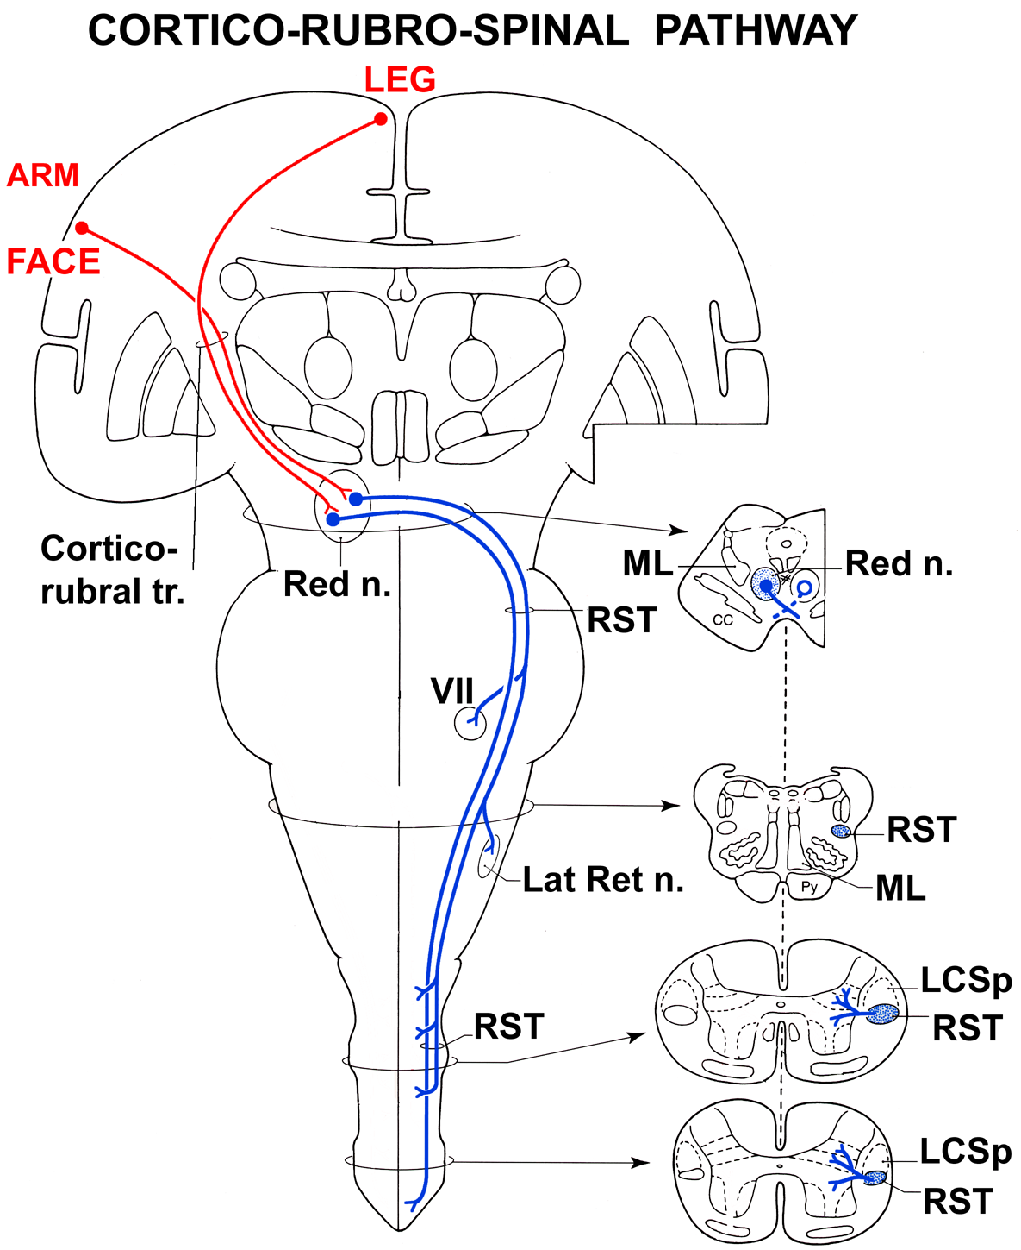
7
CORTICO-RUBRO-
SPINAL PATHWAY
Adapted from Haines, ‘Neuroanatomy, An atlas of structures, sections and systrems,’ p.187. Copyright 2000, Lippicott Williams & Wilkins

Slide 14
8
CORTICO-RUBRO-SPINAL PATHWAY
FUNCTIONS:
Carries cortical motor signals to brain stem & spinal interneurons.
Assists the cortico-spinal tract, particularly for the upper limb, but it cannot provide fractional movements as it does not synapse on motor neurons.
Facilitates activity in flexor motor nuclei and inhibits activity in extensor motor nuclei.
Helps to control muscle tone and reflexes.

Slide 15
Lateral
Pathways
Medial
Pathways

Slide 16
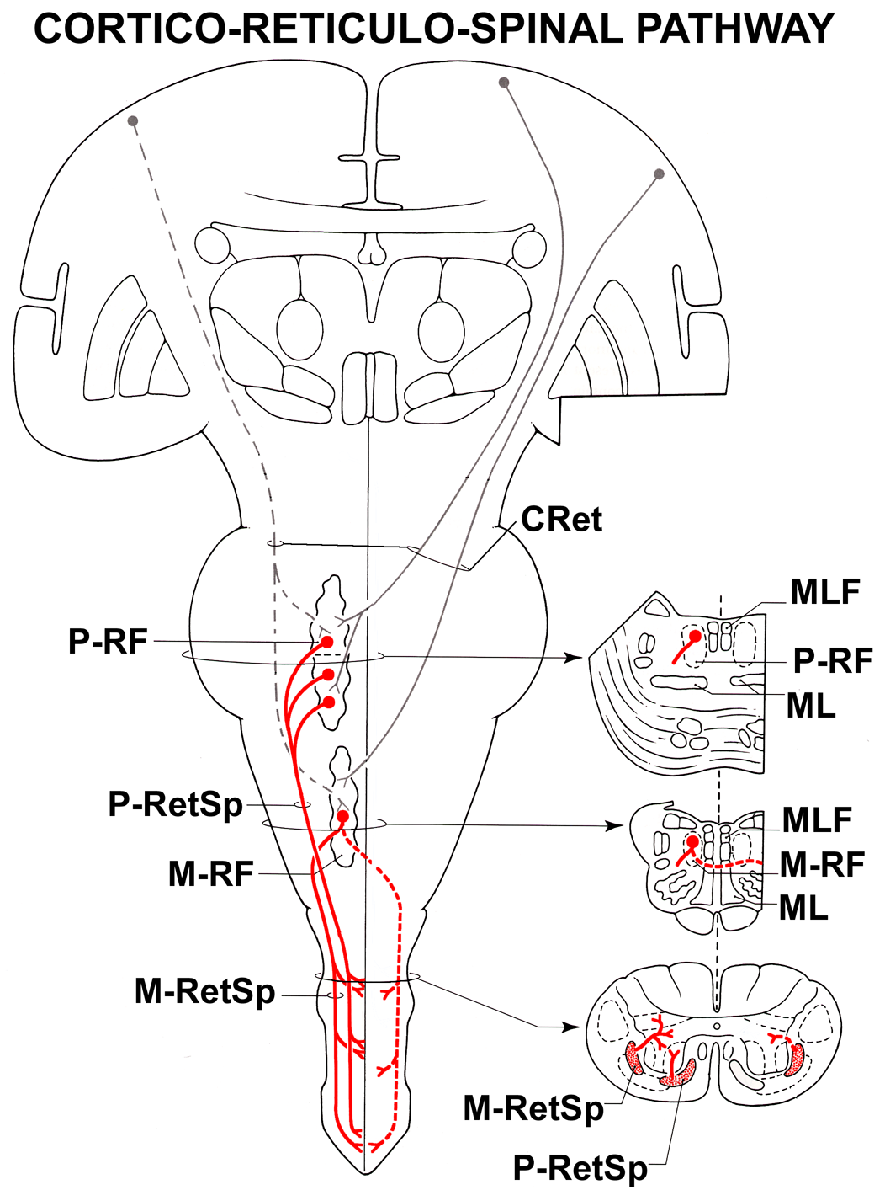
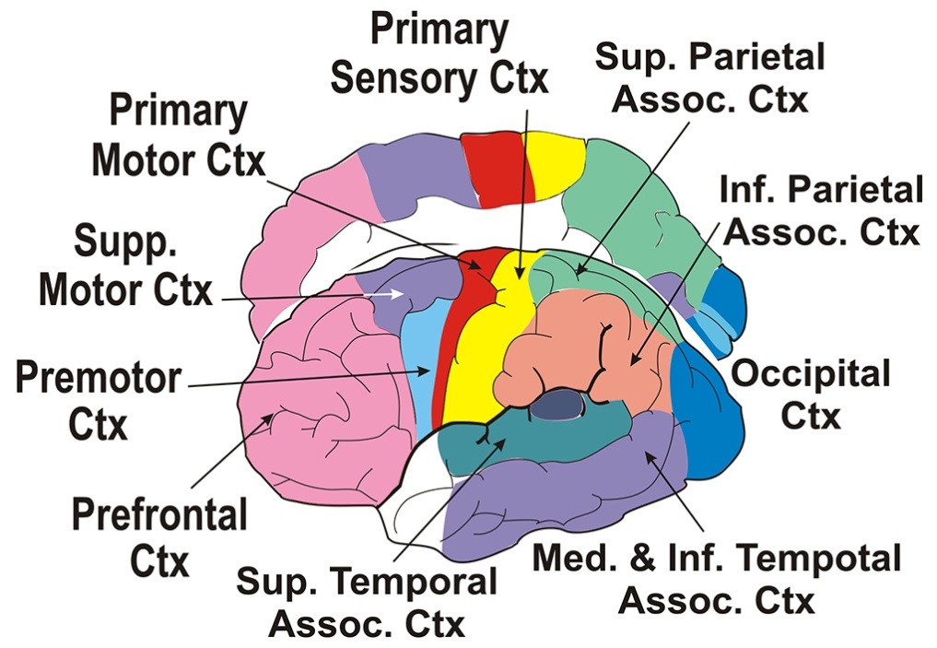
9
CORTICO-RETICULO-
SPINAL PATHWAY
Adapted from Haines, ‘Neuroanatomy, An atlas of structures, sections and systrems,’ p.185. Copyright 2000, Lippicott Williams & Wilkins

Slide 17
10
CORTICO-RETICULO-SPINAL PATHWAY
FUNCTIONS:
Carries cortical motor signals for locomotion and adjustments of posture.
Acts mainly on ventral horn interneurons projecting to motor nuclei that control axial and proximal limb muscles.
Pontine reticulo-spinal tract facilitates while medullary reticulo-spinal tract inhibits muscle contractions.
Helps to control muscle tone and reflexes.

Slide 18
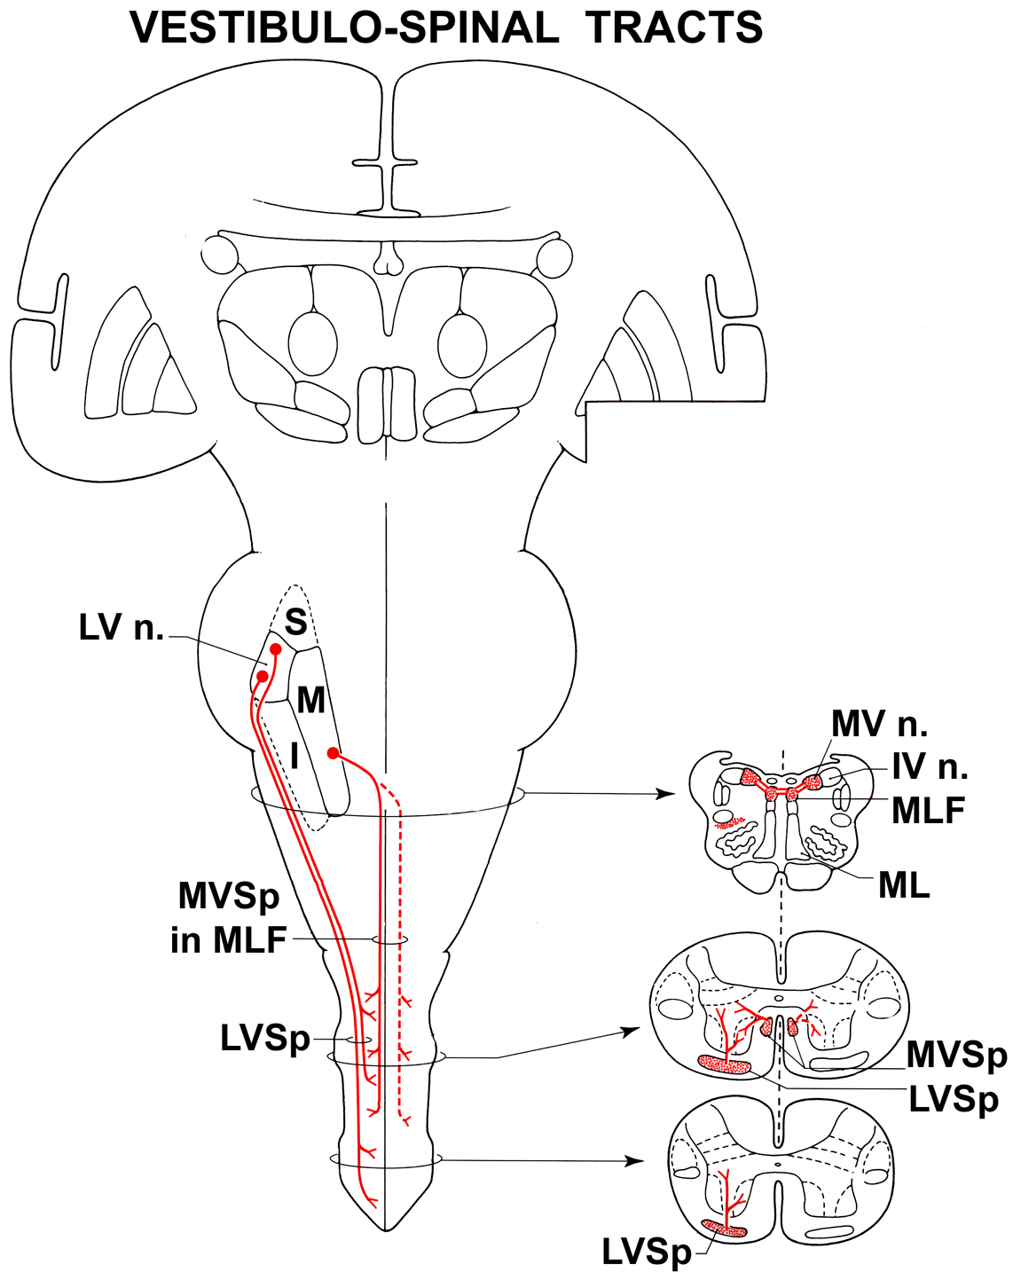
11
VESTIBULO-SPINAL
TRACTS
Adapted from Haines, ‘Neuroanatomy, An atlas of structures, sections and systrems,’ p.187. Copyright 2000, Lippicott Williams & Wilkins

Slide 19
12
VESTIBULO-SPINAL TRACTS
FUNCTIONS:
Carry postural adjustment signals for the head and body in response to changes in the position of the head.
Medial vestibulo-spinal tract acts on motor nuclei controlling muscles in the neck and proximally in the upper limbs.
Lateral vestibulo-spinal tract facilitates activity in motor nuclei controlling muscles in the limbs and trunk.
Helps to control muscle tone and reflexes.

