Slide 1
Hypothalamus
S. Potashner
sjp9713@neuron.uchc.edu

Slide 2
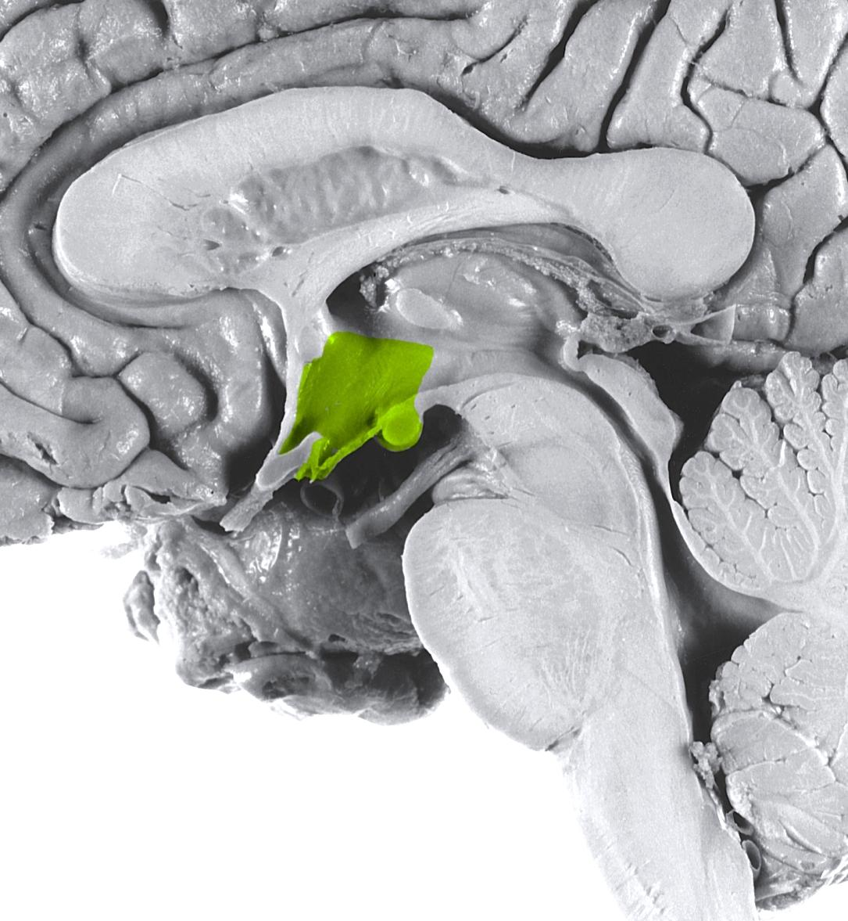
Location and Boundaries
hypothalamic
sulcus
thalamus
lamina
terminalis
optic
chiasm
optic
nerve
infundibulum
median
eminence
mammillary body

Slide 3
Functions
Essential for survival
Integrates and controls:
Homeostatic responses and behaviors
Visceral reactions to changes in the external environment
Growth
Reproduction
Acts via:
Autonomic nervous system
Endocrine system
Motivational parts of the limbic system
Somatic nervous system

Slide 4
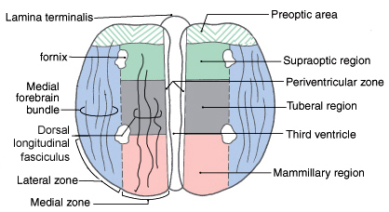
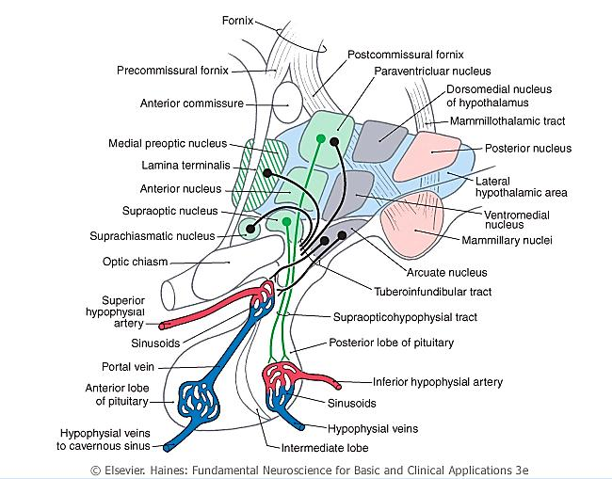
Organization

Slide 5
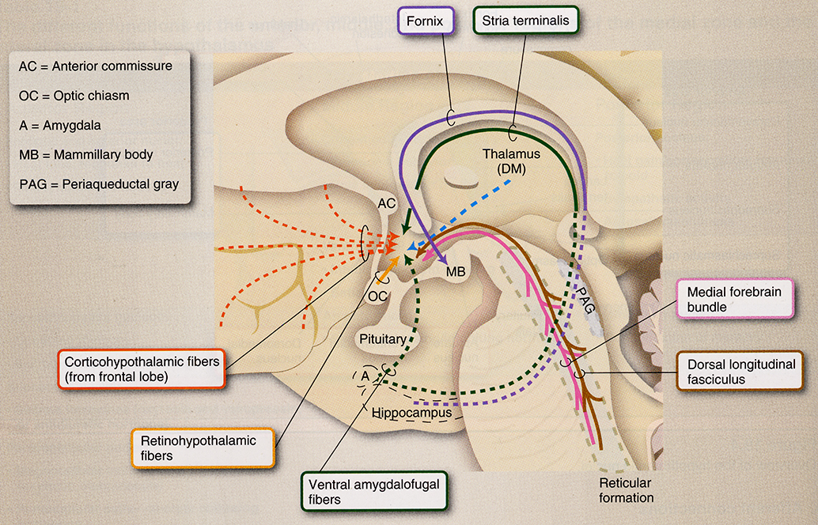
Inputs

Slide 6
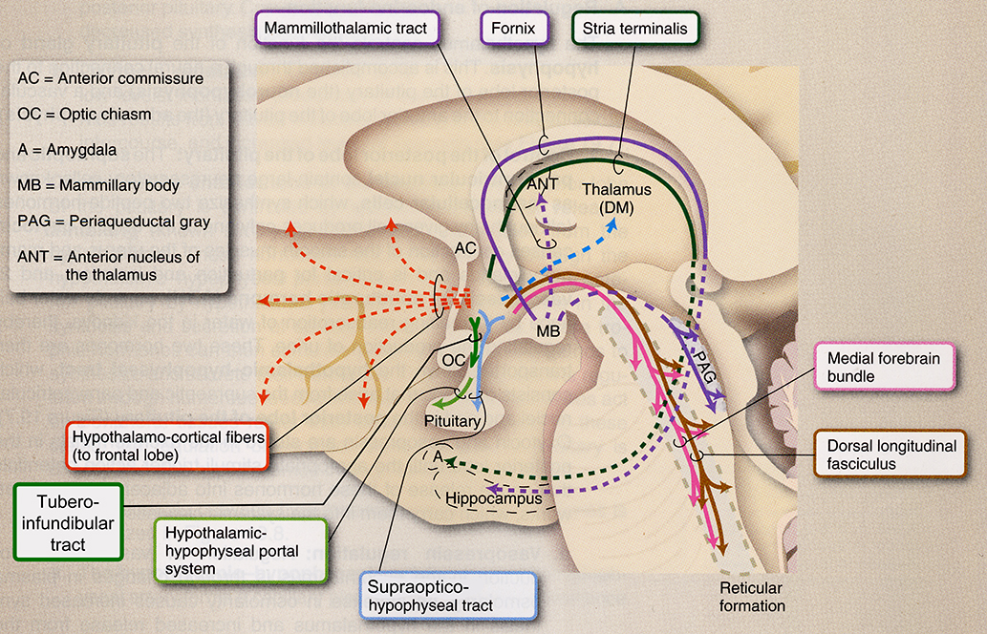
Outputs

Slide 7
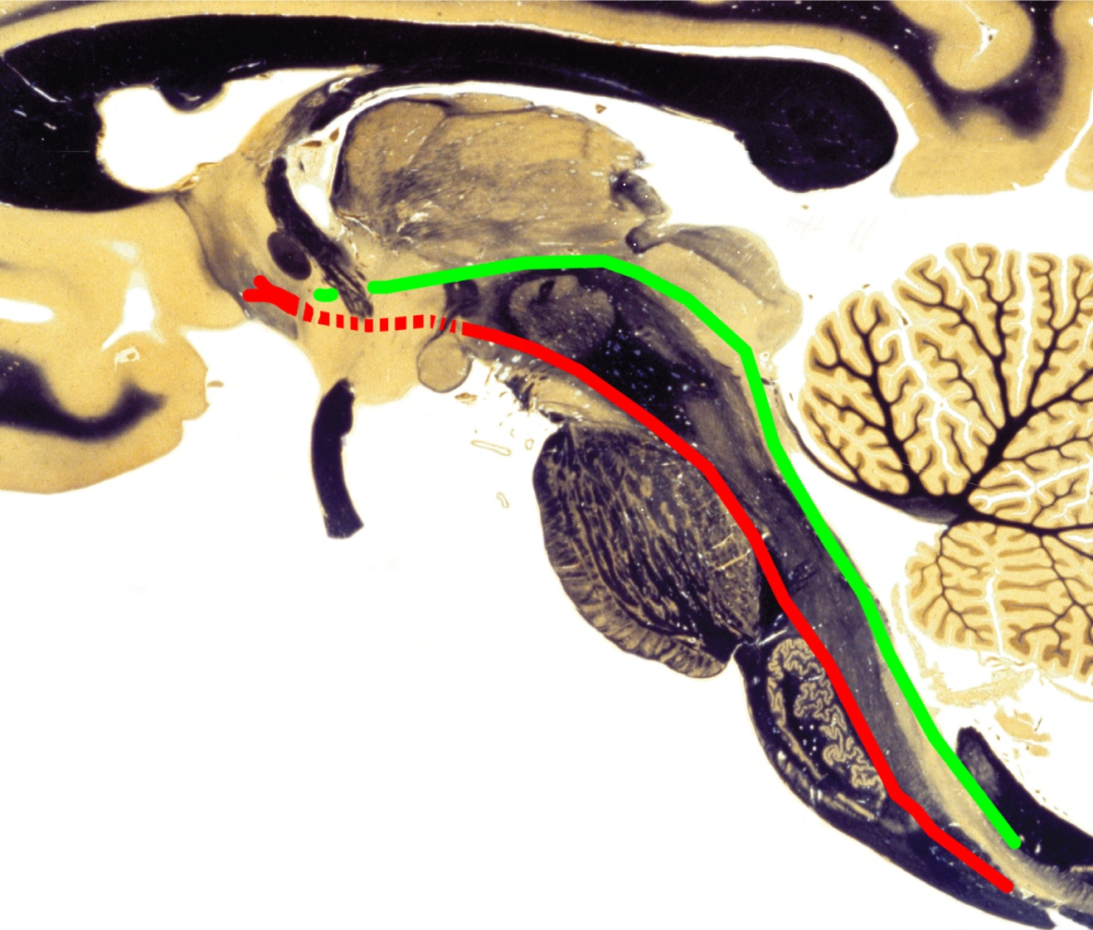
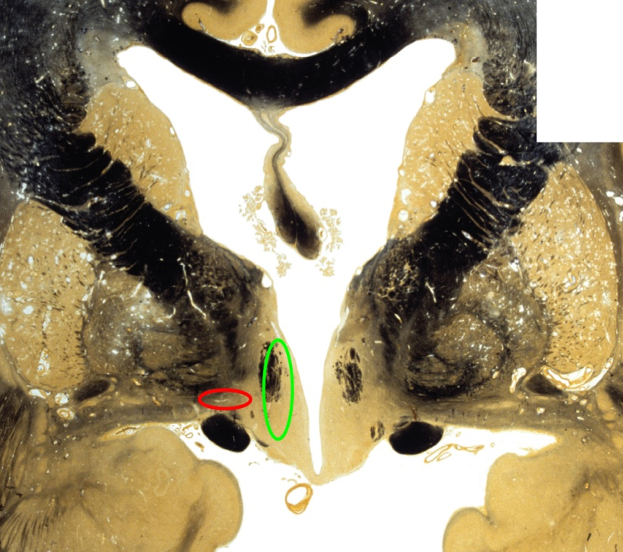
Medial Forebrain Bundle &
Dorsal Longitudinal Fasciculus
DLF
MFB
hypothalamus
hypothalamus

Slide 8
Functions of the Hypothalamus
Many hypothalamic functions are described in the syllabus, as most textbooks are poor sources of this material. So keep this syllabus for future reference.
For the OS1 course, students are responsible only for the topics discussed in the lecture.

Slide 9
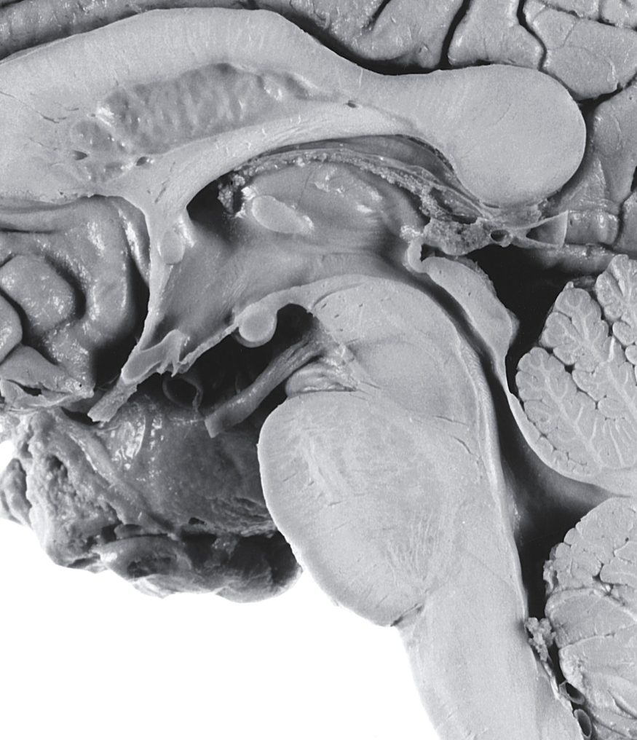
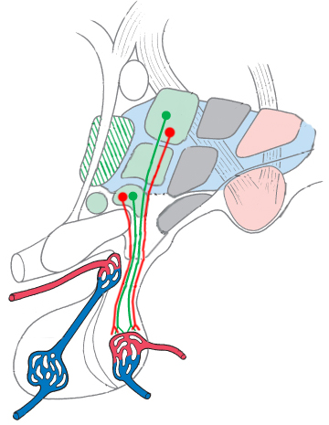
Blood Osmolarity
Homeostasis
SFO
Paraventricular
nucleus
OVLT
Supraoptic nucleus
?
Thirst
Thirst
ADH or Oxytocin
AP

Slide 10
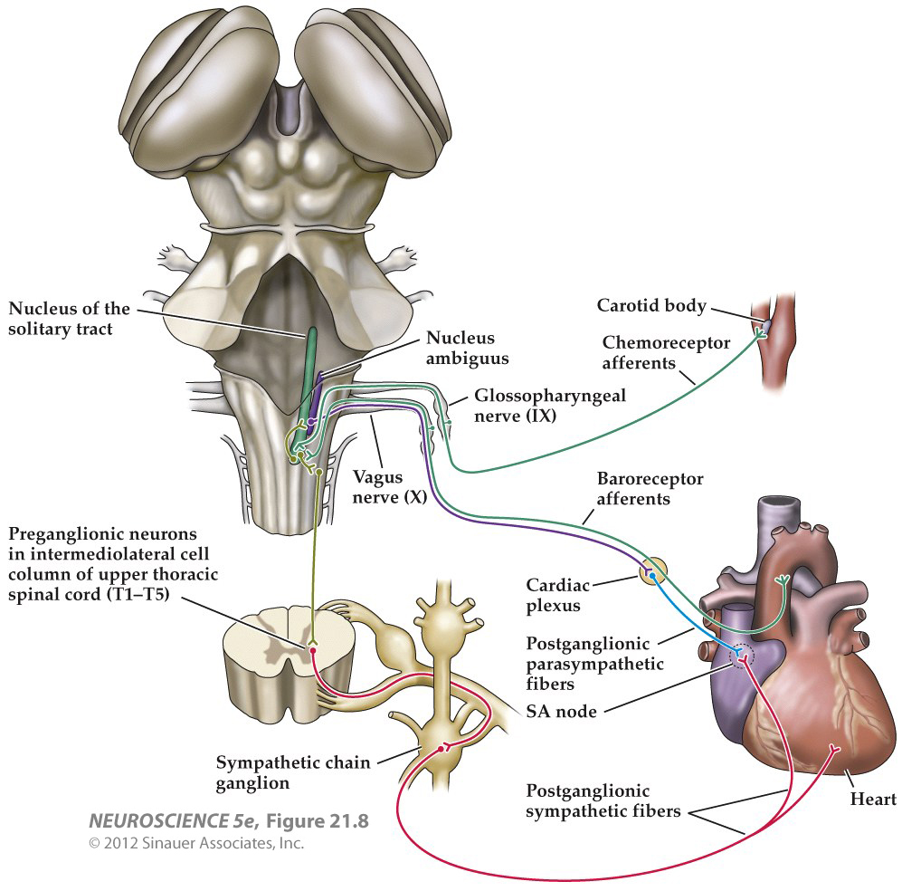
Blood Volume
Pressure &
Heart Rate
Homeostasis
DLF & MFB
Paraventricular
nucleus
ADH or Oxytocin

Slide 11
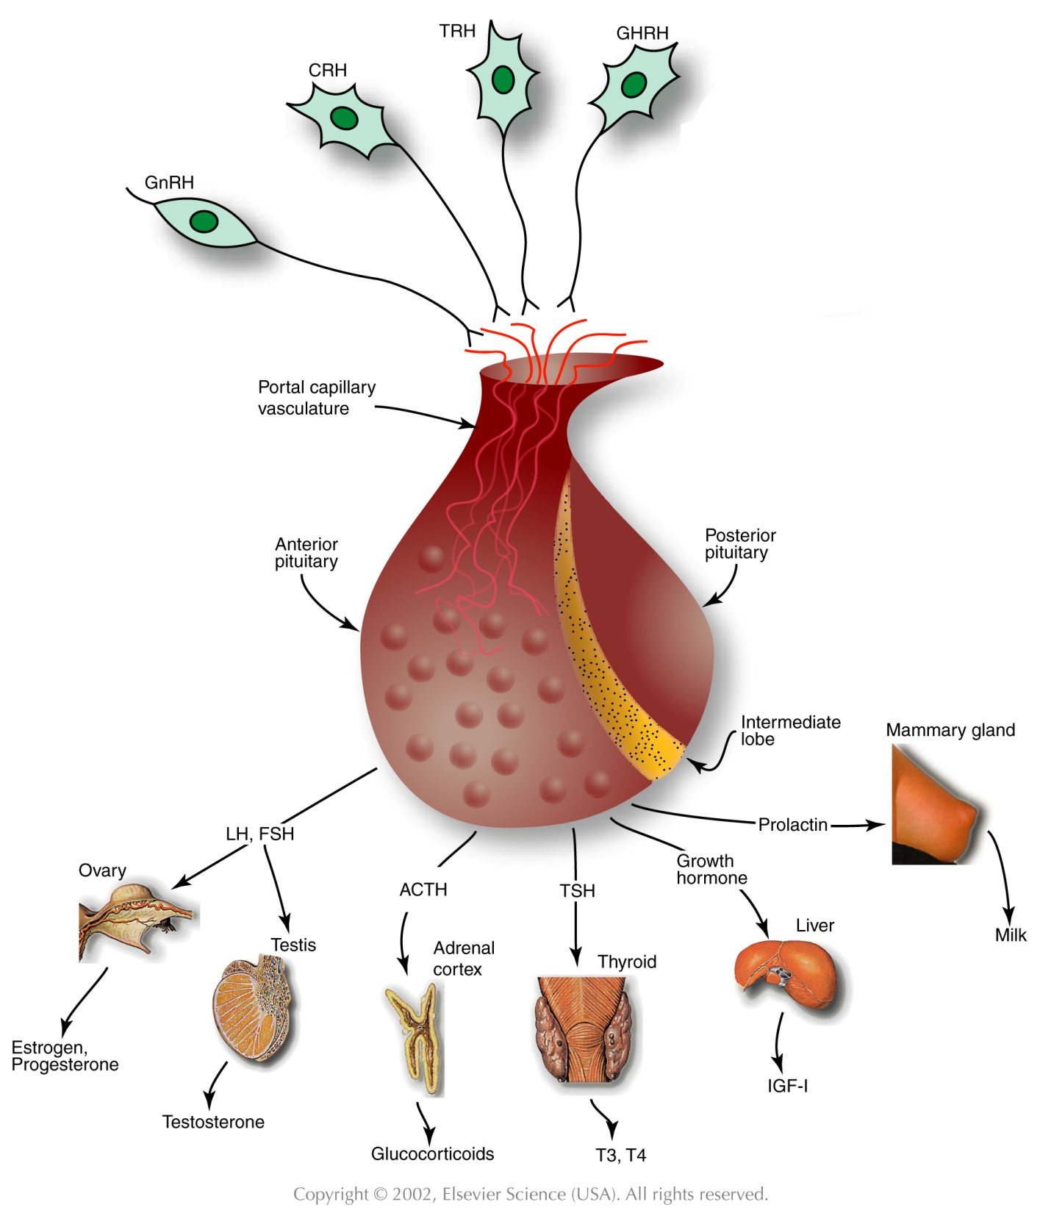
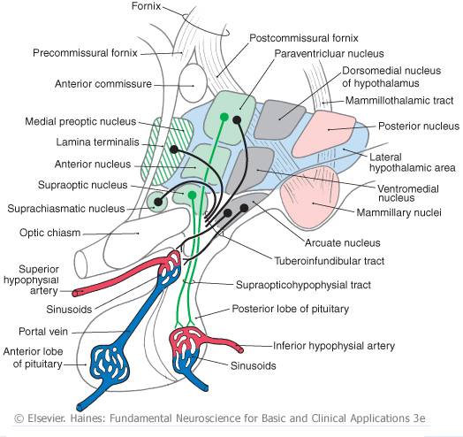
Control of Growth,
Reproduction,
Energy Metabolism,
Lactation, & Stress
via Endocrine Systems
Hypothalamus

Slide 12
Stress
Internal or external cue that disrupts homeostatic status.
Predation
Escape from predation
Threats to physical or mental integrity
Social situations
Pain, hunger, thirst, heat, cold
Disease
Animals must adapt to stress in order to survive.

Slide 13
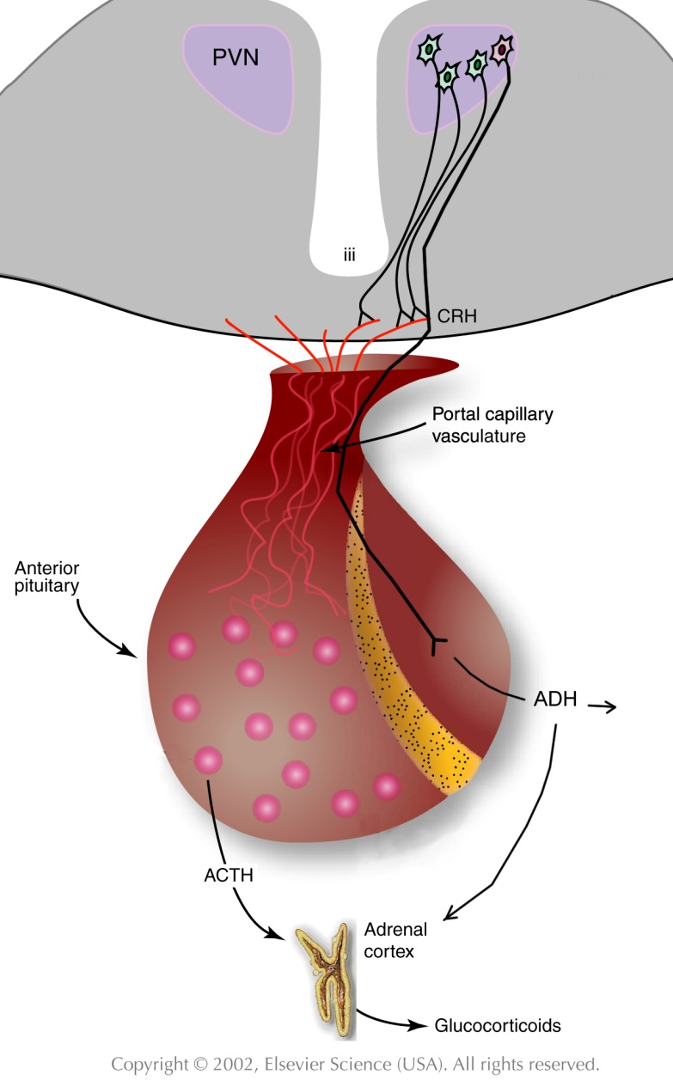
Stress
Prefrontal cortex
Septum
Amygdala
Hippocampus
CVO
Visceral &
Somatic
Sensations
Glucocorticoids
Mobilize energy stores &
improve cardiovascular tone
Glycogen storage & use
Heart rate
Blood pressure
Immune responses
Cytokine production
Inflammatory responses
Hypothalamus

Slide 14
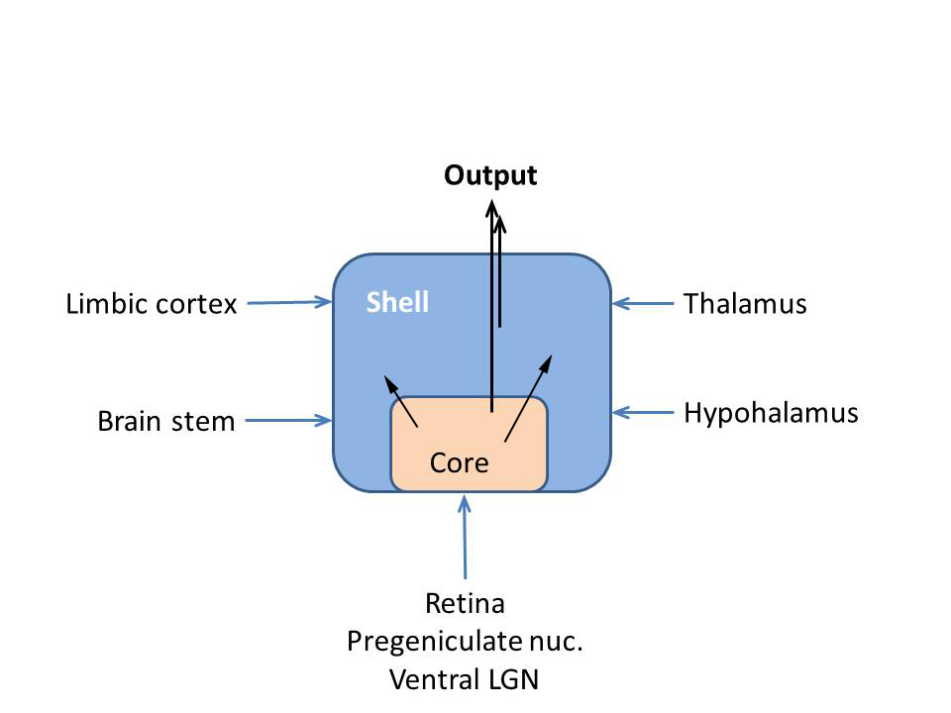
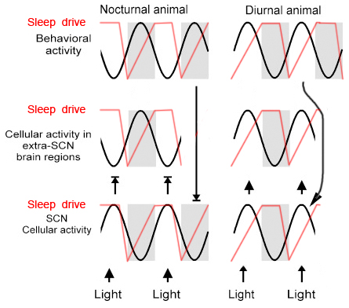
Circadian Timing
Function: coordinate physiological, humoral & behavioral
mechanisms to promote effective sleep & waking
behaviors.
Pacemaker: suprachiasmatic nucleus.

