Slide 1
Gross Anatomy of the CNS
S.J. Potashner
sjp9713@neuron.uchc.edu

Slide 2
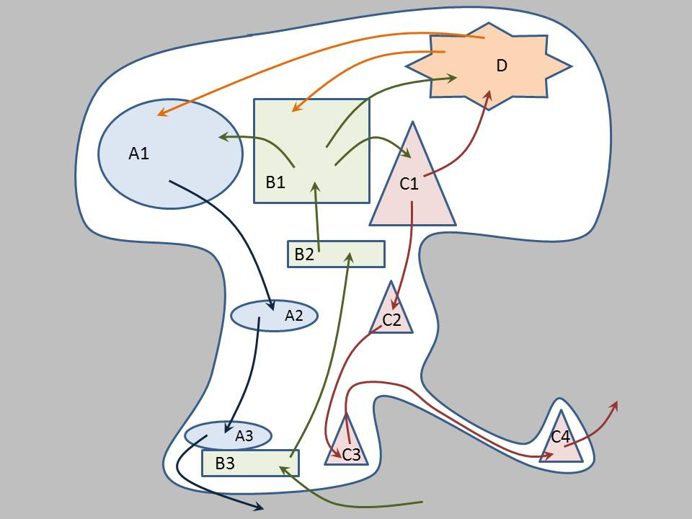
The nervous system has distinct areas that are specialized for different (sub)functions.
The distinct functional areas have different locations inside the nervous system, and they interact by signaling to one another along networks of cells.
These components are organized into sub-systems (usually called ‘systems’) each of which performs specific functions.
Many of these ‘systems’ span the length of the nervous system.

Slide 3
GOALS
Learn some language of gross anatomy
Learn the major subdivisions of the nervous system
Recognize the cardinal features of each subdivision
Learn the entry/exit points of the peripheral nerves

Slide 4
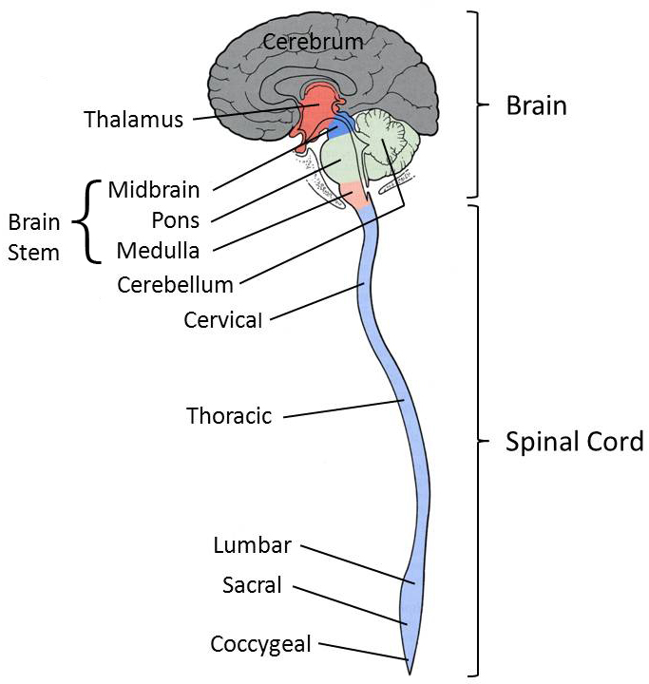
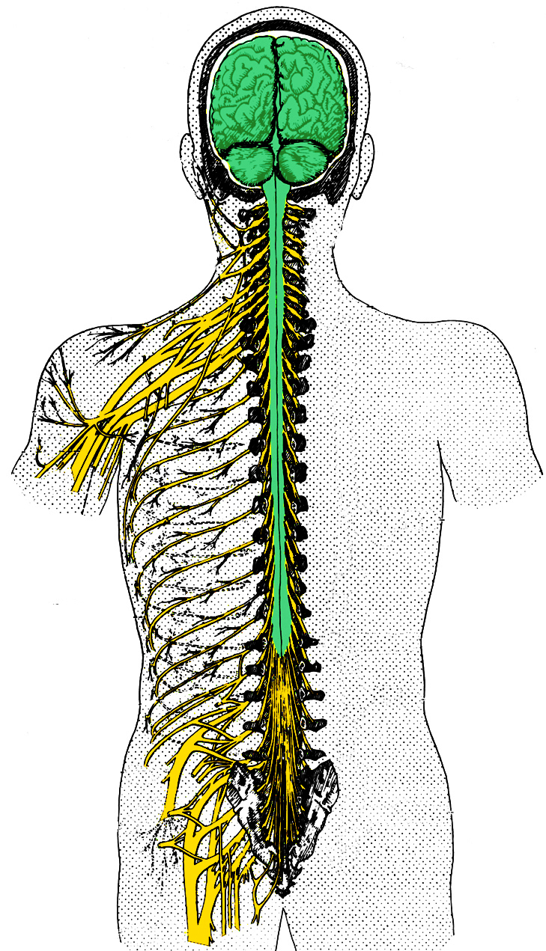
Anatomic Taxonomy

Slide 5
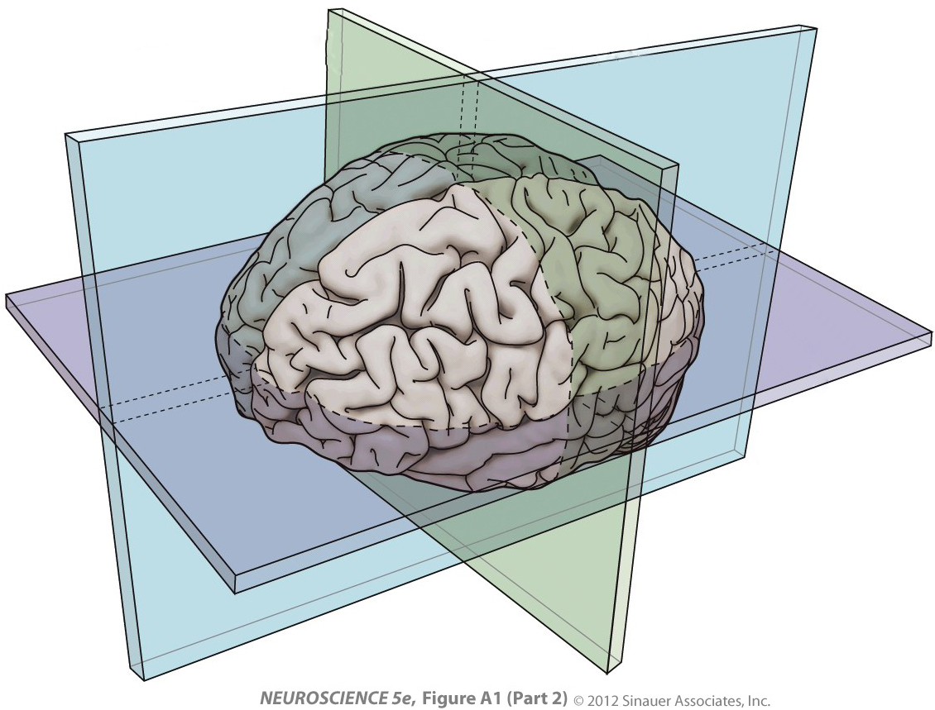
Anatomical Planes
Terms of Direction
Median
Sagittal
Frontal
Coronal
Medial
Lateral
Ipsilateral
Contralateral
Anterior, Rostral
Posterior, Caudal
Ventral
Dorsal
Horizontal
Axial
Superior, Rostral, Cranial
Inferior, Caudal

Slide 6
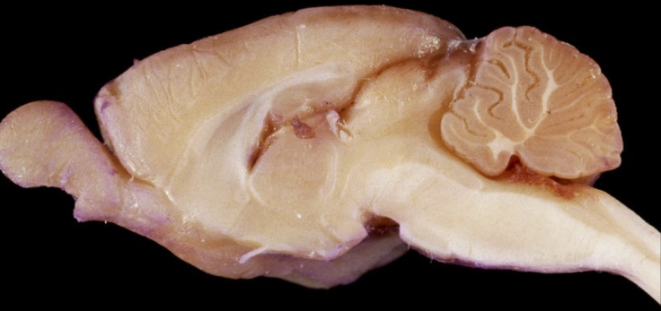
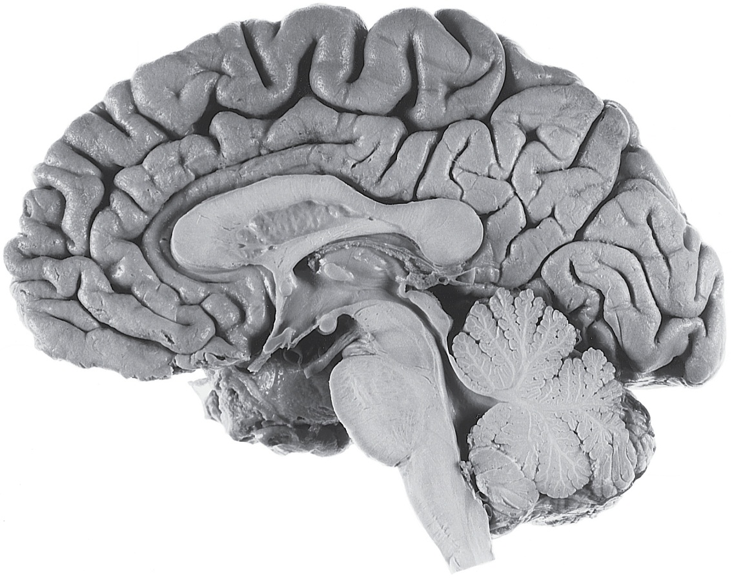
Dorsal
Terms of
Direction
Rostral
Caudal
Ventral
Rostral
Superior
Caudal
Inferior
Ventral
Dorsal
Caudal

Slide 7
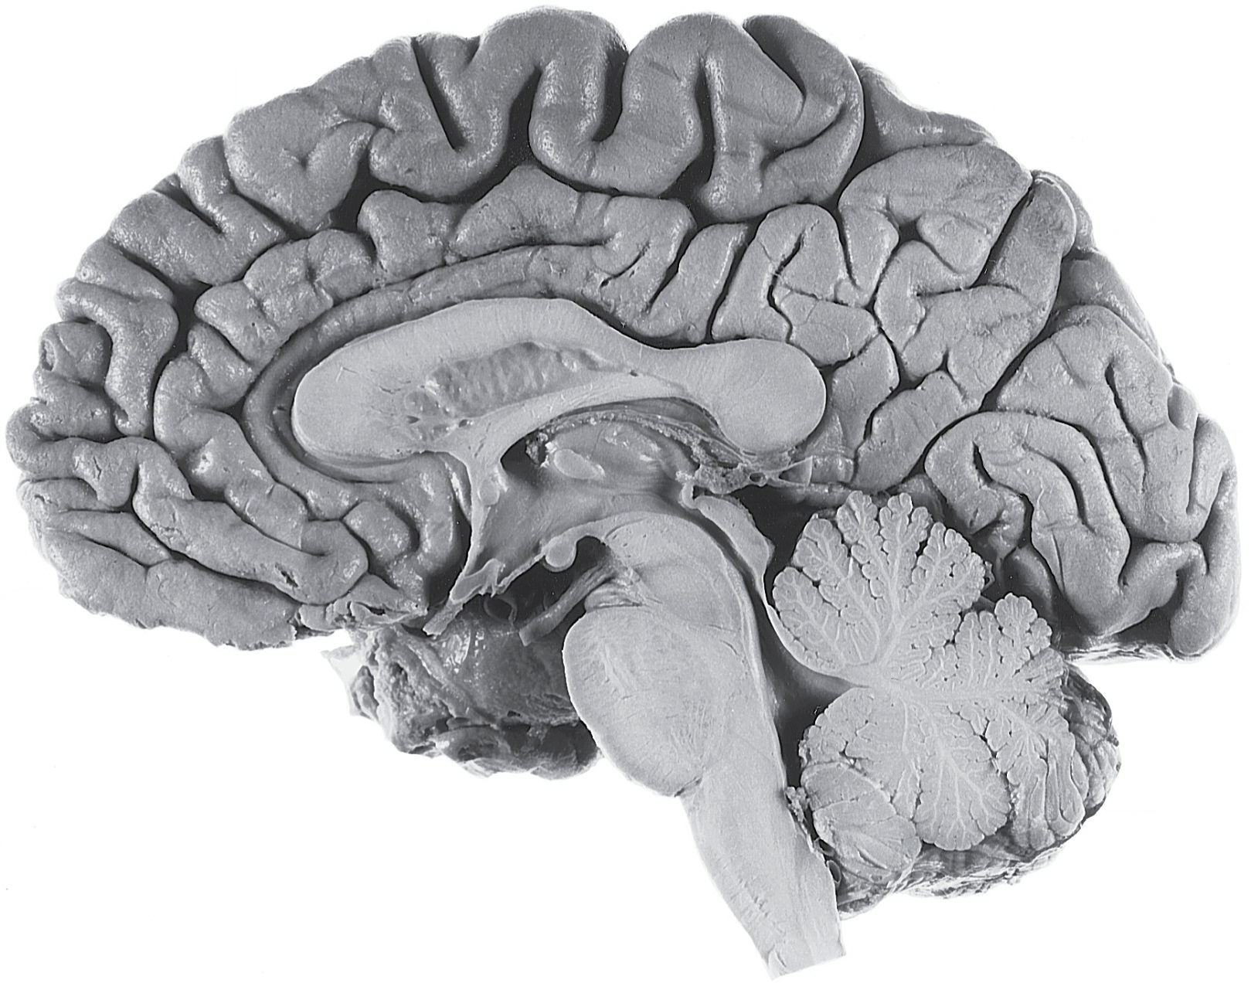
Human CNS Subdivisions
Cerebrum
Spinal cord

Slide 8
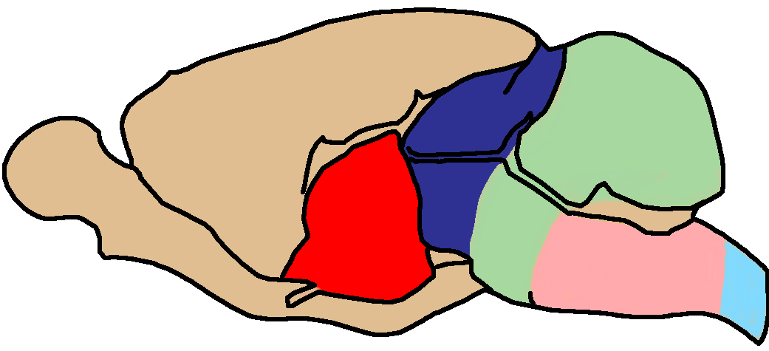
Rat CNS
Subdivisions
Cerebrum
Cerebellum
Spinal cord
Thalamus
Pons
Midbrain
Medulla
Cerebrum

Slide 9
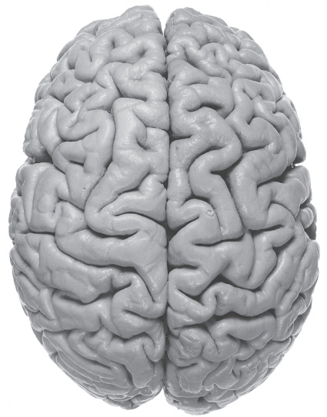
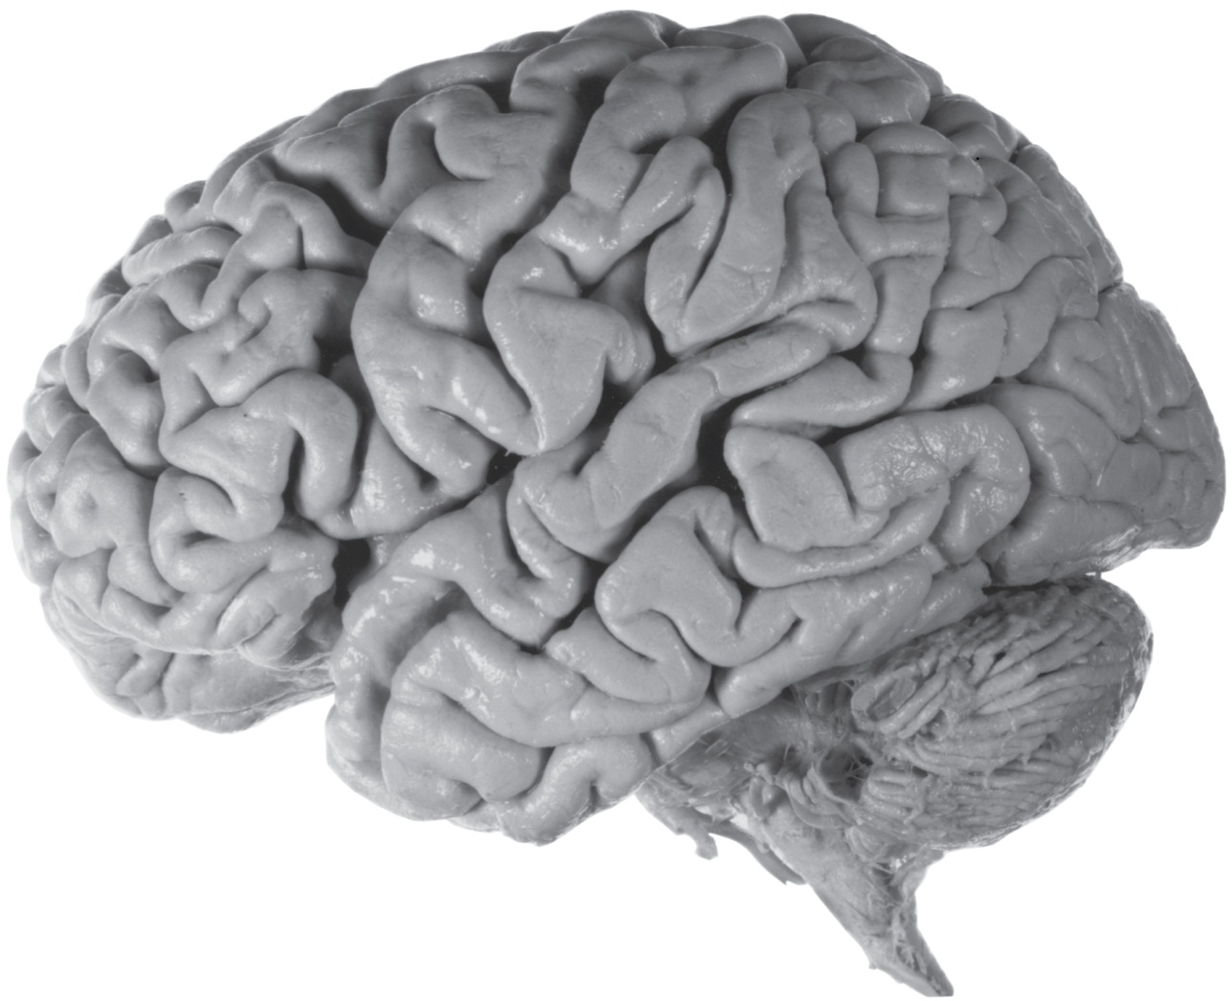
Longitudinal fissure
Surface Features: Lateral Cerebrum
Rostral
Central sulcus
Parietal
lobe
Caudal
Frontal
lobe
Occipital
lobe
Rostral
Caudal
Temporal
lobe
Lateral fissure
Preoccipital notch

Slide 10
Surface Features: Medial Cerebrum
Rostral
Central sulcus
Cingulate sulcus
Parieto-occipital
sulcus
Caudal
Frontal
lobe
Parietal
lobe
Occipital
lobe
Rostral
Caudal
Temporal
lobe

Slide 11
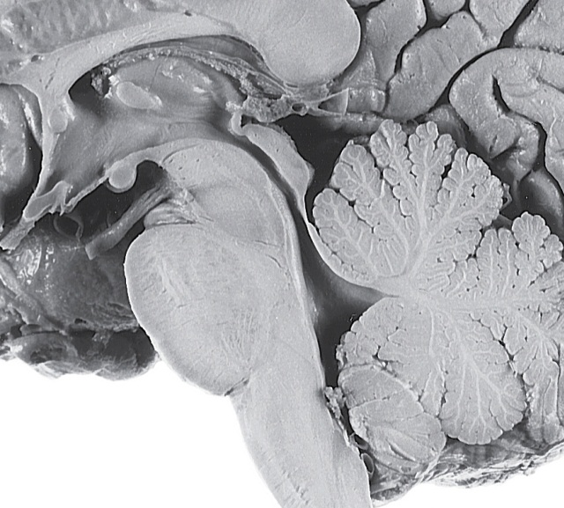
Surface Features: Thalamus
Dorsal thalamus
Hypothalamic
sulcus
Hypothalamus
Optic nerve

Slide 12
Surface Features: Midbrain
Aqueduct
Oculomotor nerve
Cerebral peduncle
Superior colliculus
Inferior colliculus

Slide 13
Surface Features: Pons
Pontine protuberance
Cerebellum

Slide 14
Surface Features: Medulla

Slide 15
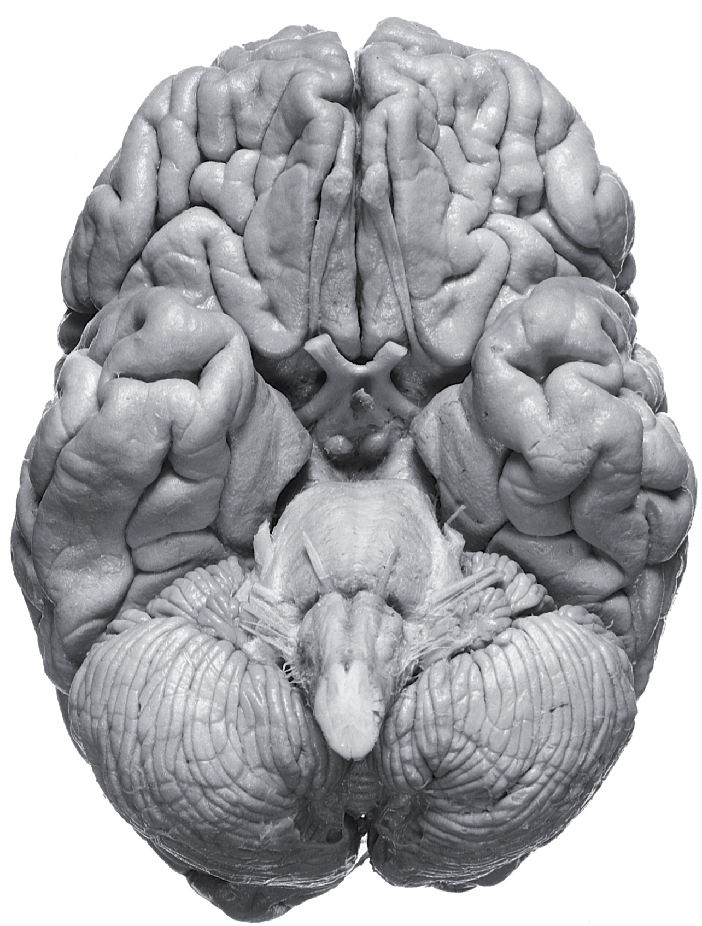
Olfactory bulb
Frontal
lobe
Olfactory tract
Lateral fissure
Temporal
lobe
Th
Mi
Pons
Med
Surface Features:
Ventral Brain Stem
Cerebellum

Slide 16
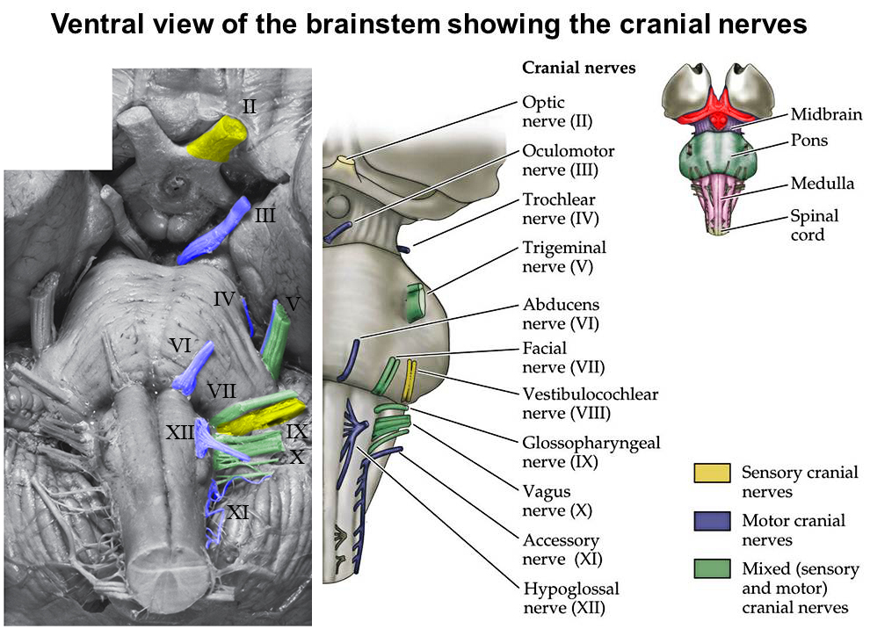

Slide 17
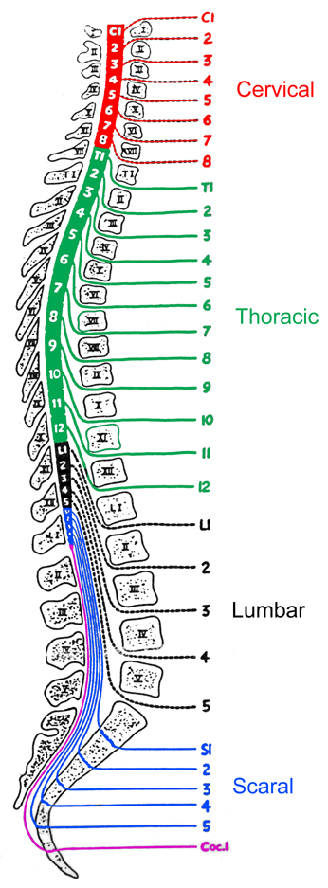
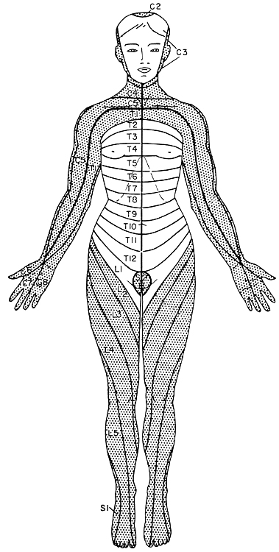
Spinal Cord
Vertebral
levels
Spinal
levels

Slide 18
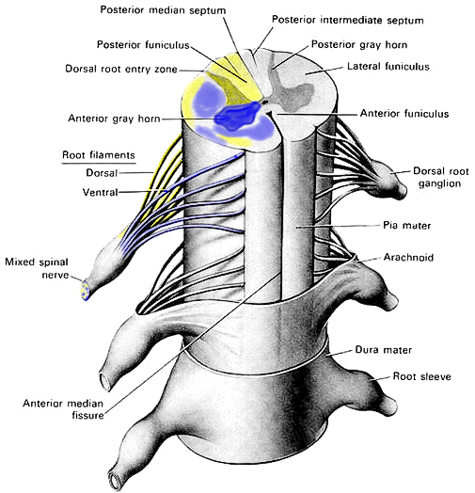
Surface Features: Spinal Cord

