Slide 1
THE BASAL GANGLIA: Neuroanatomy
S. J. Potashner
sjp9713@neuron.uchc.edu

Slide 2
FUNCTIONS
Facilitates the most effective motor, emotional and cognitive behavior for the prevailing circumstances, and suppresses other behaviors. (Action selection)
Motor: Facilitates actions with positive outcomes. Binds sequences of such actions into behavior units. Such units are bound together in sequence into longer, more complex behaviors.
Notes:
Put Parkinson’s & Huntington’s here as examples. Describe symptoms.

Slide 3
SIGNALING SCHEME
Cerebral cortex
emotions
many areas
upper
motor neurons
cognitive
Thalamus
-
Basal Ganglia
+
3 neural pathways
-
Brain stem
pre-motor neurons
output

Slide 4
COMPONENTS
BASAL GANGLIA
Caudate
Putamen
Globus Pallidus
………
Substantia Innominata
Nucleus Basalis
Nucleus Accumbens
Olfactory Tubercle
Striatum
(non-primate)
Dorsal
Ventral
ASSOCIATED NUCLEI
Subthalamic Nucleus
Substantia Nigra

Slide 5
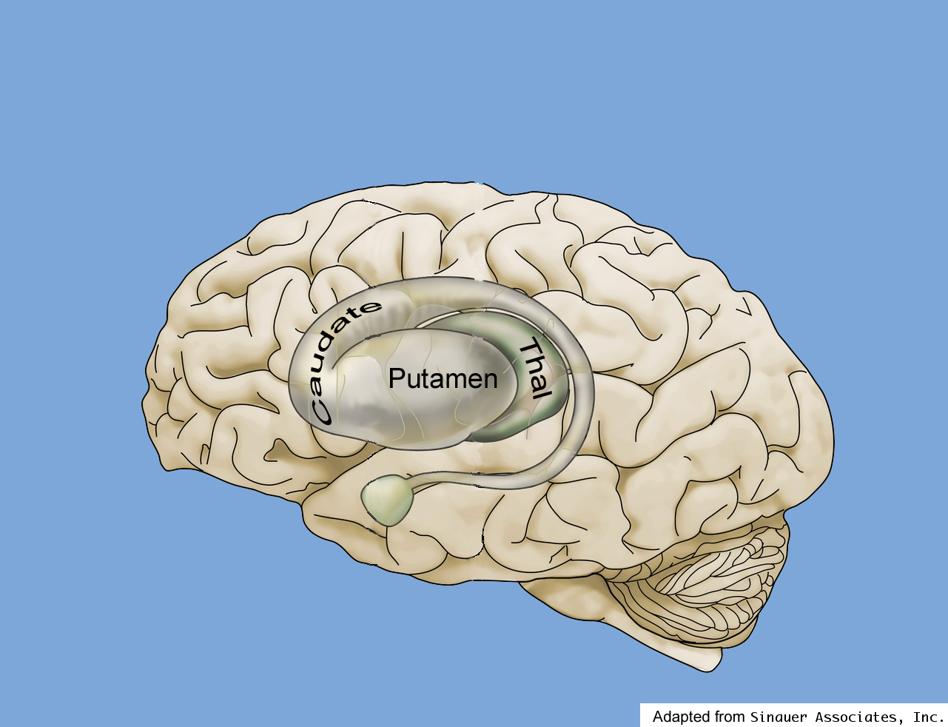
NEUROANATOMY
A
B
D
C

Slide 6
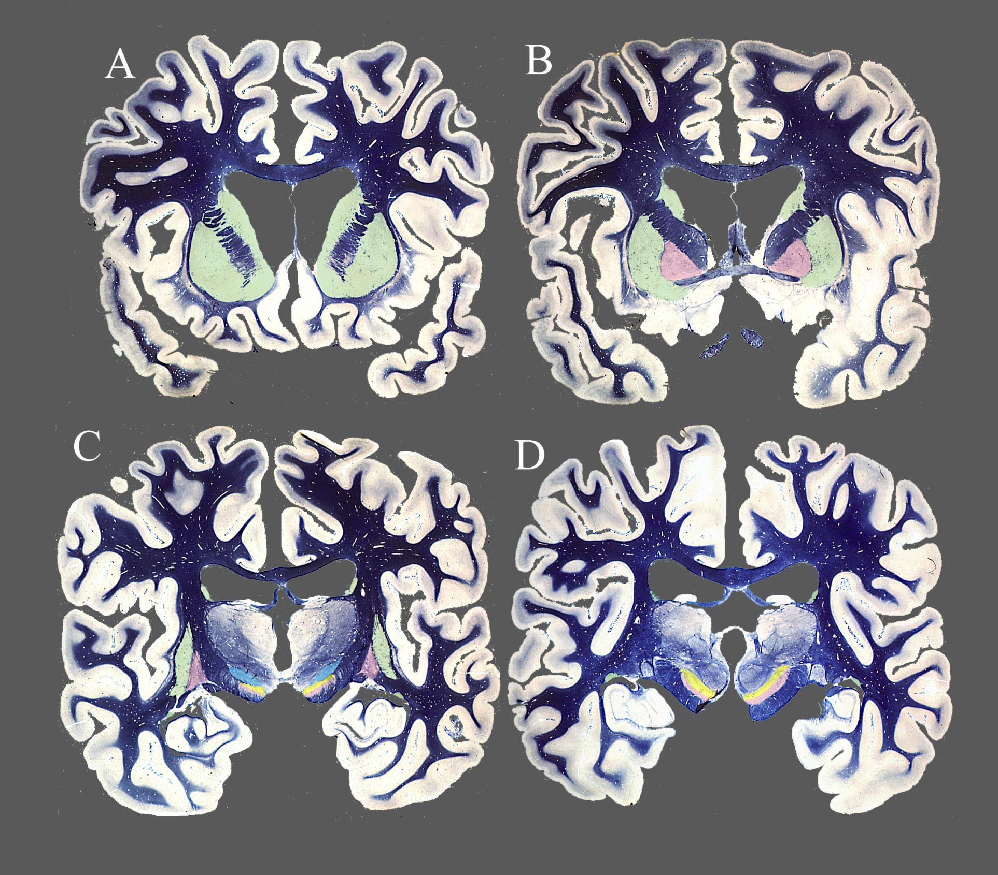
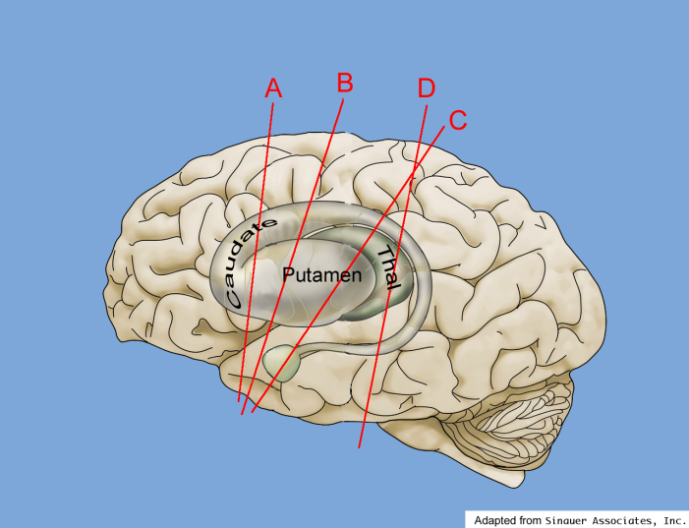

Slide 7
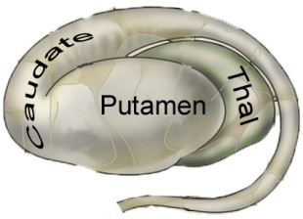
INPUT PATHWAYS TO THE STRIATUM
Dorso-lat Prefrontal Ctx
Post Parietal Ctx
Supp & Pre-motor Ctx
Parietal Eye Field
Prim Motor Ctx
Frontal Eye Field
Prim Somatosensory Ctx
Visual Assoc Ctx
Auditory Assoc Ctx
Lat Orbito-frontal Ctx
Ant Cingulate Ctx
Ant Temporal Ctx
Putamen
Amygdala
Association Ctx
Motor or Sensory Ctx
Temporal Ctx
Para-hippocampal Ctx

Slide 8
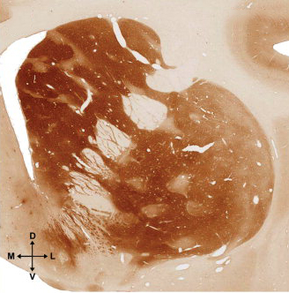
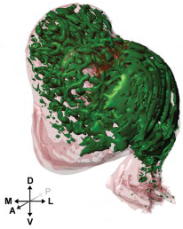
STRIATAL ANATOMY
Caudate
Striosomes
Striosome reticulum
Matrix
Putamen

Slide 9
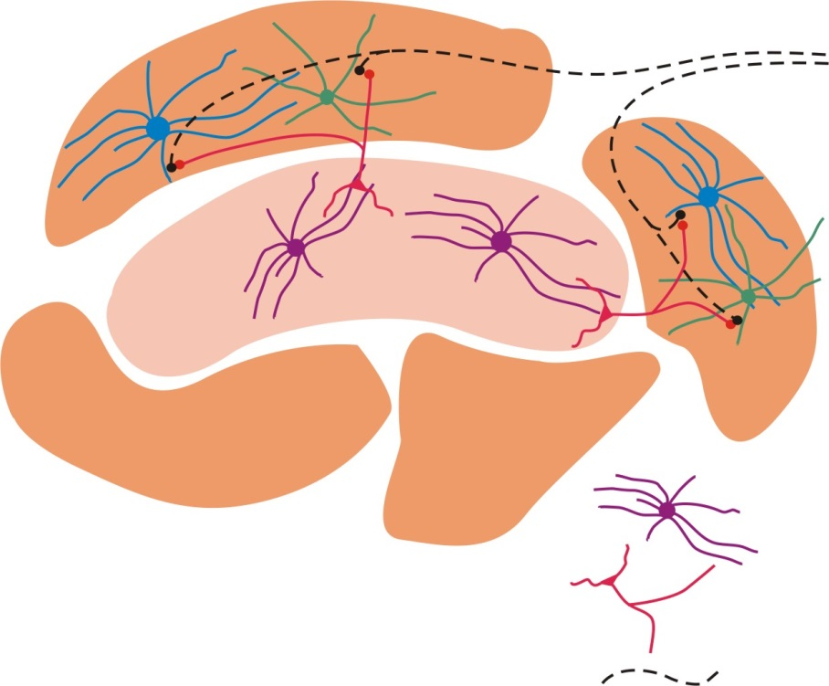
STRIATAL ANATOMY
Association Ctx (layers IIII-V)
Limbic & Other
Association Ctx
(deep layer V)
Somatosensory Ctx
Motor Ctx
Substantia Nigra compacta
Direct pathway
(action selection)
Striosome
Indirect pathway
(action suppression)
Matrix
Medium spiny neurons
Cholinergic interneurons
Dopaminergic axons

Slide 10
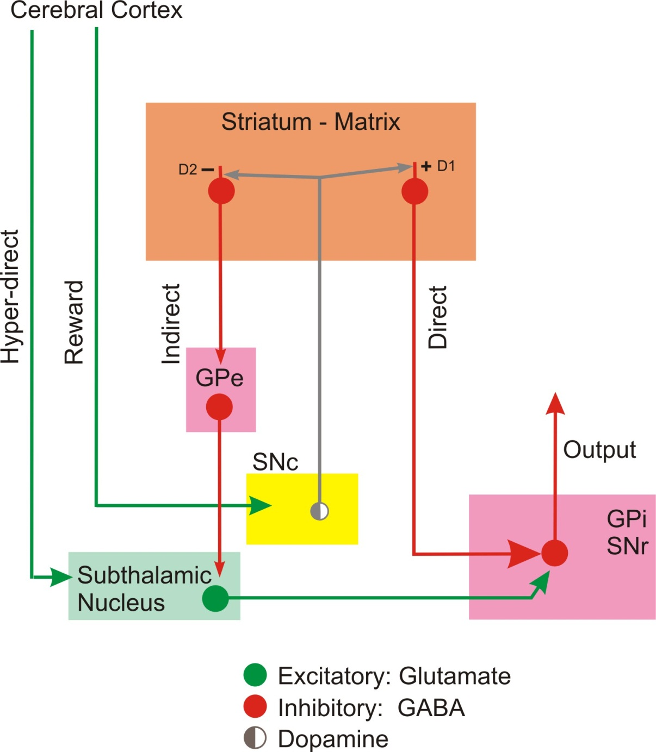
PATHWAYS THROUGH THE BASAL GANGLIA

Slide 11
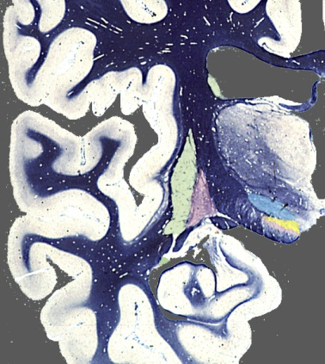
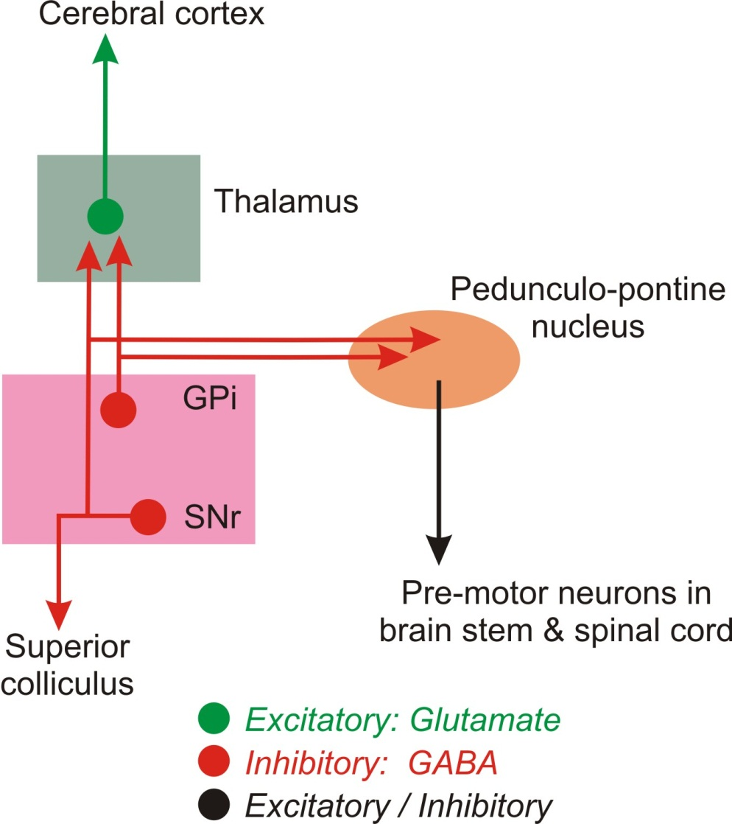
BASAL GANGLIA OUTPUT PATHWAYS
Lenticular fasciculus
Thalamic fasciculus
Thalamus
Ansa lenticularis

Slide 12
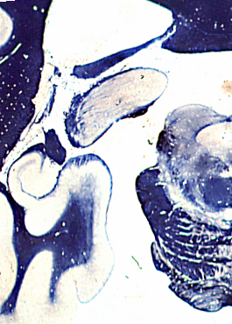
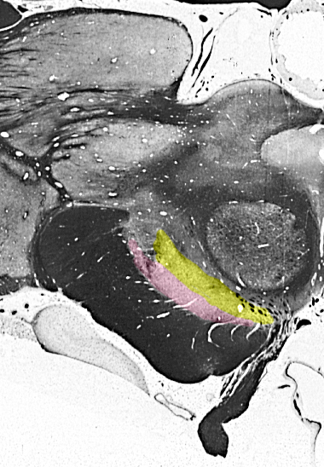
BASAL GANGLIA OUTPUT PATHWAYS
SC
SN

Slide 13
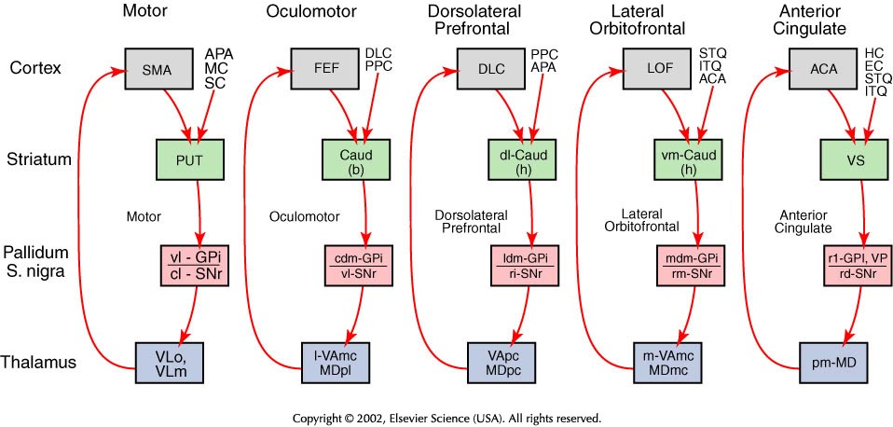
SEGREGATED PATHWAYS
ACA ant cingulate area; APA arcuate premotor area; CAUD b body, h head; DLC dorsolat prefrontal ctx; EC entorhinal ctx;
FEF frontal eye fields; HC hippocampal ctx; ITQ Inf temporal gyrus; LOF lat orbitofrontal ctx; MC motor ctx; MD medial dorsal thalamus; PPC post parietal ctx; PUT putamen; SC somatosensory ctx; SMA suppelmentary motor ctx; STQ sup tempotal gyrus; VA ventral anterior thalamus; VL ventral lateral thalamus; VP ventral pallidum; VS ventral striatum; cl caudolateral; cdm caudal dorsomedial; l lateral; ldm lateral dorsomedial; m medial; mdm medial dorsomedial;; pm posteromedial; rd rostrodorsal; rl rostrolateral; rm rostromedial; vm ventromedial; vl ventrolateral.

