Slide 1
The Autonomic Nervous System
S. J. Potashner
sjp9713@neuron.uchc.edu

Slide 2
Autonomic NS
A division of the nervous system
Innervates & regulates effectors of homeostasis
Cardiovascular organs
Respiratory organs
Digestive organs
Urinary organs
Reproductive organs
Glands
Part of a network of structures in the CNS

Slide 3
Autonomic NS
Three major subdivisions
Sympathetic division:
organized to mobilize the body for activity
Parasympathetic division:
organized for energy conservation
Enteric division:
controls the local functions of the GI tract

Slide 4
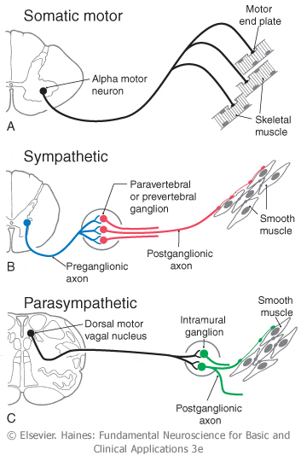
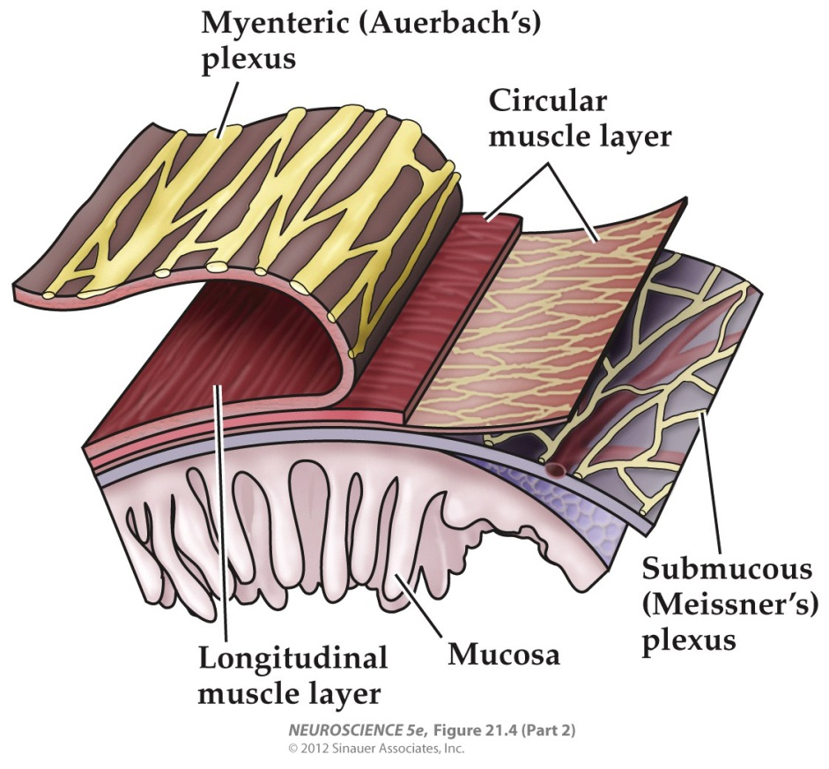
Lower Motor Pathways

Slide 5
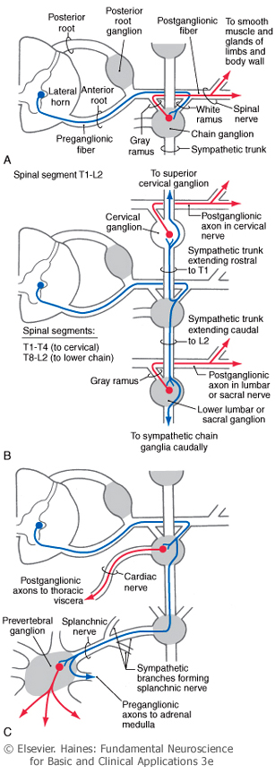
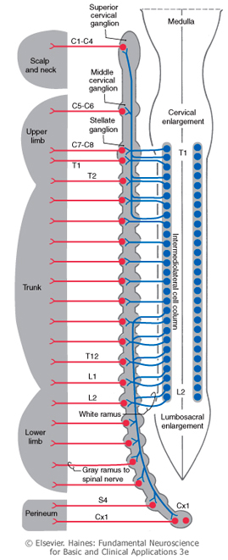
Sympathetic
Pathways

Slide 6
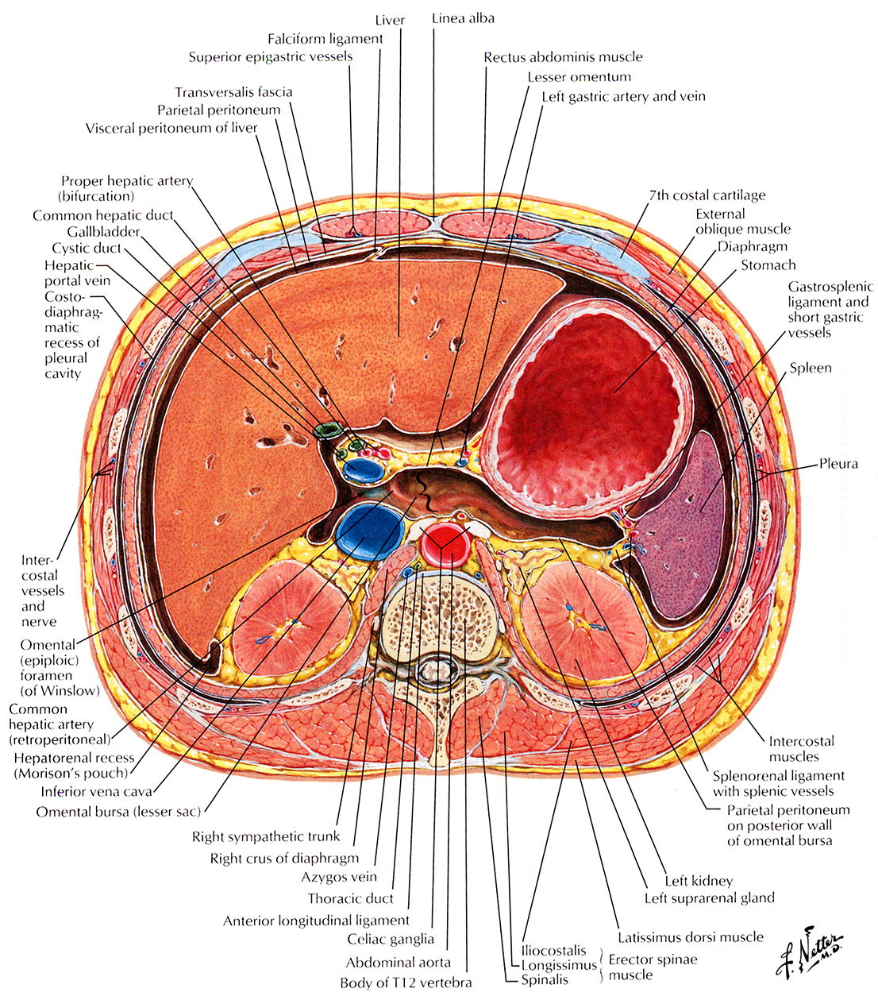
X-Section
Upper
Abdomen
Ant
R
L
Post

Slide 7
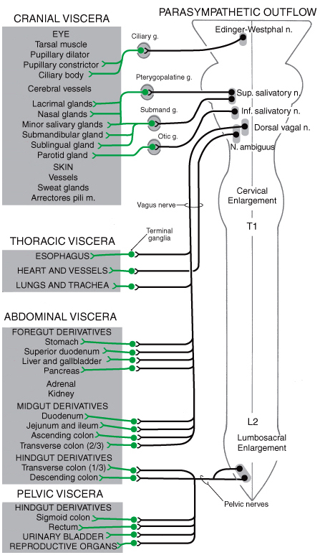
Parasympathetic
Pathways

Slide 8
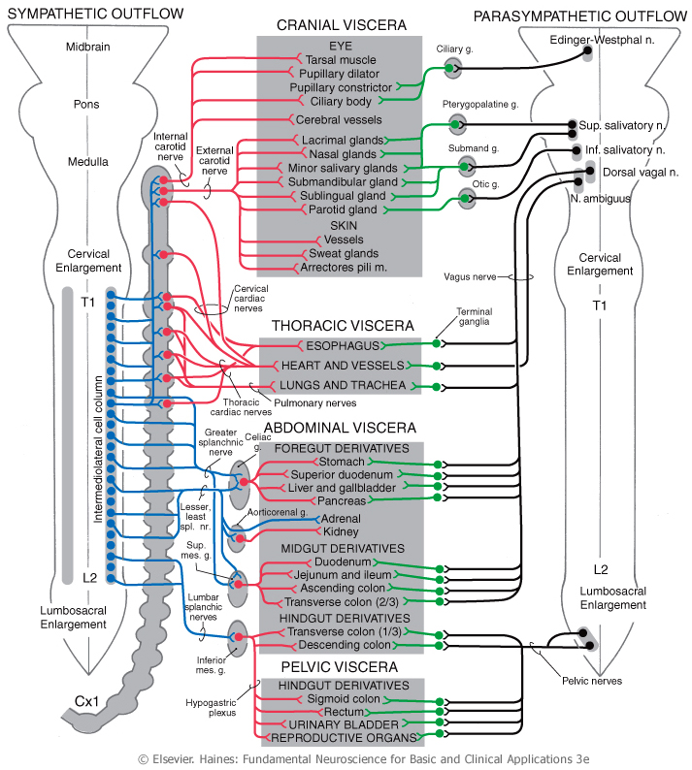
Autonomic
Pathways

Slide 9
Functions
Sympathetic Division
Parasympathetic Division
Mobilize body for activity:
Energy expenditure
Decrease energy stores
Catabolic functions
Cardio-pulmonary adjustments
Energy conservation:
Reduce energy expenditure
Increase energy stores
Anabolic functions
Cardio-pulmonary adjustments

Slide 10
Functions
Actions | Symp | Parasymp
Breathing rate | + | -
Bronchodilation | + | -
Heart rate & output | + | -
Blood pressure | + | 0
Skeletal muscle vasodilation | +
GI blood flow | - | +
Digestion | - | +
Glycogenolysis & glucose release from liver | + | 0
Insulin secretion | - | +
Fat & glycogen synthesis & storage | - | +
Pupillary dilation | + | 0
Pupillary constriction | 0 | +
Sweating | + | 0

Slide 11
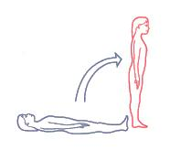
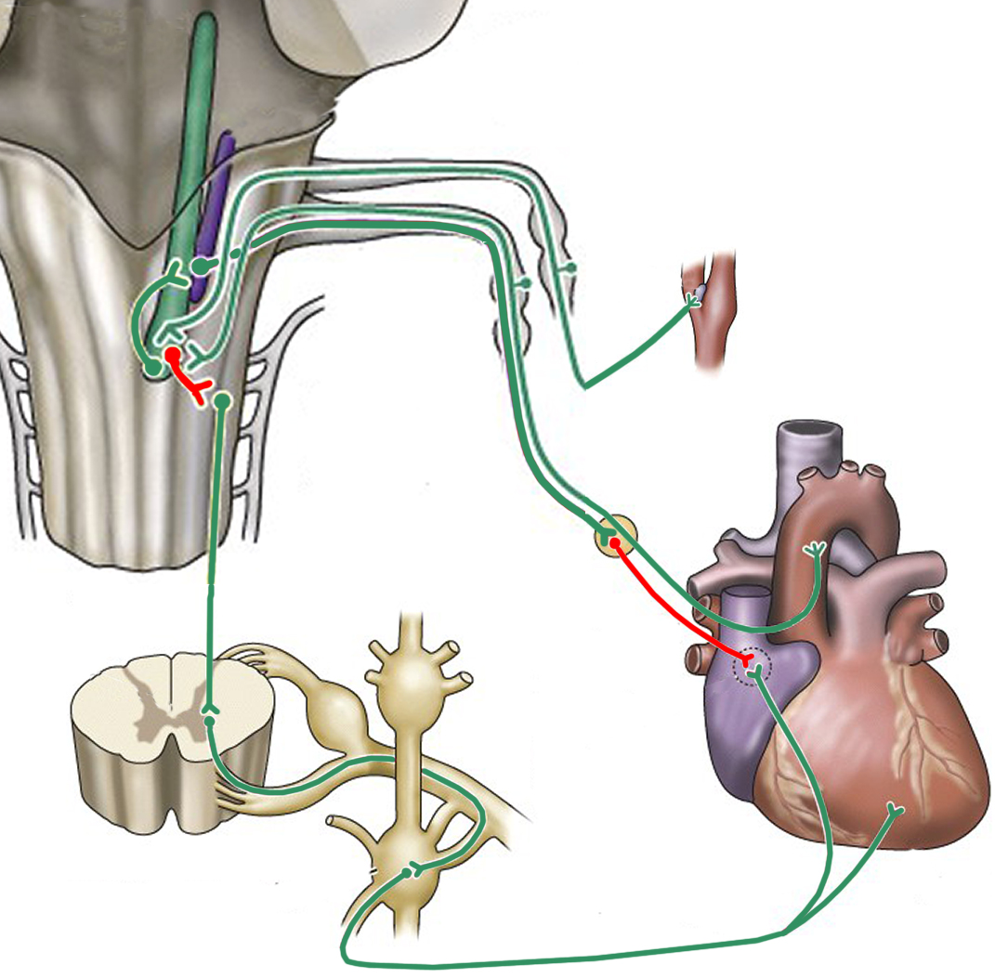
Baroreflex
NTS
Nucleus
ambiguus
Glossopharyngeal n.
Vagus n.
(-)
Carotid body
(-)
Cardiac
plexus
(-)
Heart rate &
contraction
increase
SA node
Excitatory
Inhibitory
T1-T5
(+)
Cardiac n.

Slide 12
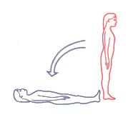
Baroreflex
NTS
Nucleus
ambiguus
Glossopharyngeal n.
Vagus n.
(+)
Carotid body
(+)
Cardiac
plexus
(+)
Heart rate &
contraction
decrease
SA node
Excitatory
Inhibitory
T1-T5
(-)
Cardiac n.

Slide 13
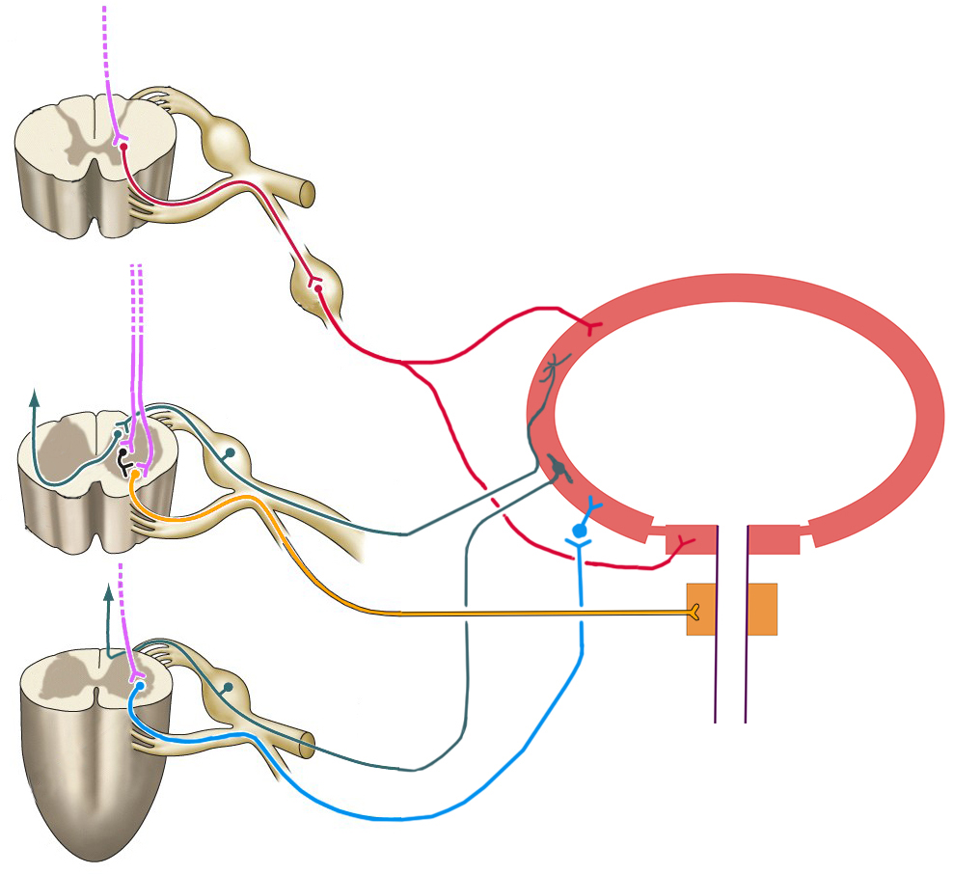
Bladder Control
Sensory
Sympathetic
Somatic motor
T10-L2
Parasympathetic
Detrusor
muscle
-
Bladder
Internal
urethral
sphincter
(males)
+
+
S2-S4
+
External
urethral
sphincter
Urethra

