Slide 1
Auditory midbrain and forebrain
Douglas Oliver
University of Connecticut Health Center

Slide 2
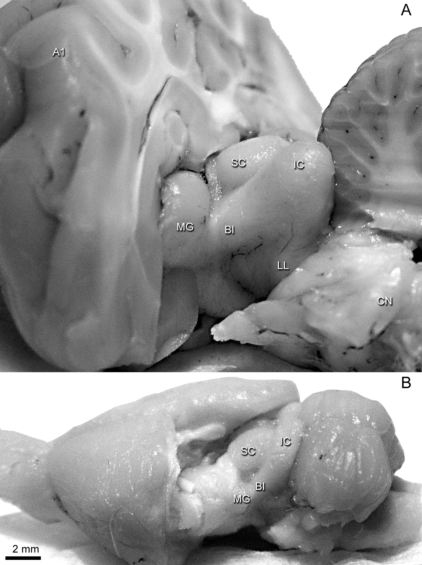
Auditory system in gross brain
Cat
Rat

Slide 3
Auditory system in gross brain

Slide 4
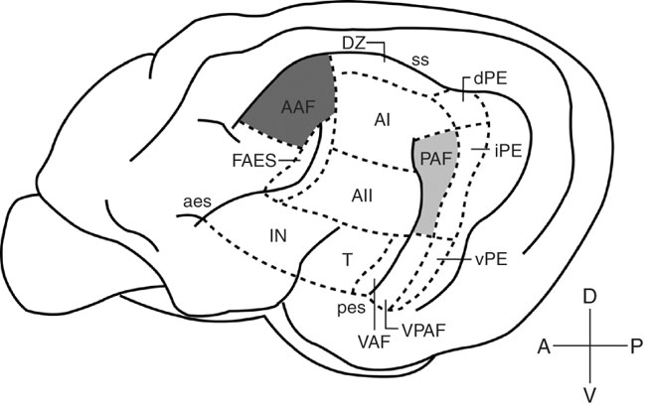
Cat Auditory Cortex
Subdivisions
  Primary – A1 (AI), Anterior auditory field (AAF), Posterior auditory field (PAF)
  Non-primary – Secondary area A2 (AII), Dorsal zone (DZ), Posterior ectosylvian (PE), Ventral auditory field (VAF), Insular (IN), Temporal (T), Frontal anterior ectosylvian sulculus (FAES)
Neuron types
  Pyramidal - GLUT, layers 2, 3, 5, 6
  Spiny stellate – GLUT, layer 4
  Non-spiny stellate - GABA, most layers
Inputs
  Medial geniculate body

Slide 5
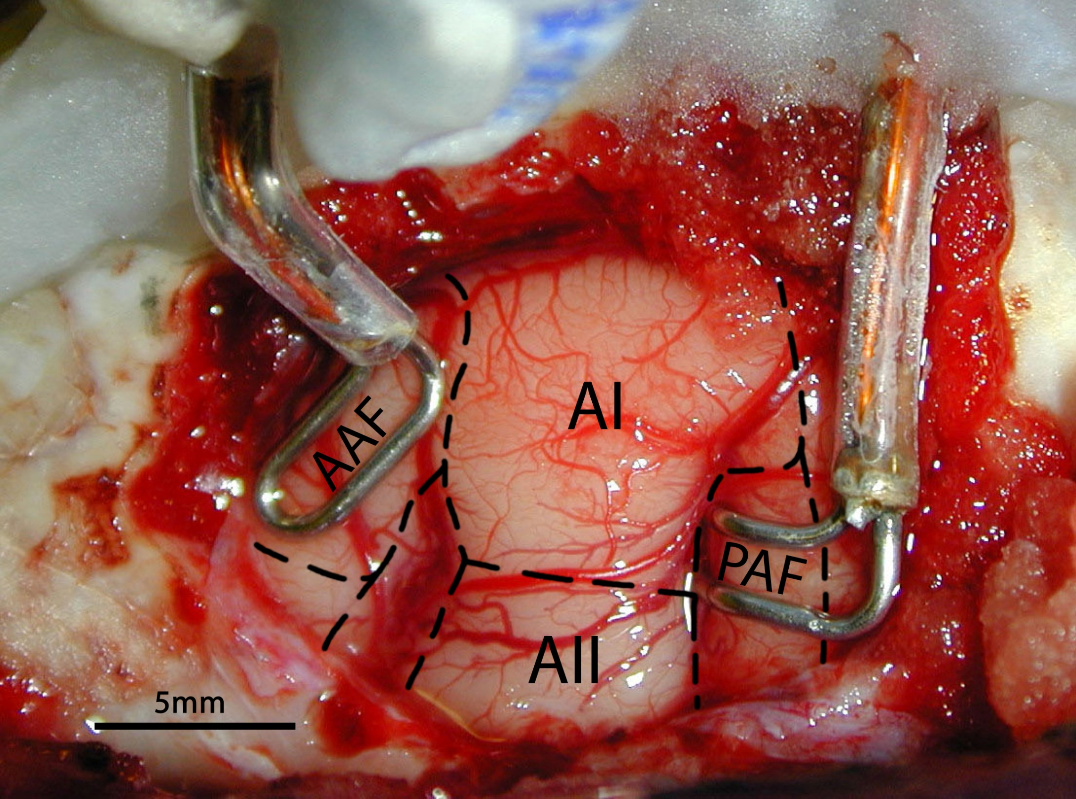

Slide 6
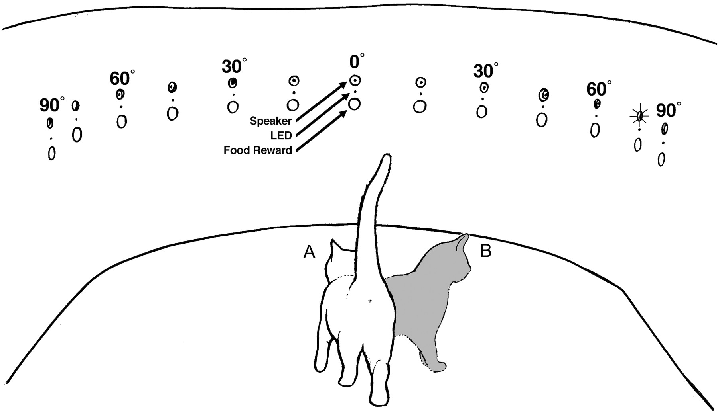

Acoustic and visual orienting arena
Malhotra, S. et al. J Neurophysiol 92: 1625-1643 2004;
doi:10.1152/jn.01205.2003
Copyright ©2004 The American Physiological Society

Slide 7
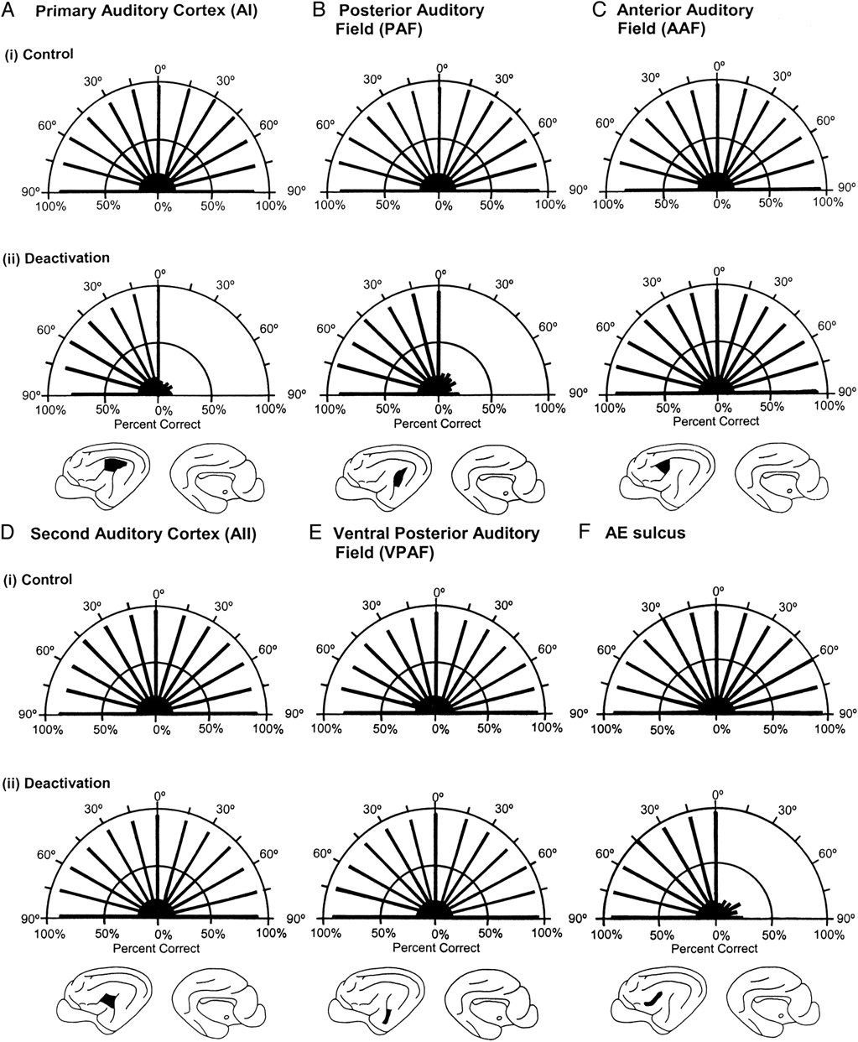
Orienting responses to a sound before and after (i) and during (ii) cooling deactivation
Malhotra, S. et al. J Neurophysiol 92: 1625-1643 2004;
doi:10.1152/jn.01205.2003
Copyright ©2004 The American Physiological Society

Slide 8
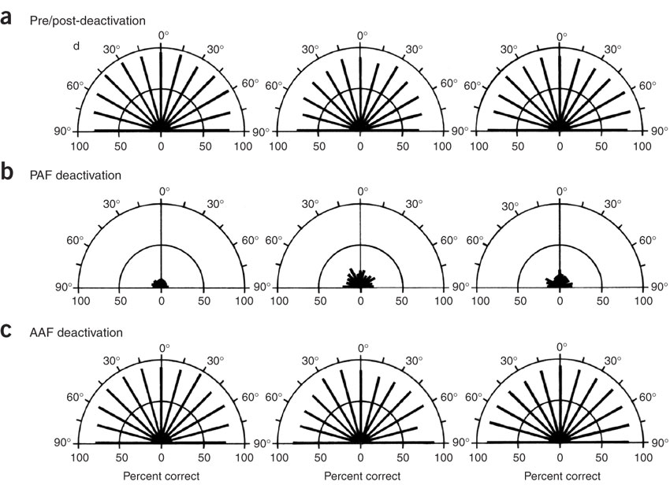
Dissociation of What and Where Processing in Auditory Cortex
Lomber & Malhotra
2008, Nature Neurosci

Slide 9
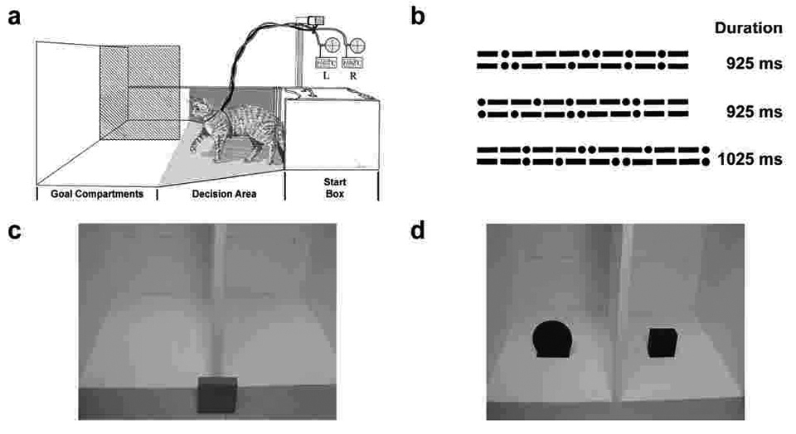
Pattern Discrimination Behavior

Slide 10
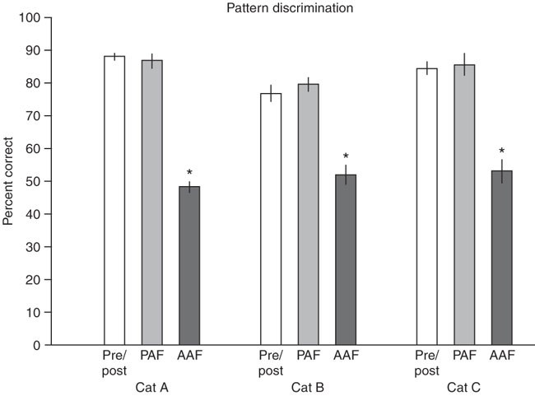
Behavioral Response to Pattern Discrimination

Slide 11
What and Where in Auditory Cortex
Subdivisions used on sound localization
  Primary – A1 and PAF
  Non-primary – AE sulcus
Subdivisions used for pattern discrimination
  AAF
How does this come about?

Slide 12
Auditory Pathways
Auditory
Cortex
CORTEX
GLUT
GABA
GLY
Medial Geniculate Body
MGB
Inferior
Colliculus
IC
DLL
DLL
COCHLEA
VLL
VLL
DCN
VCN
SOC

Slide 13
Questions about the Inferior Colliculus
What are the types of neurons?
How are the synapses organized?
What are their inputs?
What neural circuits do they make?

Slide 14
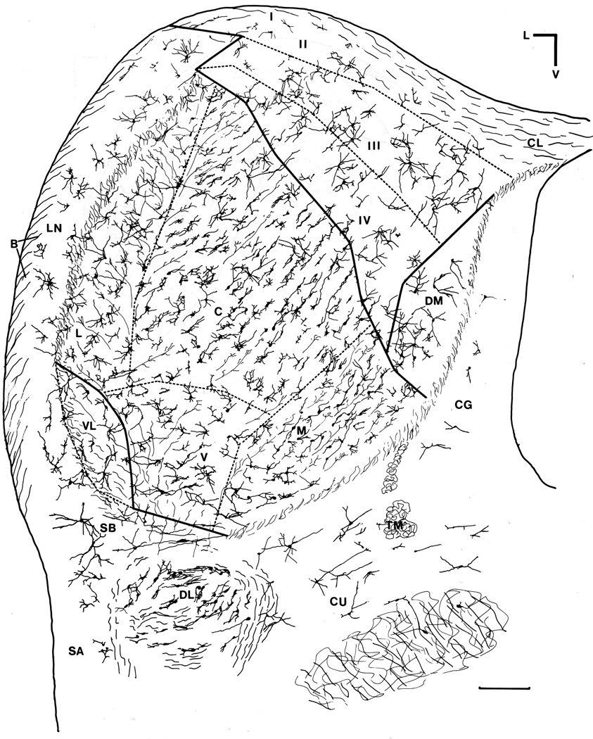
Neurons in the Inferior Colliculus
DC
LC
CN
Divided into parts with different cellular organization
CN=central nucleus has layers of cells

Slide 15
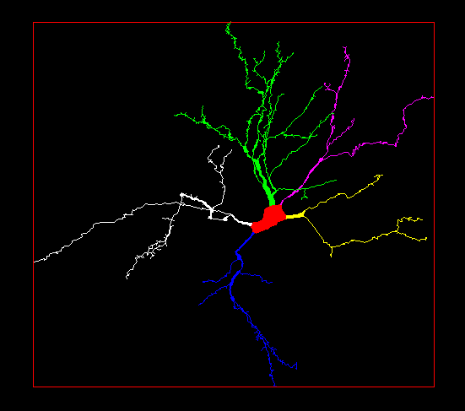
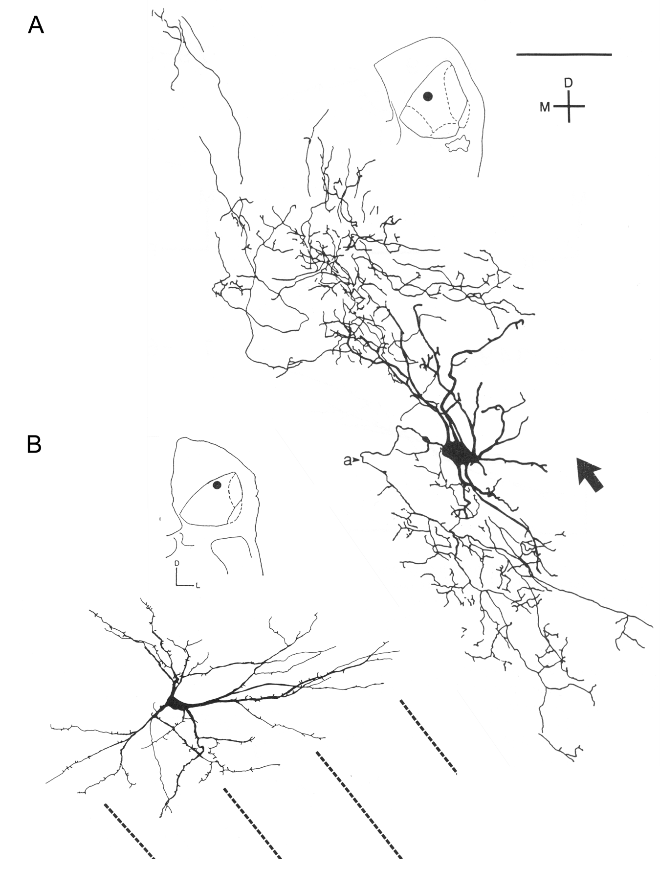
Highly oriented disc- shaped neurons
Disc
Stellate

Slide 16
Cell types based on membrane properties
Rebound-Regular
Ca⁺⁺ rebound & Delayed rectifier
Rebound-Adapting
Ca⁺⁺ rebound & Apamin-sensitive Ca⁺⁺ activated sK
Rebound-Transient
Ca⁺⁺ rebound CTX-sensitive Ca⁺⁺ act. BK
Sustained-Regular, Delayed rectifier K
Onset, Low threshold and Kv 3.1 type high threshold
Buildup-pauser, Transient A-type K+current

Slide 17
Questions about the Inferior Colliculus
What are the types of neurons?
  Flat dendrites in layers
  Different intrinsic properties
How are the synapses organized?
What are their inputs?
What neural circuits do they make?

Slide 18
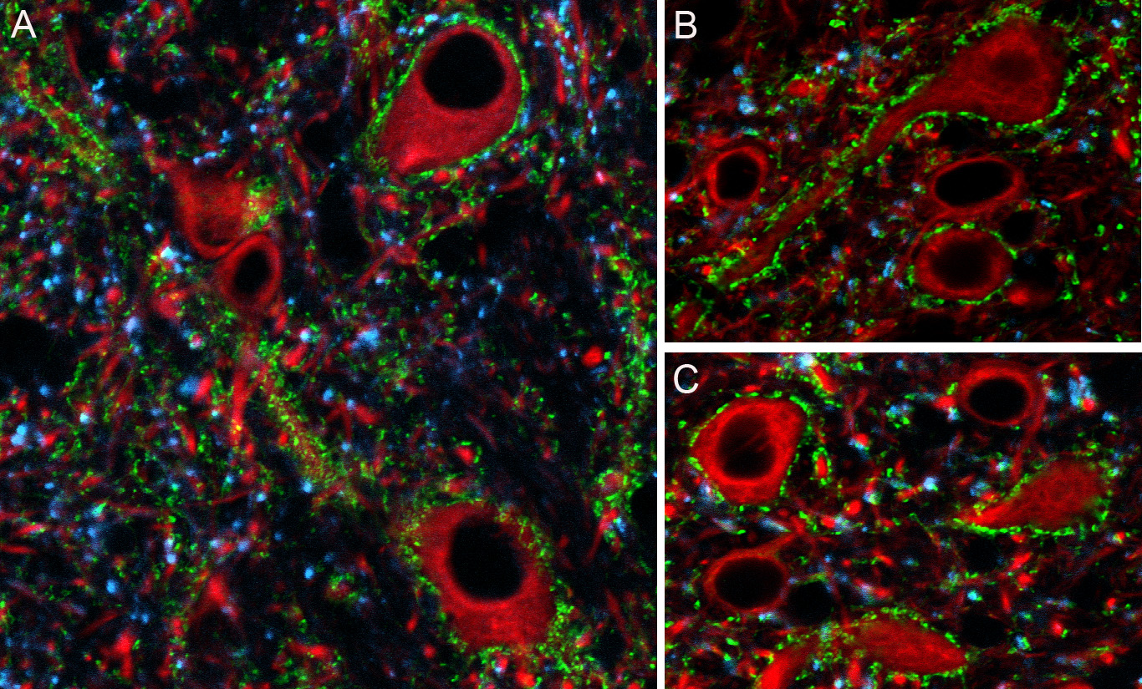
VGLUT marks glutamate synapses
MAP2
VGLUT2
VGLUT1
Altschuler et al 2008

Slide 19
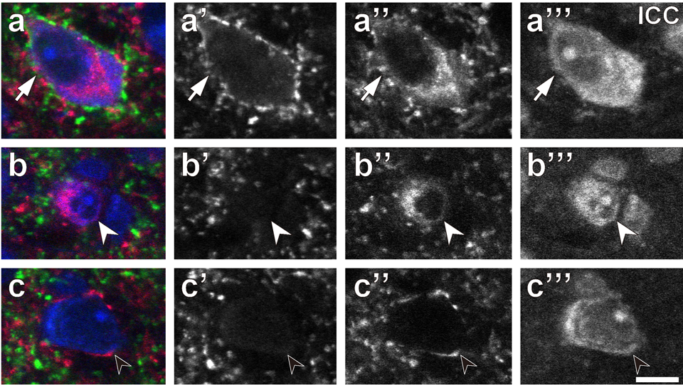
Only some GABAergic neurons have VGLUT2 axosomatics - ICC
VGLUT2-glutamate
GAD67-GABA
Nissl

Slide 20
Questions about the Inferior Colliculus
What are the types of neurons?
  Flat dendrites in layers
  Different intrinsic properties
How are the synapses organized?
  Large GABAergic neurons have special excitatory synapses on the cell body and proximal dendrites
What are their inputs?
What neural circuits do they make?

Slide 21
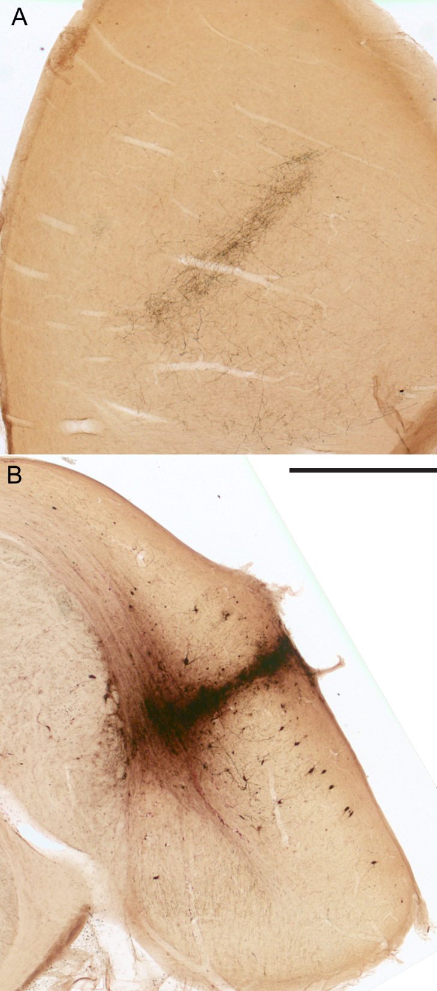
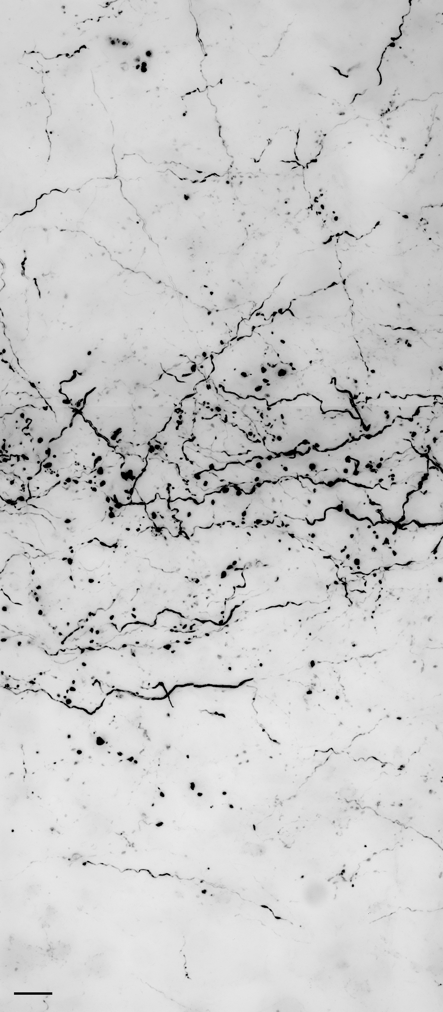
Laminar axons in IC from DCN
Cat
Axons terminate in narrow layer
Boutons indicate synapses from major inputs to IC

Slide 22
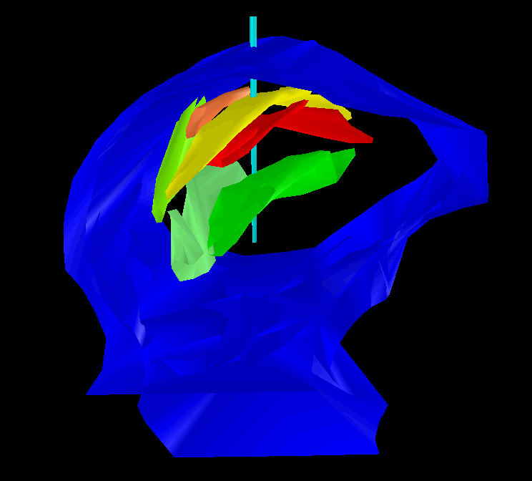
Axonal Layers In Rat
Anatomic laminae 150 µm thick
Insert electrode
Record neuronal activity
Penetrate dorsal to ventral

Slide 23
Place Principle: Frequency= Place
COCHLEA
COCHLEAR
NUCLEUS
INFERIOR
COLLICULUS
APEX
1.75K
3.5K
7K
14K
BASE
28K

Slide 24
Frequency Coding In The Inferior Colliculus
Laminar structure
  Presynaptic layers of axons
  Postsynaptic highly oriented dendrites
  Substrate for frequency coding?

Slide 25
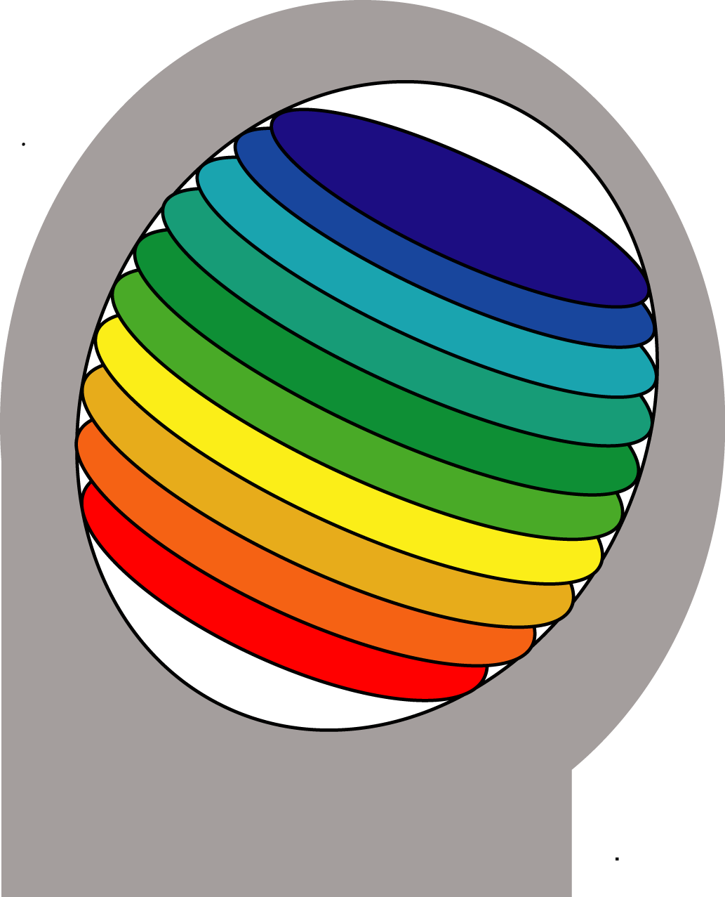
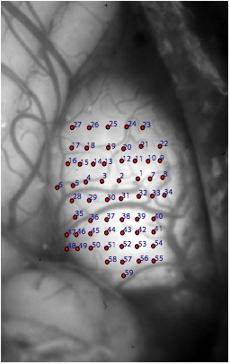
Laminar Frequency Organization
IC
CTX
Dorsal
Medial
Medial
Lateral
Caudal
Rostral
Cerebellum
Ventral
Francisco Campos – UCONN PhD thesis with BME Professor Monty Escabi
Lateral
Notes:
WITHIN LAMINA
Electrods – orthogonal to lamina
Birds Eye View!!!!!!!!!!!!

Slide 26
Frequency and spectrotemporal responses at different depths with multichannel probes
Intensity dB
L H
Latency
L H
Dorsal
Medial
Lateral
L H Frequency
L H Frequency
Ventral
Francisco Campos – UCONN PhD thesis with BME Professor Monty Escabi
Notes:
WITHIN LAMINA
Electrods – orthogonal to lamina
Birds Eye View!!!!!!!!!!!!

Slide 27
Questions about the Inferior Colliculus
What are the types of neurons?
  Flat dendrites in layers
  Different intrinsic properties
How are the synapses organized?
  Large GABAergic neurons have special excitatory synapses on the cell body and proximal dendrites
What are their inputs?
  Axons make layers
What neural circuits do they make?

Slide 28
Inputs to IC–Segregation of Function
INFERIOR
COLLICULUS
GABA
Binaural-GABA
DLL
Binaural
VLL
Monaural
GLUT
GLY
DCN
Monaural-GLUT
VCN
GLUT
LSO
MSO
MSO
LSO
CONTRA
Binaural
Binaural
IPSI

Slide 29
Synaptic domain hypothesis
Inputs make functional zones
Each zone has unique combination of inputs
Main domains from excitatory inputs:
  Binaural Low-frequency ITD
  Binaural Complex ILD & ITD
  Monaural
Separate “What” and “Where”?

Slide 30
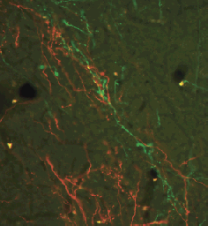
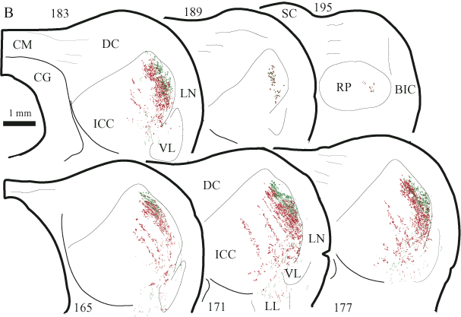
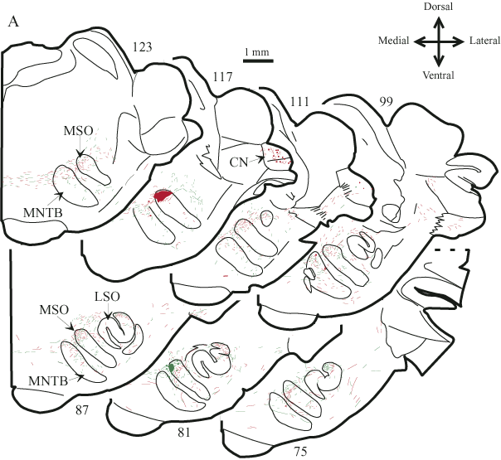

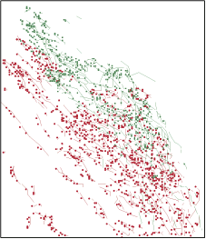
MSO inputs
Gaps in the laminae

Slide 31
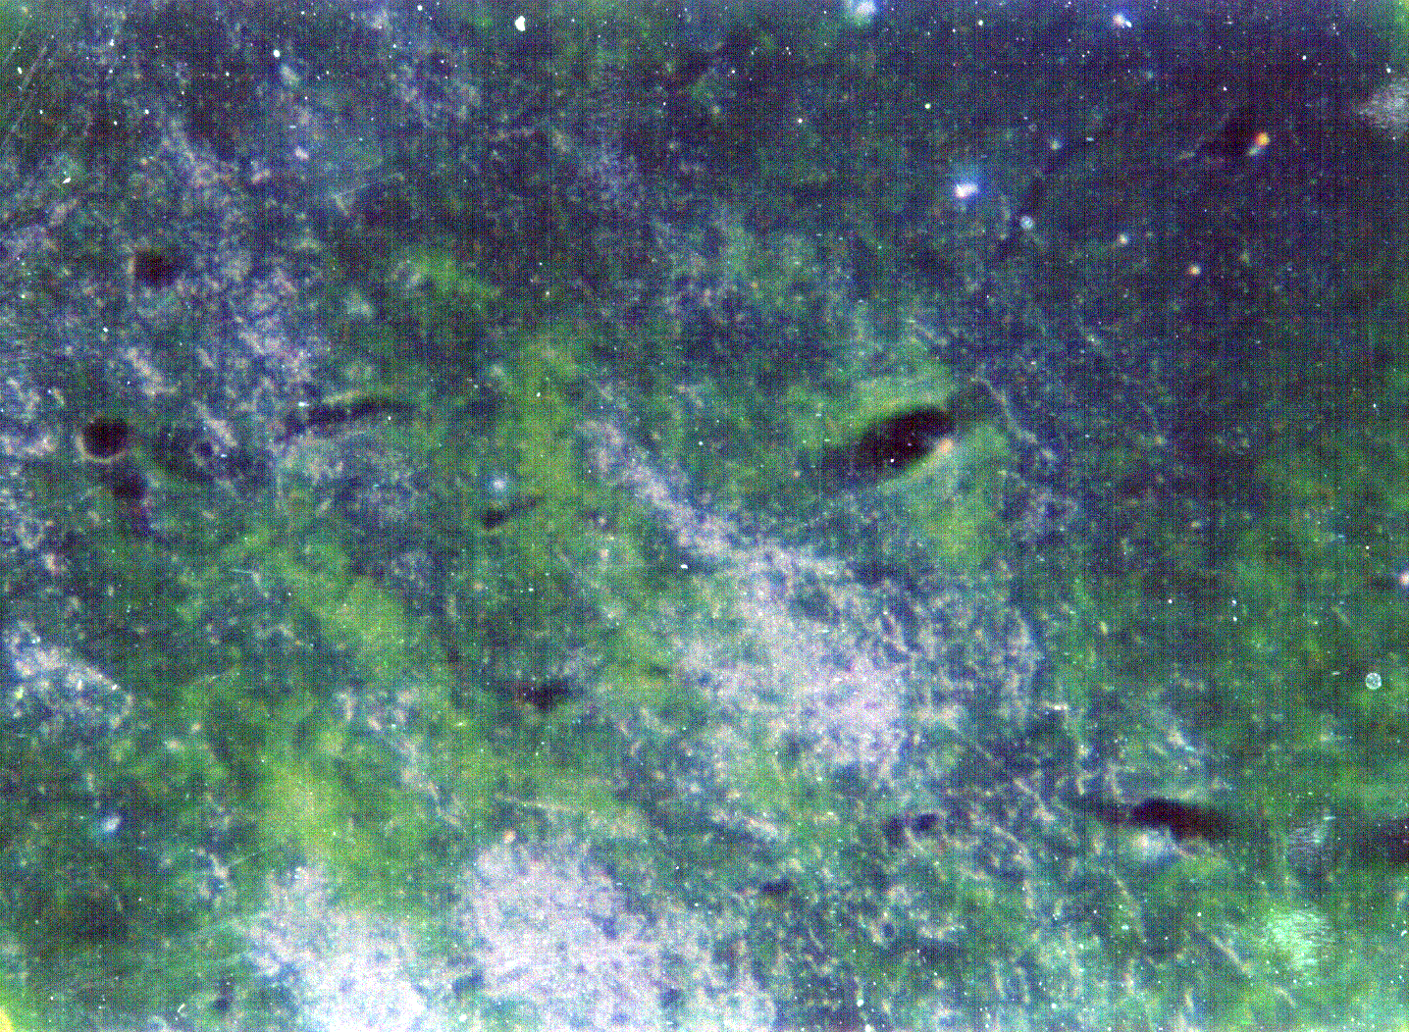
Shneiderman and Henkel ‘87
Bilateral inputs from LSO do not overlap

Slide 32
MSO vs LSO inputs to IC
The LSO also sends an inhibitory projection to the ipsilateral IC
-
+
-
-
+
GLU
ITD pathway
GLU
ILD pathway
GLY
GLY
LSO
MSO
MSO
LSO

Slide 33
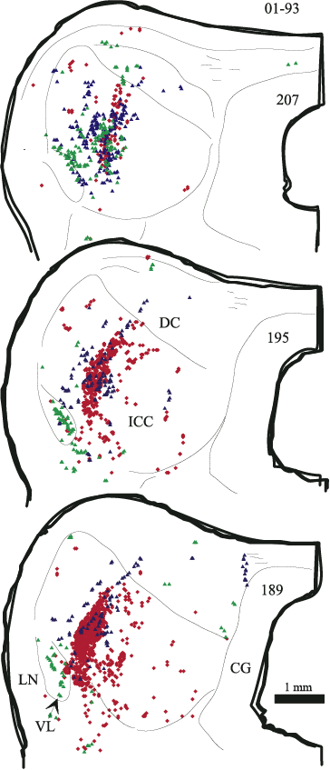
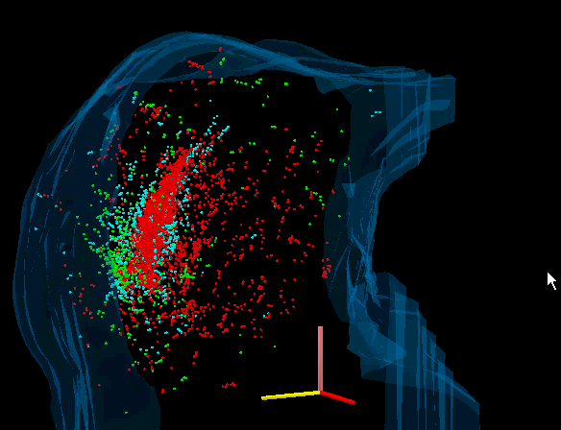
Ipsi MSO & contra LSO inputs remain separate
Inhibitory ipsi LSO converges with ipsi MSO

Slide 34
Binaural code
?
?
?
?
Monaural
Binaural
Monaural
Binaural
Do the inputs determine the response properties of zones within the IC?
William C. Loftus and Deborah C. Bishop, A Strict Segregation of Brainstem Inputs Underlies Separate Monaural and Binaural Pathways in the Cat Inferior Colliculus (IC)

Slide 35
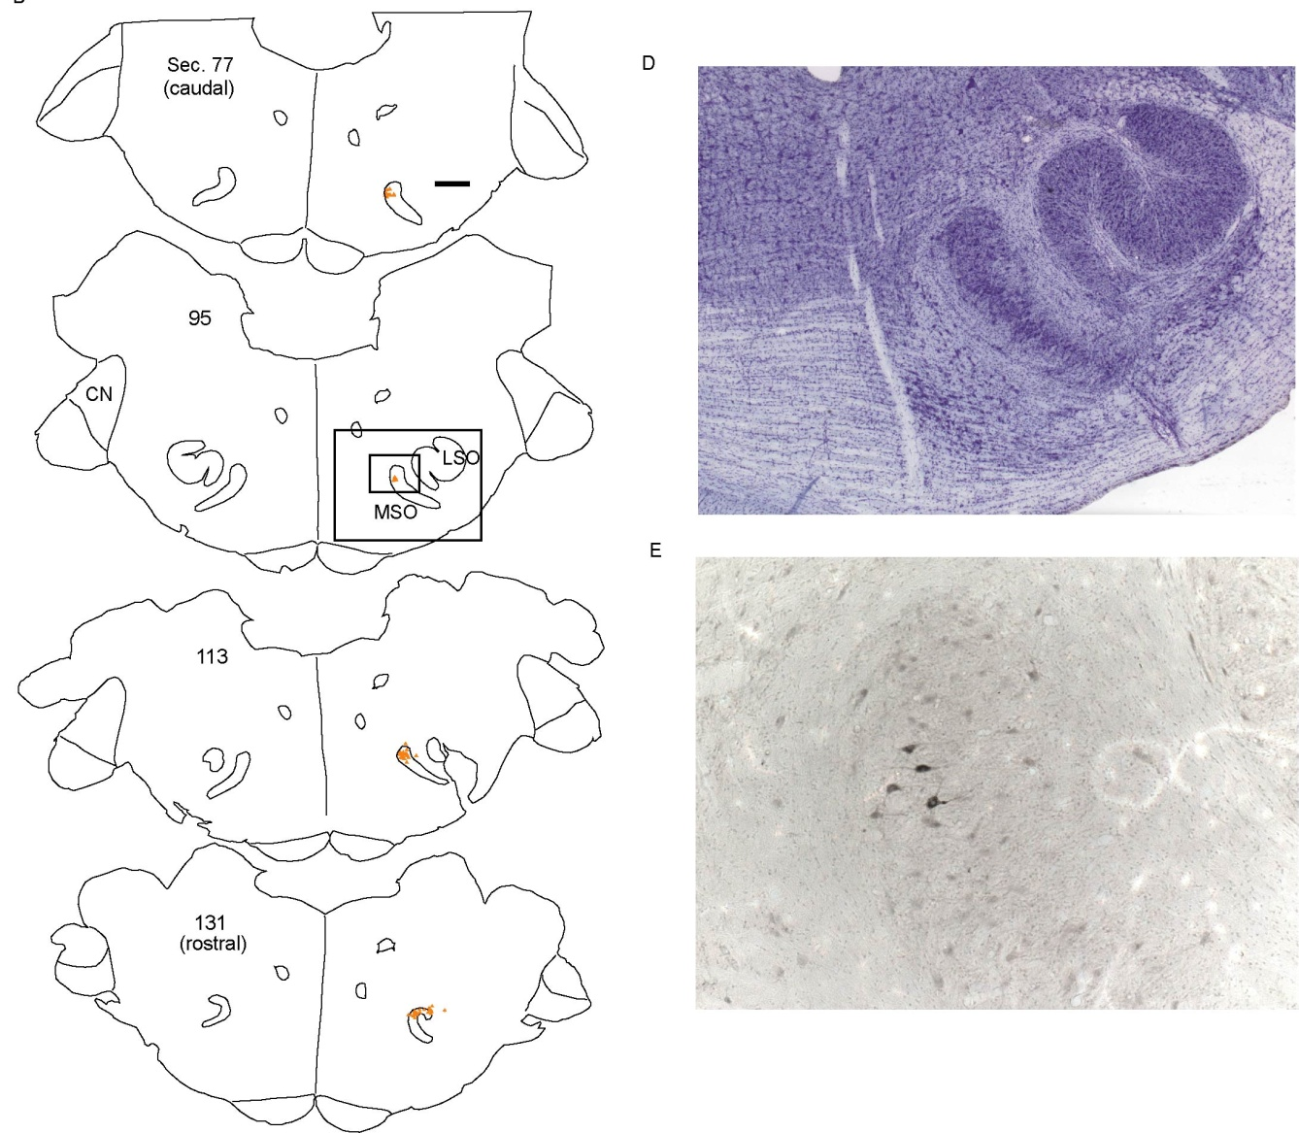

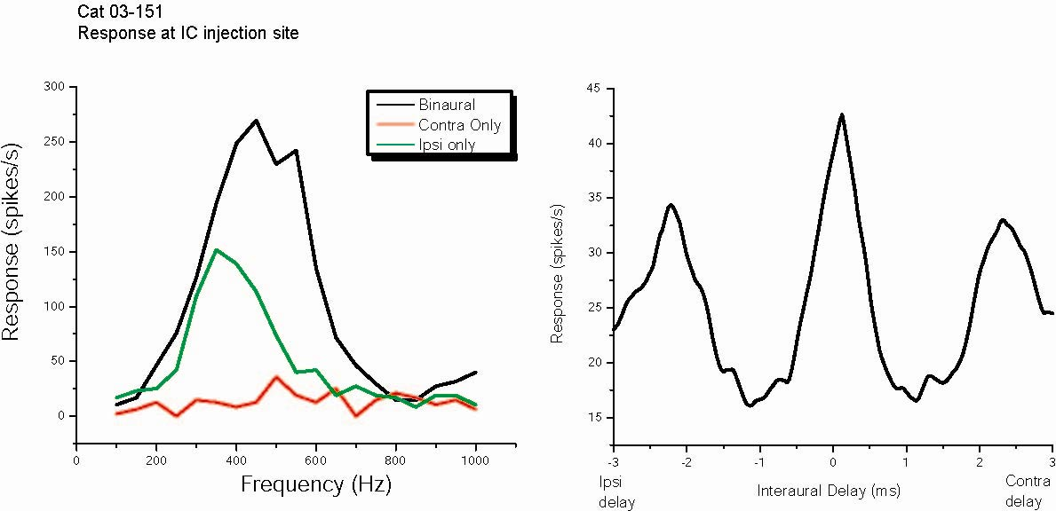
ITD sensitive zone: MSO input
MSO
Notes:
Here, is the response of one such recording site in the IC.
The graph on the left shows the response to tones of various frequency played to the ipsilateral ear alone, the contralateral ear alone, and to both ears simultaneoulsy. Notice that although the Ipsilateral ear stimulsulus does not eliciti a response, there is a large facilitation, when both ear inputs are stimulated, suggestive of binarual input.
To further characterize this recording site, we used the binaural beat stimulus to determine if it was tuned to interaural time differences. I won’t get into the specifics of the binaural beat stimulus, but suffice it to say that it involves playing two tones of slightly different frequency to both ears. This frequency differences creates a dynamic difference in phase between the two ears and, from the response to this, we can determine ITD tuning in a way that is roughly equivalent to testing with static ITD stimuli, but faster.
The graph n the right shows that this

Slide 36
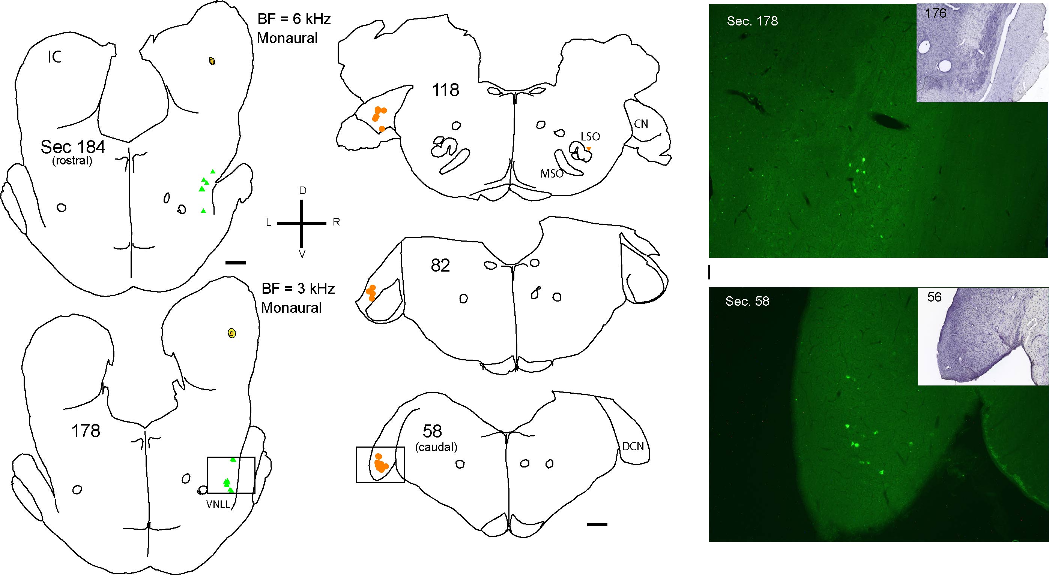
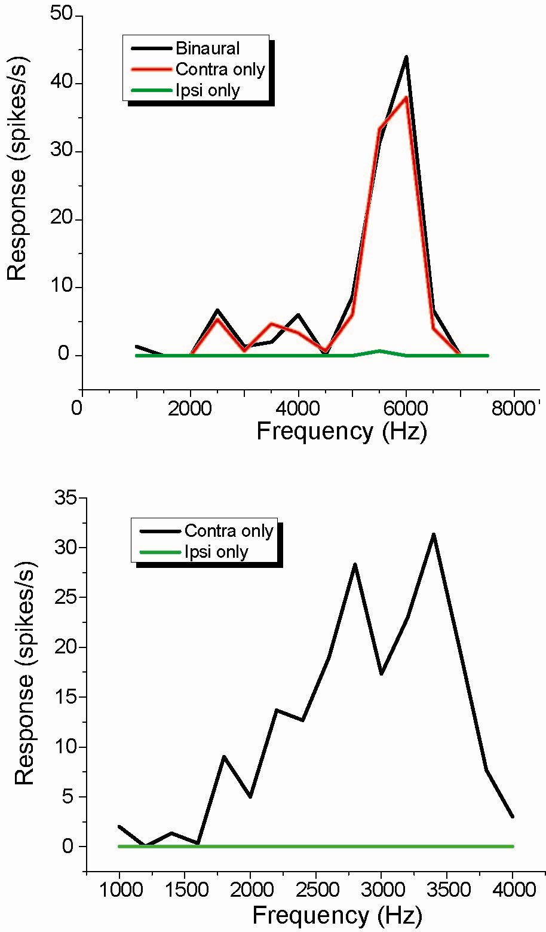
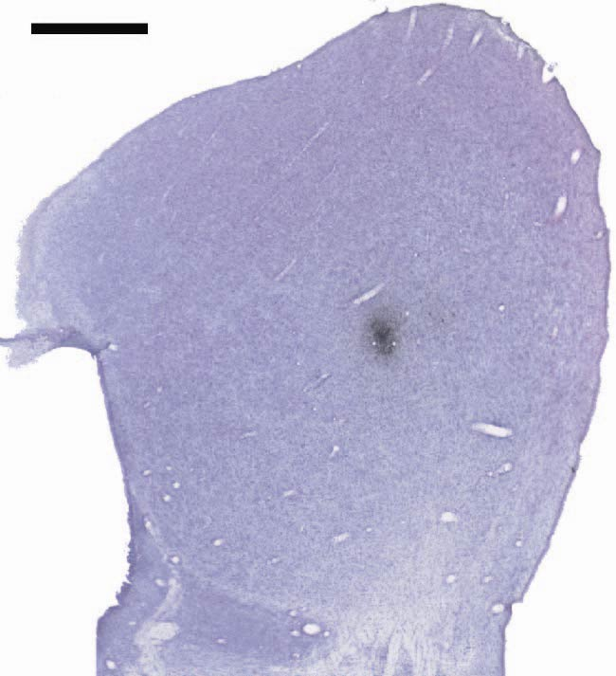
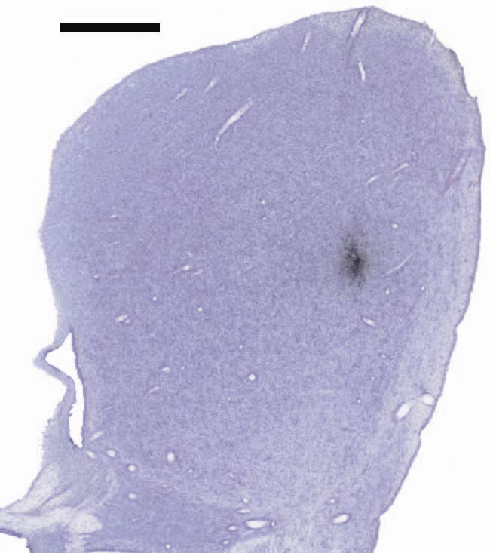
Monaural zone: CN and VNLL

Slide 37
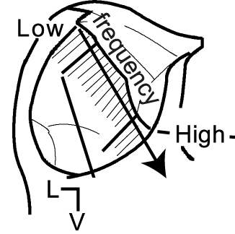

What neural circuits do they make?
Laminated inputs and neurons form functional zones (synaptic domains)
Each zone has a unique combination of inputs
Inputs:
WHERE:
Red MSO binaural
Green LSOc & MSO – binaural
WHAT:
Blue cochlear nucleus --monaural

Slide 38
Auditory Pathways
CORTEX
GLUT
GABA
GLY
Medial Geniculate Body
MGB
IC
DLL
DLL
COCHLEA
VLL
VLL
DCN
VCN
SOC

Slide 39
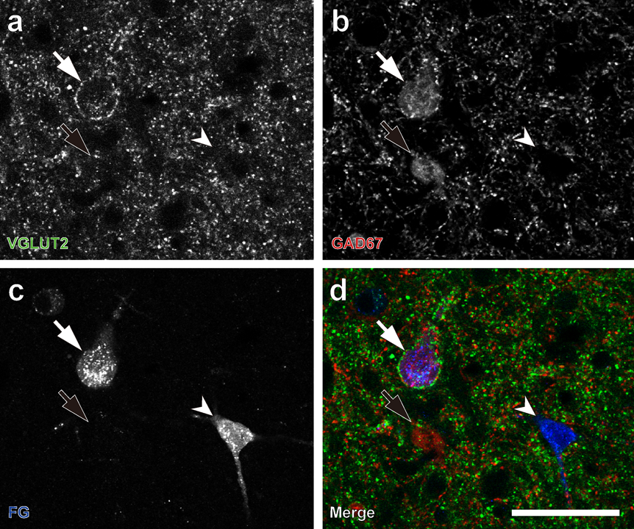
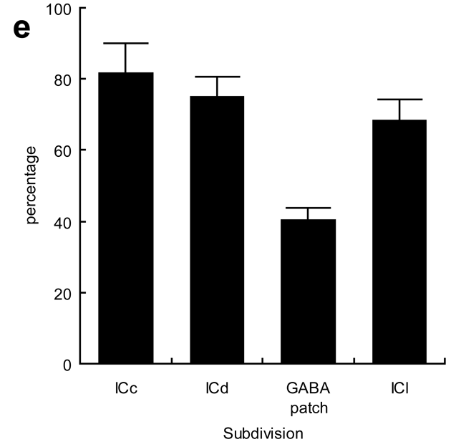
80% of GABAergic Projections to MGB have VGLUT2 axosomatics
1404 cells from 5 rats

Slide 40
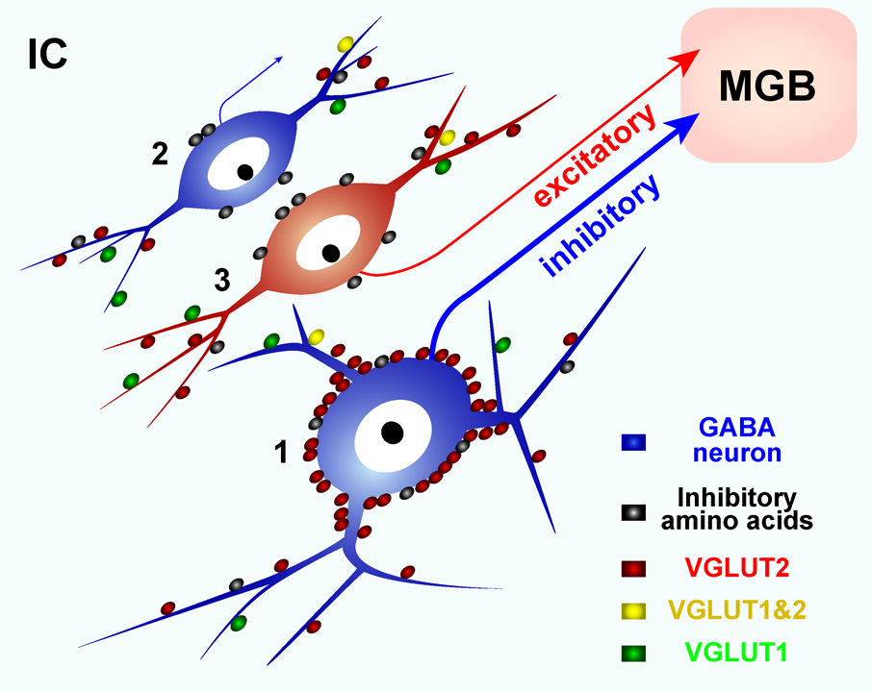
What neural circuits are made?
Most neurons to MGB use Glutamate
Two types of GABA neurons
  Large GABA cell goes to MGB
  Small GABA cell?
Parallel excitation and inhibition

Slide 41
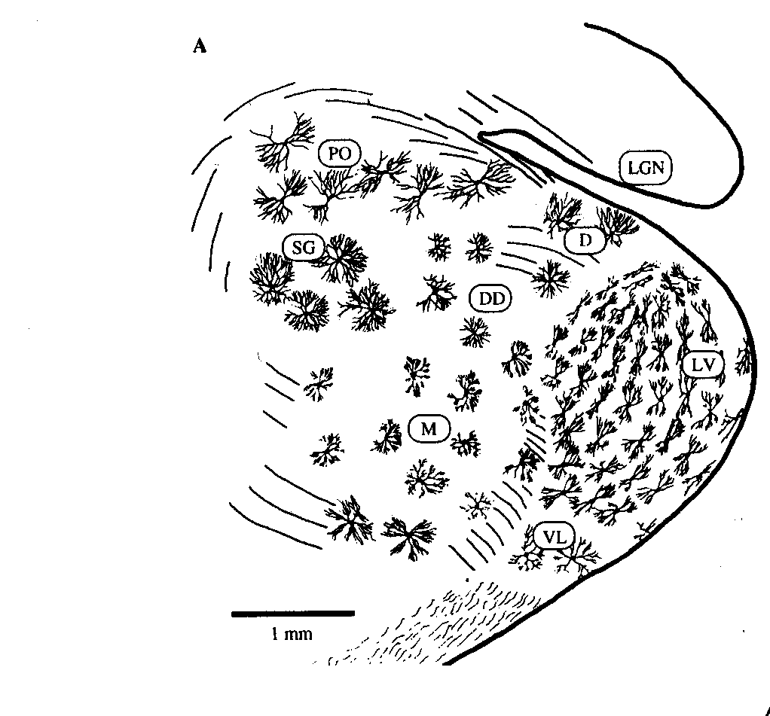
Medial Geniculate Body
Subdivisions
  ventral (LV)
    tonotopic, laminar to Primary Cortex
  Medial (M) & Dorsal (DD, D, SG, PO)
    non-tonotopic to non-primary cortex
Neuron types
  Disc-shaped
  Stellate
Inputs
  IC: Excitatory and GABAergic
  Midbrain tegmentum and superior colliculus
  Auditory cortex
Output – Auditory Cortex
Morest, 1964

Slide 42
Auditory Pathways
Auditory
Cortex
CORTEX
GLUT
GABA
GLY
MGB
IC
DLL
DLL
COCHLEA
VLL
VLL
DCN
VCN
SOC

Slide 43
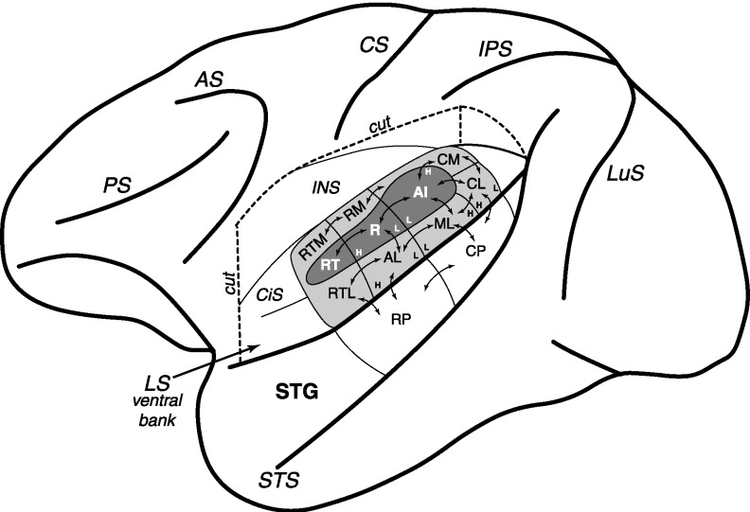
Primate Auditory Cortex
Hackett et al. 2001
‘Core’ and ‘Belt’ areas of macaque auditory cortex

Slide 44
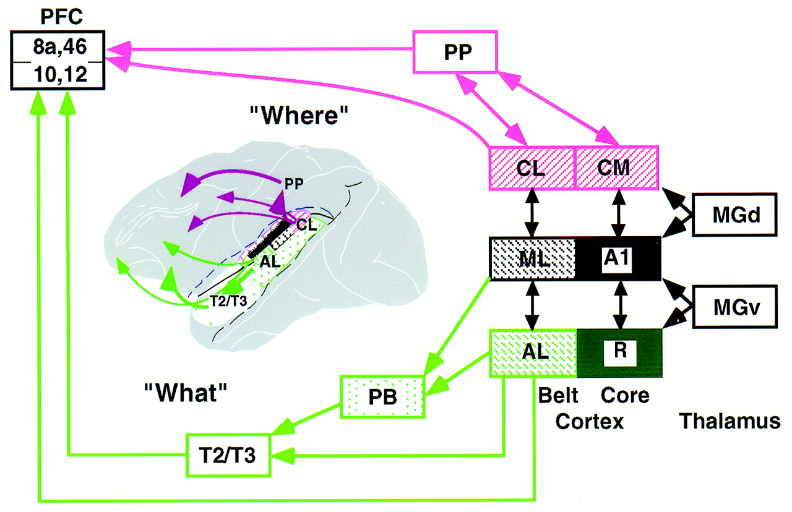
What and Where Streams
Rauschecker & Tian, 2000

