Slide 1
MEDS371 Systems Neuroscience
Neurochemical Modulatory Systems

Slide 2
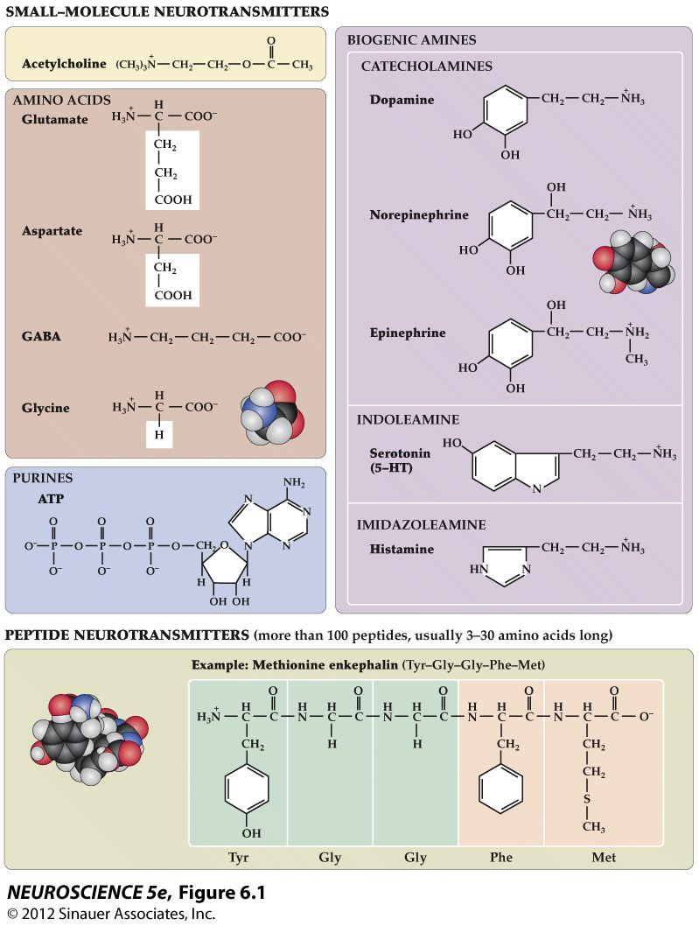

Slide 3
Organization of Neurotransmitter Systems in the Brain
Amino Acid transmitters (Glu, GABA, Gly)
Local circuit neurons - intrinsic processing
Projection systems connecting related areas (e.g. thalamo-cortical, cortical-cortical)
Acetylcholine
Local circuit neurons - striatum
Modulatory projections
basal forebrain ACh neurons → hippocampus/cortex

Slide 4
Monoamines
Catecholamines
Dopamine
Norepinephrine (noradrenaline)
Epinephrine (adrenaline)
Indoleamine
Serotonin
Common features shared by these systems:
Small number of neurons
Cell bodies contained in discrete brainstem nuclei
Widespread projections - single cell makes up to 100,000 synapses
Possible paracrine release of transmitter
Postsynaptic effects mediated by G-protein coupled receptors
These systems all strongly related to neuropsychiatric disease -
potential underlying cause as well as the target of psychotherapeutic drugs

Slide 5
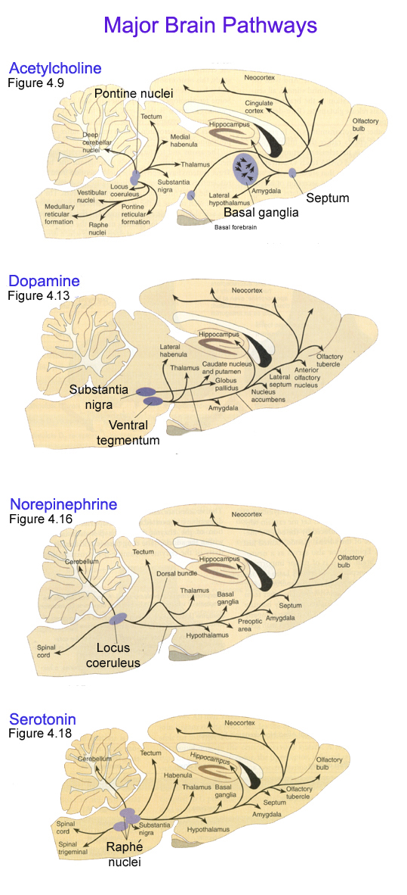
Physiological/Pathophysiological Roles of Monoamines
Acetylcholine - laterodorsal and peduncular pontine nuclei, septum
- attention, learning and memory, arousal
- Alzheimer’s disease
Dopamine - ventral tegmental area, substantia nigra pars compacta
- motor behavior, reward, reinforcement, cognition
- Parkinson’s Disease, Schizophrenia, Addiction
Norepinephrine - locus coeruleus
- sleep & arousal, attention, response to stress
- Depression, Anxiety disorders
Serotonin – brainstem raphe nuclei
- sleep & arousal, aggression, stereotyped motor behaviors
- Depression, Panic disorders, OCD

Slide 6
Serotonin

Slide 7
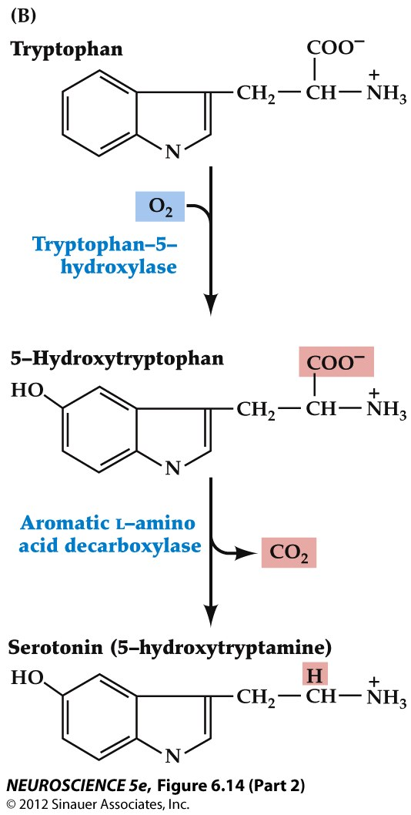
Figure 6.14 Synthesis of serotonin

Slide 8
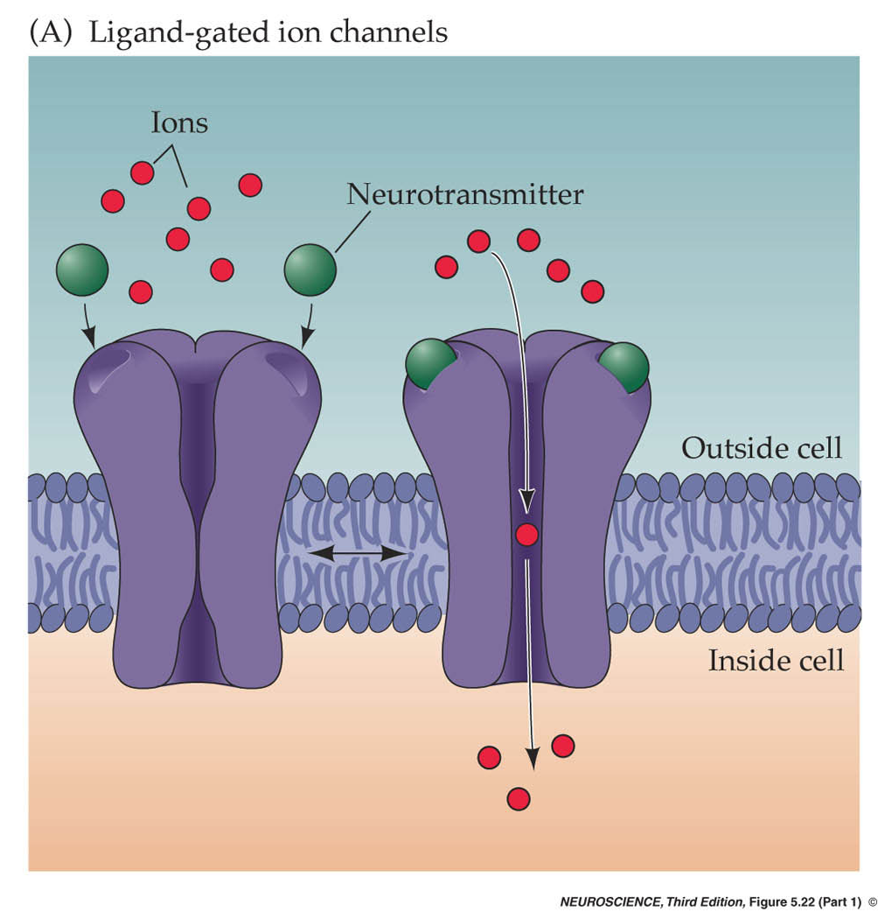
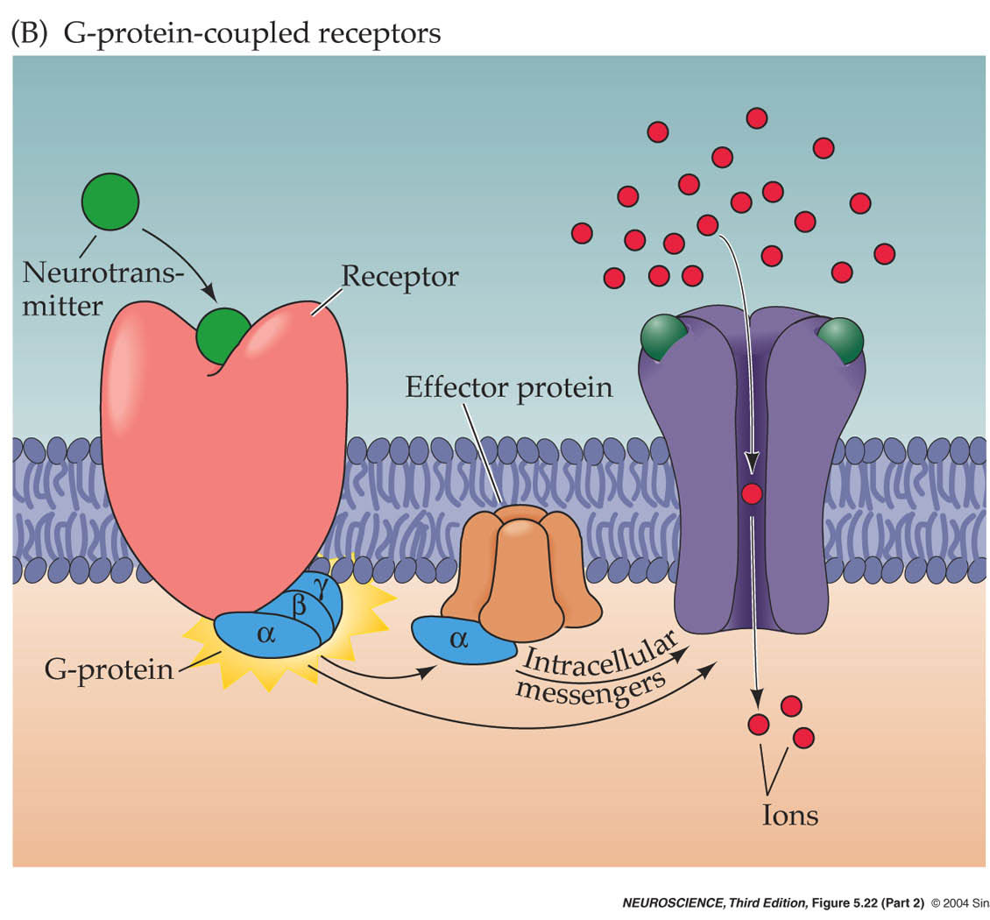
Neurotransmitter receptors
Ionotropic receptors
Metabotropic receptors

Slide 9
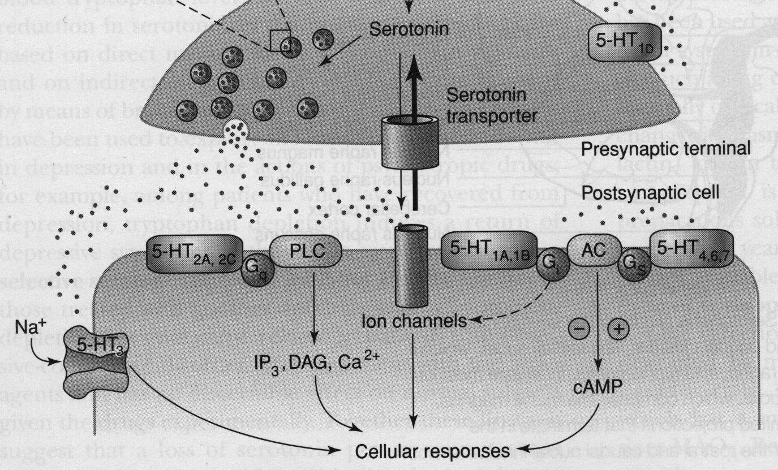
Serotonin Receptors
5-HT₁ - G_{i} -linked receptor; decreases AC and modulates Ca⁺⁺, K⁺ channels
both presynaptic (autoreceptor) and postsynaptic
5-HT₂ - G_{q} -linked receptor, stimulates phospholipase C
5-HT₃ - ionotropic, excitatory, related to nicotinic and GABA_{A} receptors
5-HT_{4, 6, 7} - G_{S} -linked receptor, stimulates AC

Slide 10
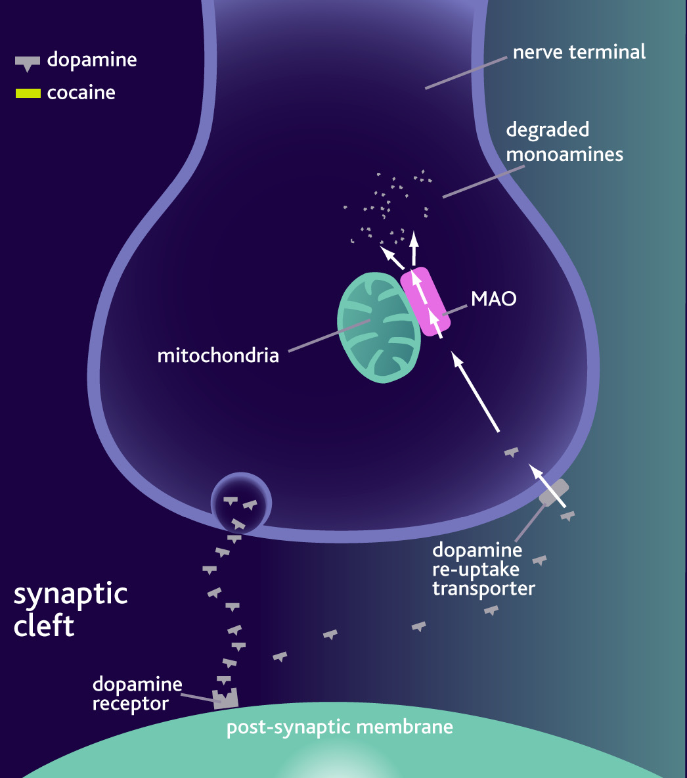
Degradation of monoamine transmitters
Serotonin
- Diffusion
- High-affinity re-uptake
- serotonin transporter
Enzymatic breakdown
- Monoamine oxidase (MAO)

Slide 11
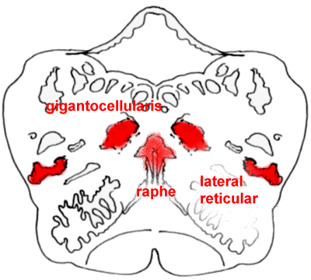
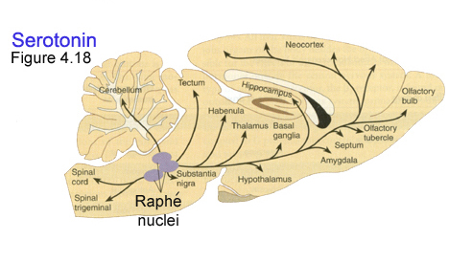
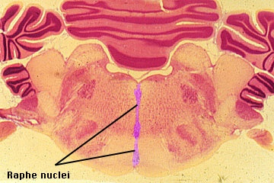

Slide 12
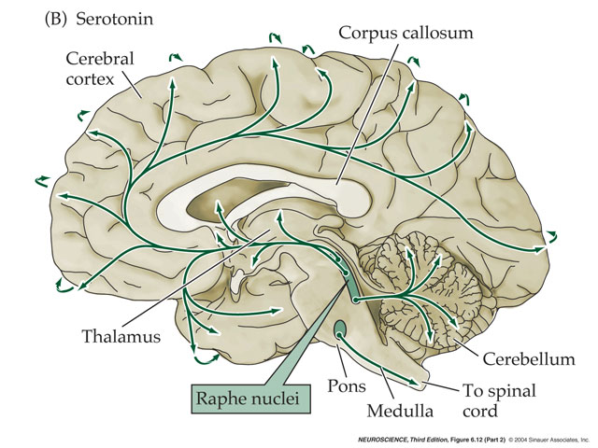
Serotonergic Pathways
Dorsal Raphe Nucleus - innervates neocortex, thalamus, striatum, substantia nigra
Median Raphe Nucleus - hippocampus, limbic structures
Caudal raphe groups (magnus, pallidus, obscurus) - medulla, spinal cord, cerebellum

Slide 13
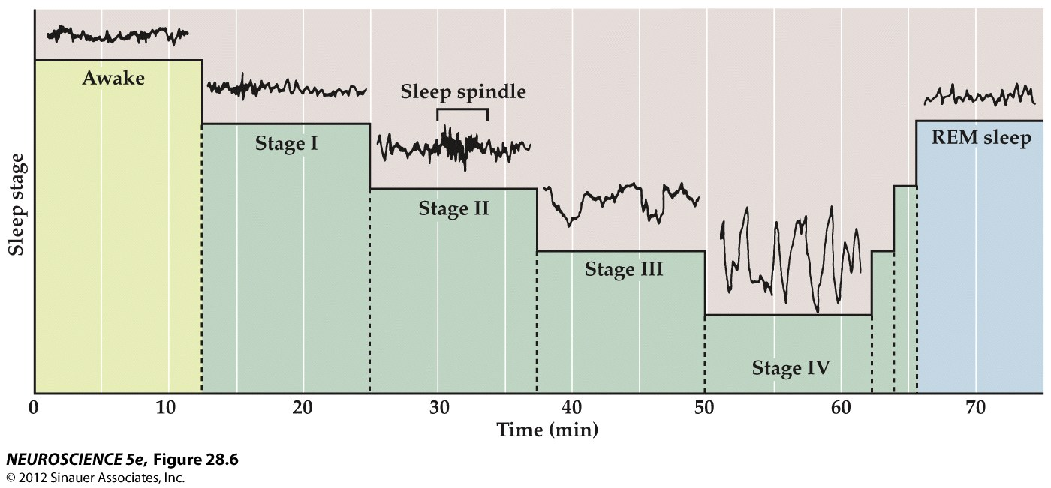

Slide 14
Example firing pattern of a single serotonin neuron

Slide 15
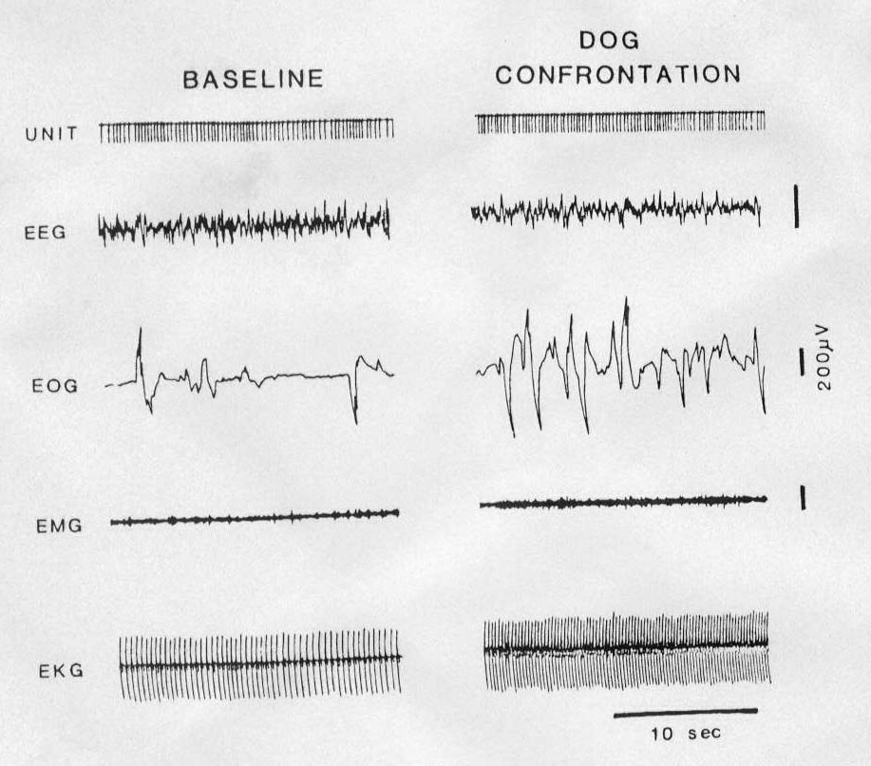
Serotonergic neurons are not specifically responsive to stress

Slide 16
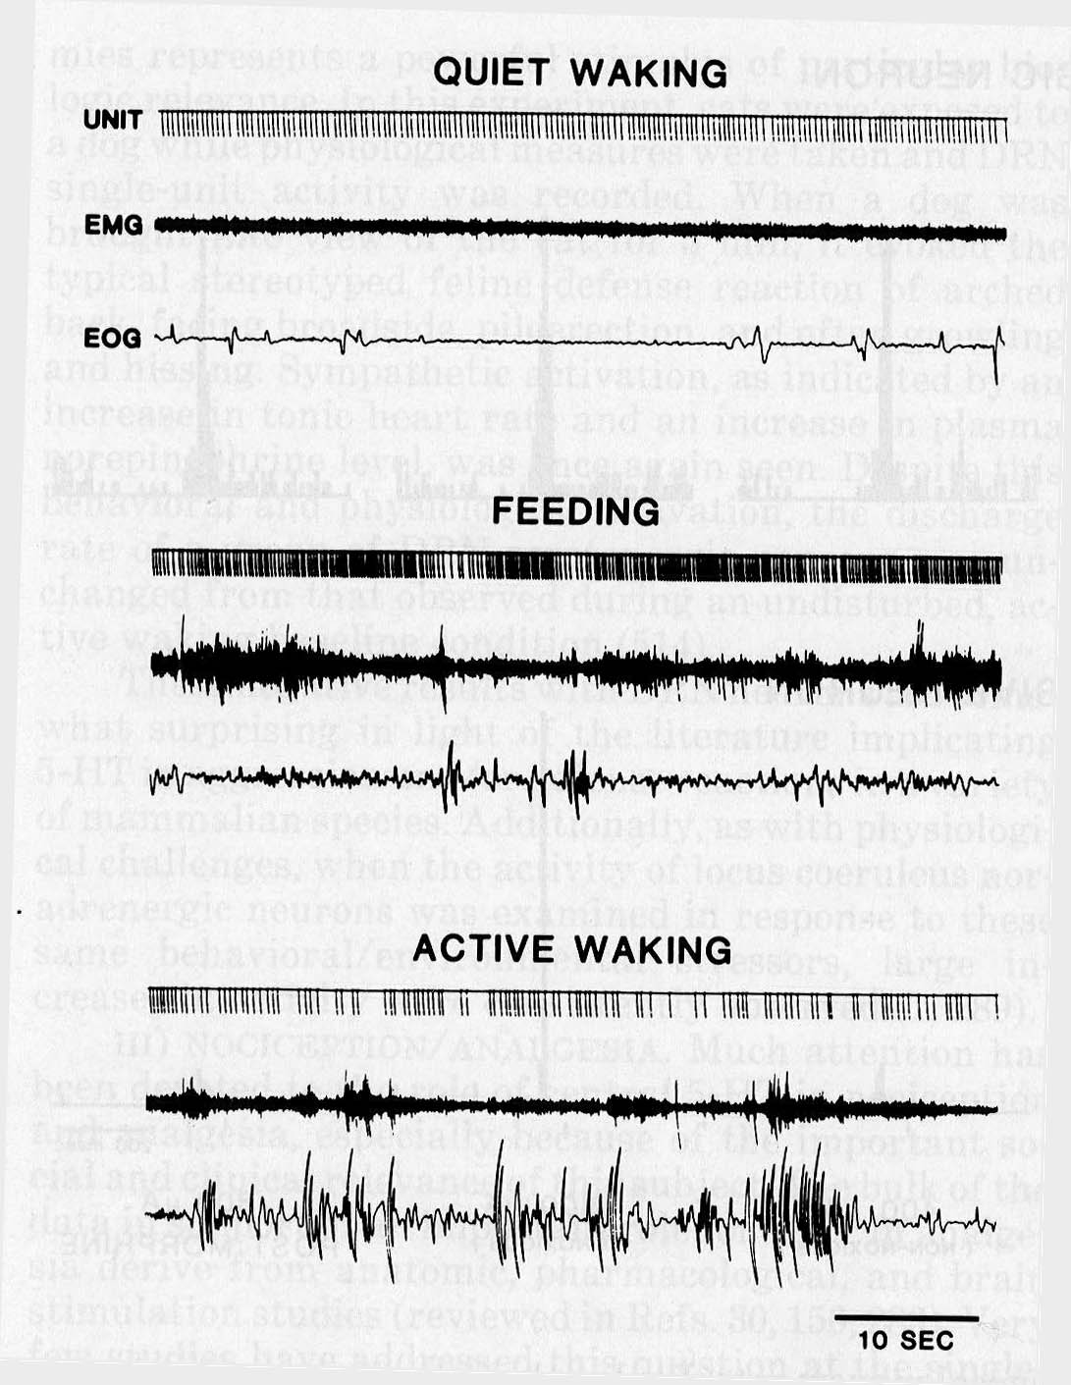
Serotonin neurons are activated during stereotyped motor behavior

Slide 17
Serotonin (5-HT) Disorders
Depression
OCD
Anxiety

Slide 18
Norepinephrine

Slide 19
Figure 6.10 The biosynthetic pathway for the catecholamine neurotransmitters

Slide 20
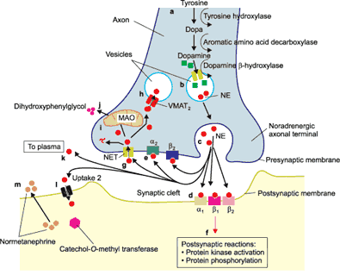
Catecholamines
Diffusion
Enzymatic breakdown
Monoamine oxidase (MAO) - intra, extra
Catechol-O-Methyl Transferase (COMT) - extra
High-affinity reuptake - plasma membrane transporters (NET)

Slide 21
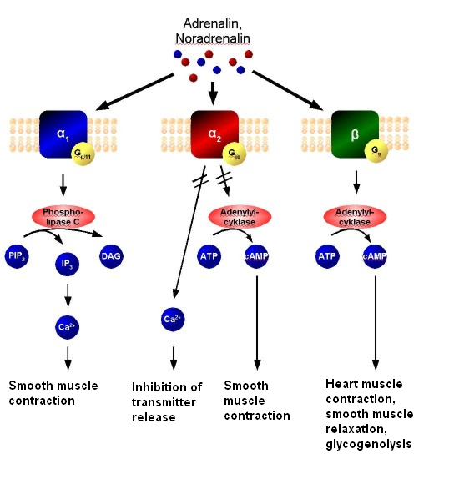

Slide 22
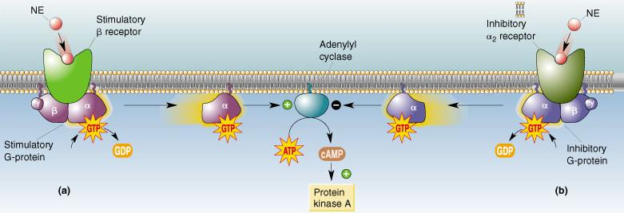
Norepinephrine Receptors (same receptors for epinephrine)
· alpha₁ - increases excitability - activates PLC, IP₃
- increase Ca⁺⁺, decrease K⁺ channel activity
· alpha₂ - decreases excitability - decrease cAMP, activates K⁺ channels
- autoreceptor
· beta - increases excitability via increases in AC

Slide 23
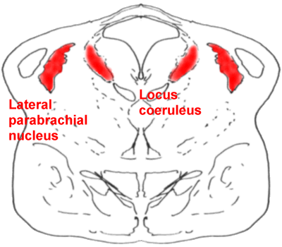
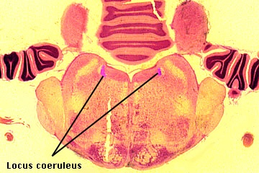

Slide 24
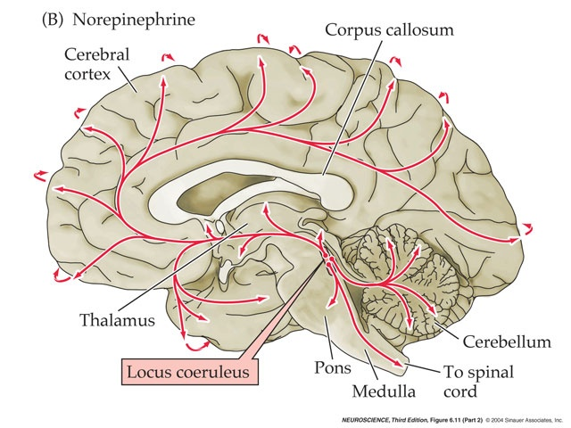
Noradrenergic Pathways

Slide 25
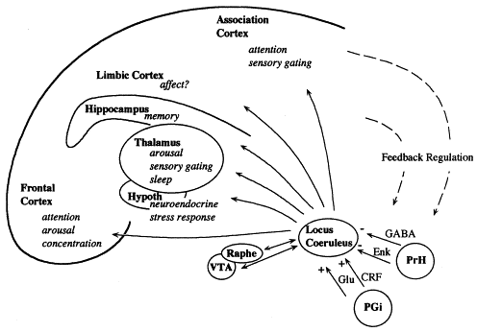
PGi: Nucleus paragigantocellularis
PrH: Perirhinal Cortex

Slide 26
Locus Coeruleus/Norepinephrine System
Very widespread projection system
LC is activated by stress and co-ordinates responses via projections to thalamus, cortex, hippocampus, amygdala, hypothalamus, autonomic brainstem centers, and the spinal cord
Sleep: LC activity predicts changes in sleep/wake cycle
Attention/Vigilance: LC activated by novel stimuli, and LC activates EEG

Slide 27
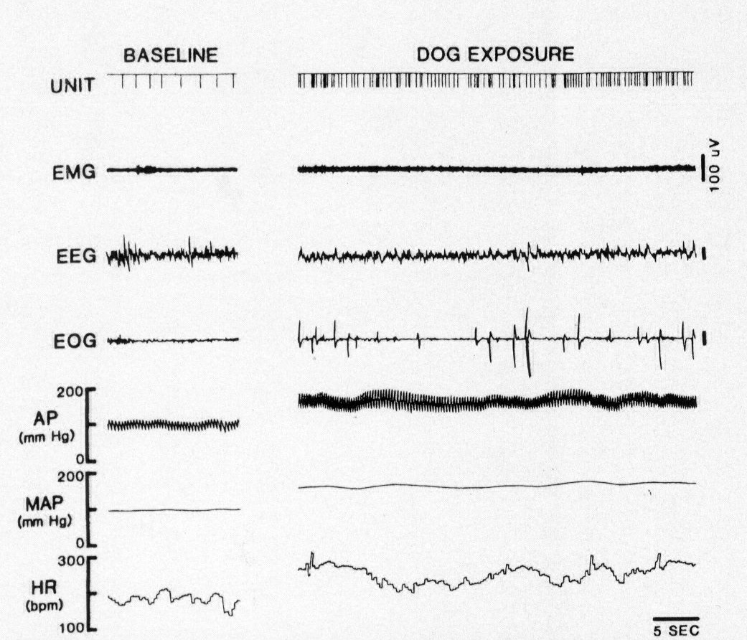
Noradrenergic neurons are activated during stress

Slide 28
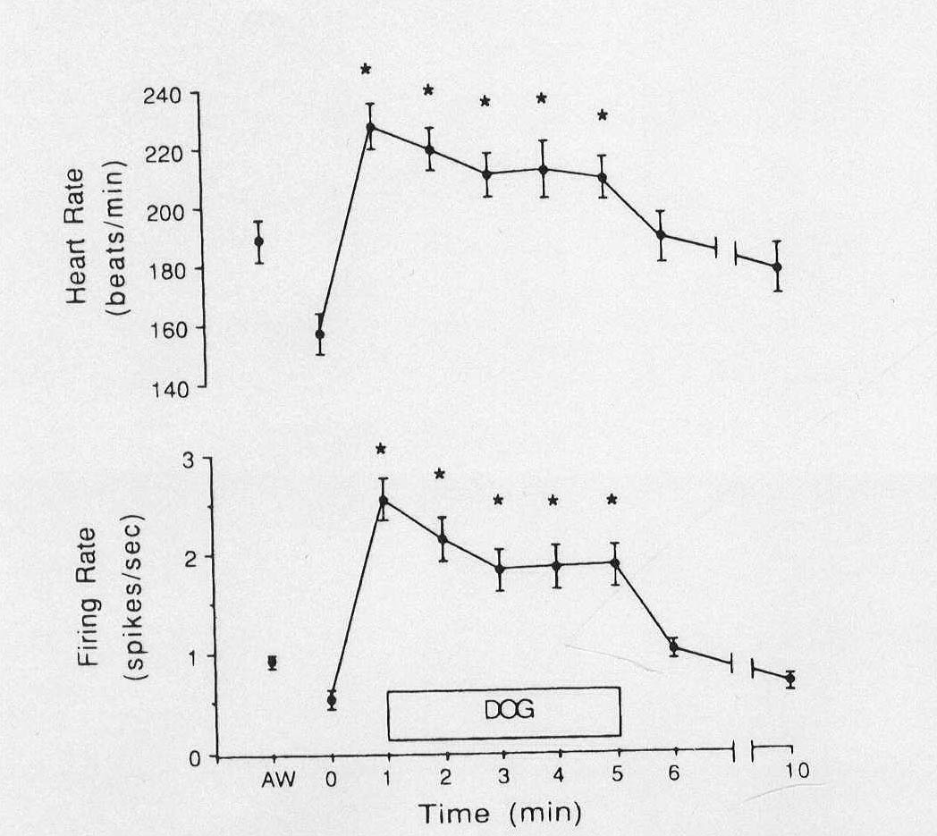
Activity of LC noradrenergic neurons parallels sympathetic activation

Slide 29
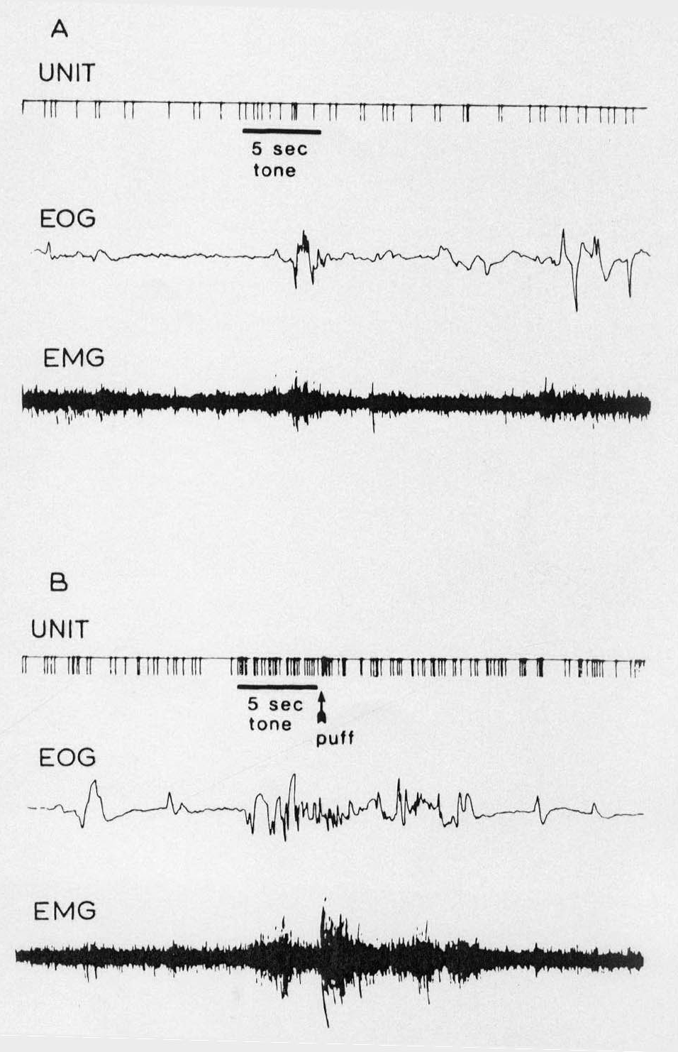
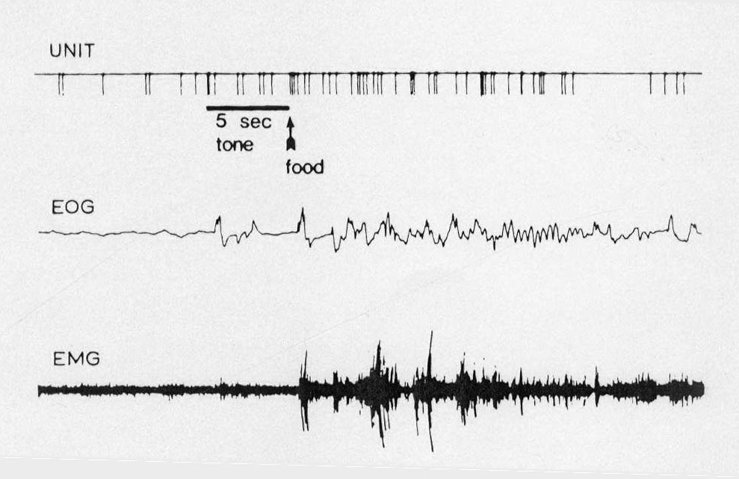
Noradrenergic neurons respond to “anxiety-like” conditions

Slide 30
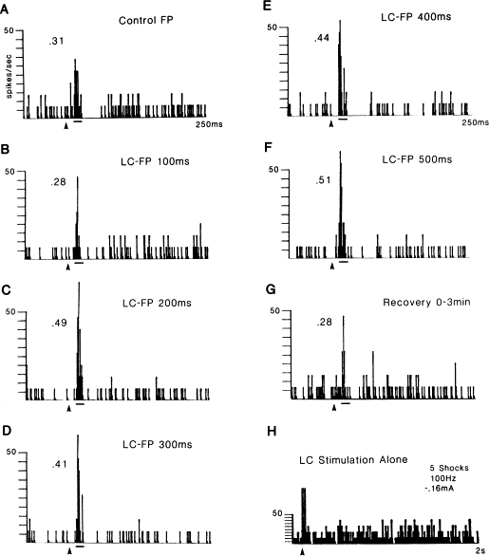
LC can influence the way in which cortical neurons respond to sensory stimuli.
Response of somatosensory
cortical neurons to contralateral
forepaw stimulation. LC was
stimulated at different times with
respect to forepaw stimulation.
(Waterhouse et al., Brain Research, 790: 33-44.)

Slide 31
Antidepressants
Tricyclics: Block re-uptake of NE and 5HT
MAO inhibitors: Inhibit enzymatic degradation of the monoamine by monoamine oxidase (MAO)
Selective 5-HT and NE re-uptake inhibitors: The popular SSRIs

Slide 32
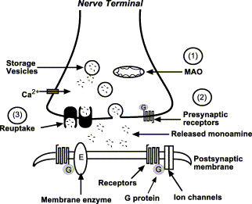
SSRIs and SNRIs:
Why antidepressants take so long to be effective
α2
- Antidepressants acutely increase NE and/or 5-HT
concentrations in synapse via reuptake blockade.
- Feedback inhibition via autoreceptors decreases firing rate and release probability. Signaling still depressed.
- With chronic treatment, tolerance develops to this effect – autoreceptor desensitization
- Continued reuptake block with normal firing/release enhances postsynaptic signaling
β receptor

Slide 33
Dopamine

Slide 34
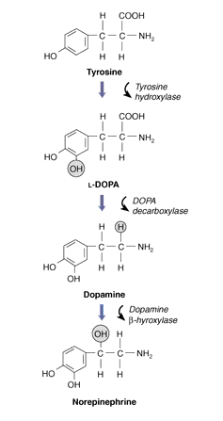

Slide 35
Enzymatic degradation
Disrupt Vesicular Storage
D₂ auto-receptor: Inhibitory
5-HT_{2A} receptor: Inhibits
DA release
D₁-like (D₁ and D₅) receptors: G_{S}-coupled, excitatory
D₂-like (D₂, D₃, D₄) receptors: G_{i}-coupled, inhibitory

Slide 36
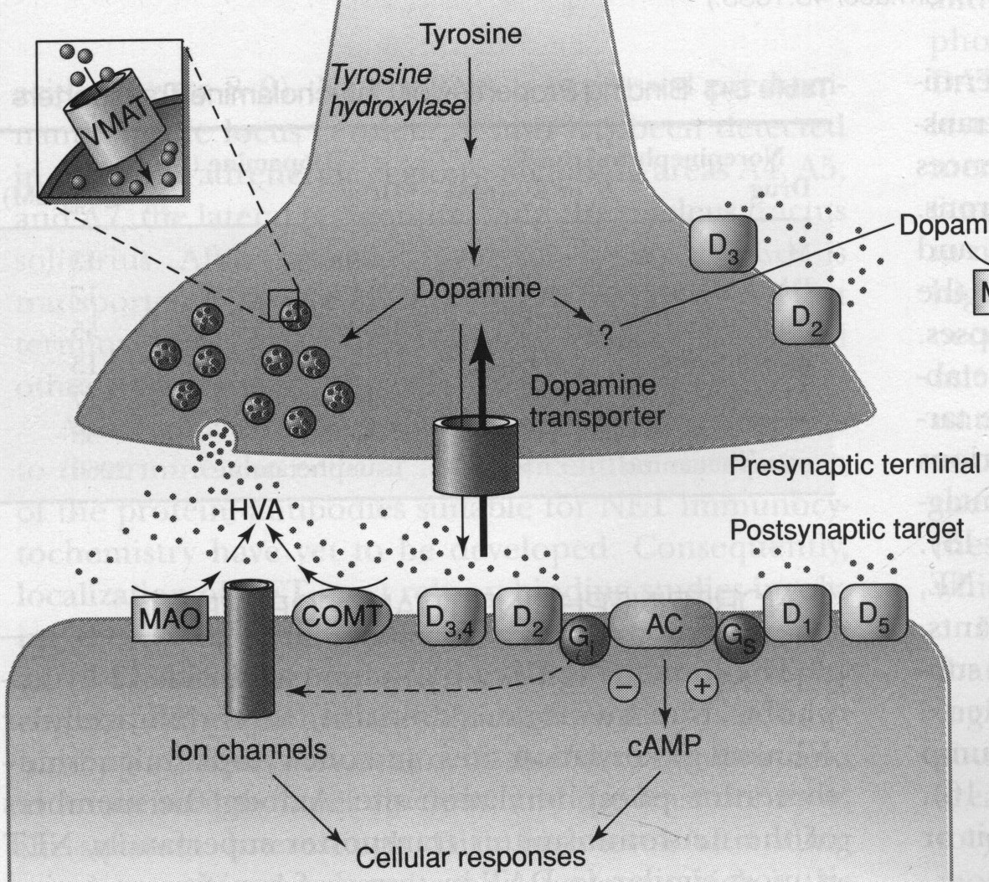
Dopamine Receptors
D₁-like
D₁, D₅ receptors
G_{s} linked
increase AC, cAMP
D₂-like
D₂, D₃, D₄
G_{i} linked
decrease AC, cAMP
increases K⁺ activity
decreases Ca⁺⁺

Slide 37
Dopamine Pathways
Substantia Nigra pars compacta
- nigro-striatal pathway
Ventral Tegmental Area (VTA)
- mesolimbic (nucleus accumbens)
- mesocortical (frontal cortex)
Periventricular hypothalamus - pituitary
retina, olfactory bulb - interneurons

Slide 38
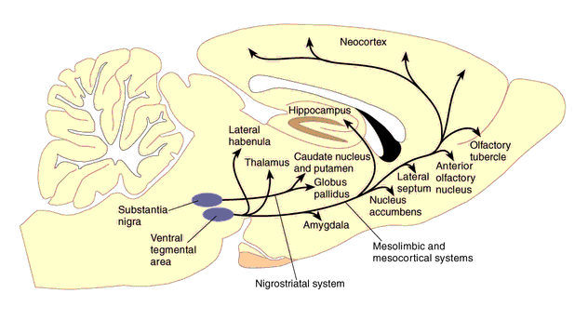
Dopamine (DA) Systems

Slide 39
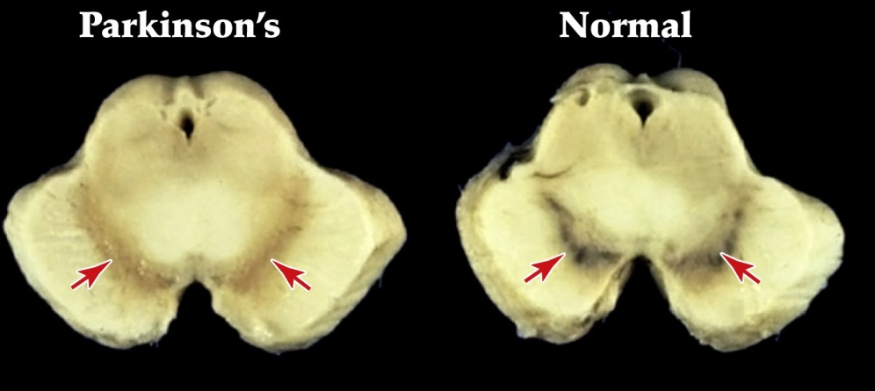
DA Receptors
D₁-like (D₁, and D₅): G_{S}-coupled, and will increase cAMP. D₂-like
(D₂, D₃, and D₄) G_{i}-coupled, and will decrease cAMP.
D₂ receptors primarily in NAc. Excess DA here thought to contribute to positive symptoms of schizophrenia.
D₁ receptors primarily in prefrontal cortex (PFC). Deficient DA here thought to contribute to negative symptoms and cognitive deficits.
Basal Ganglia: D₁ and D₂ receptors: direct and indirect pathways

Slide 40
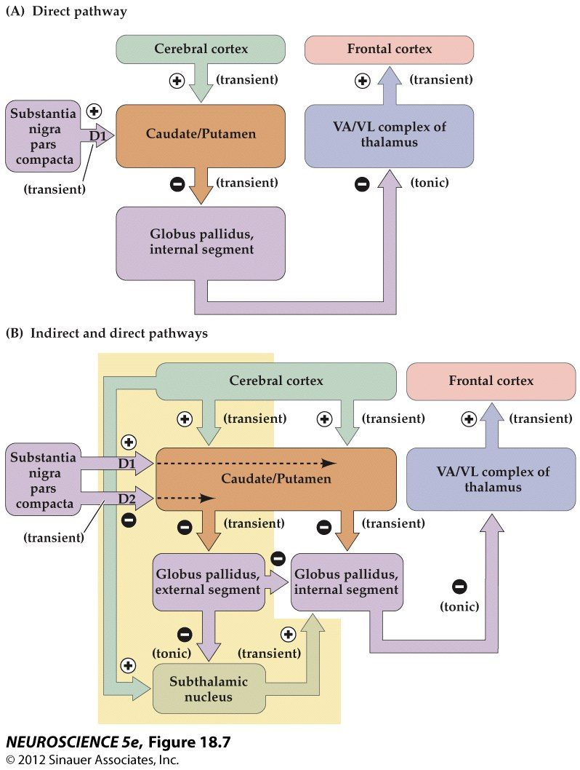
Figure 18.7 Disinhibition in the direct and indirect pathways through the basal ganglia

Slide 41
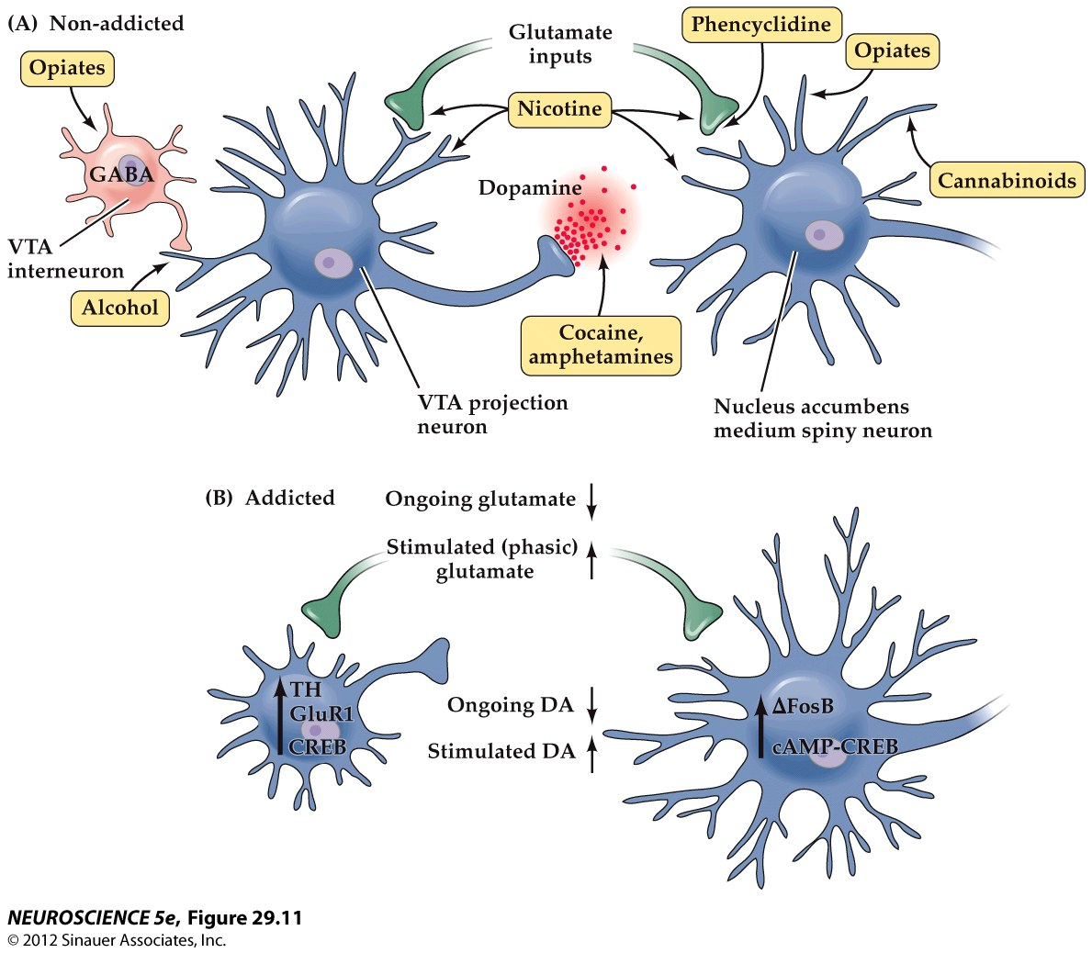
Figure 29.11 Drugs of abuse affect dopamine projections from the ventral tegmental area to the nucleus accumbens

Slide 42
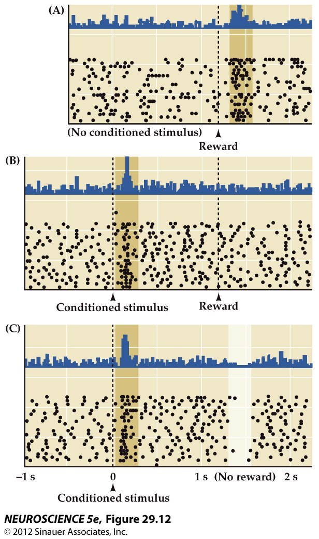
Figure 29.12 Changes in the activity of dopamine neurons in the VTA during stimulus–reward learning

Slide 43
Acetylcholine

Slide 44
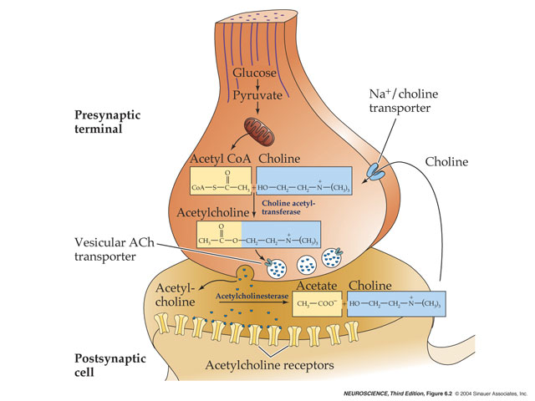
Synthesis - choline + acetyl Coa - (Chat) - ACh and CoA (source of choline and acetyl CoA?)
Rate limiting – choline
Degradation – extracellular cholinesterase - choline + acetate

Slide 45
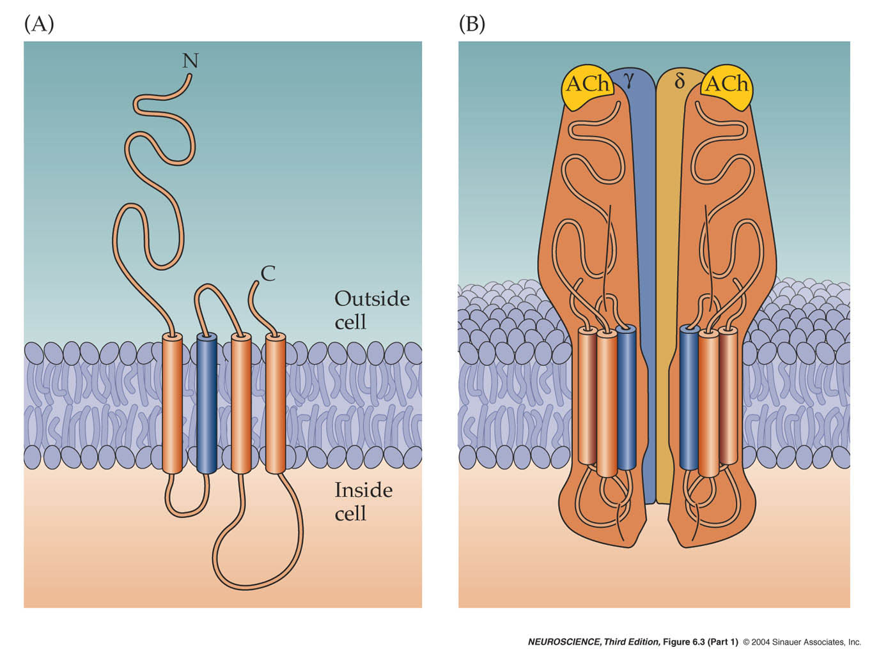
Nicotinic receptors
4 TM domains
TM2 = pore
2 ACh bind to 2 alpha subs
subunit diversity = pharm specificity
(nicotine at NMJ vs brain)

Slide 46
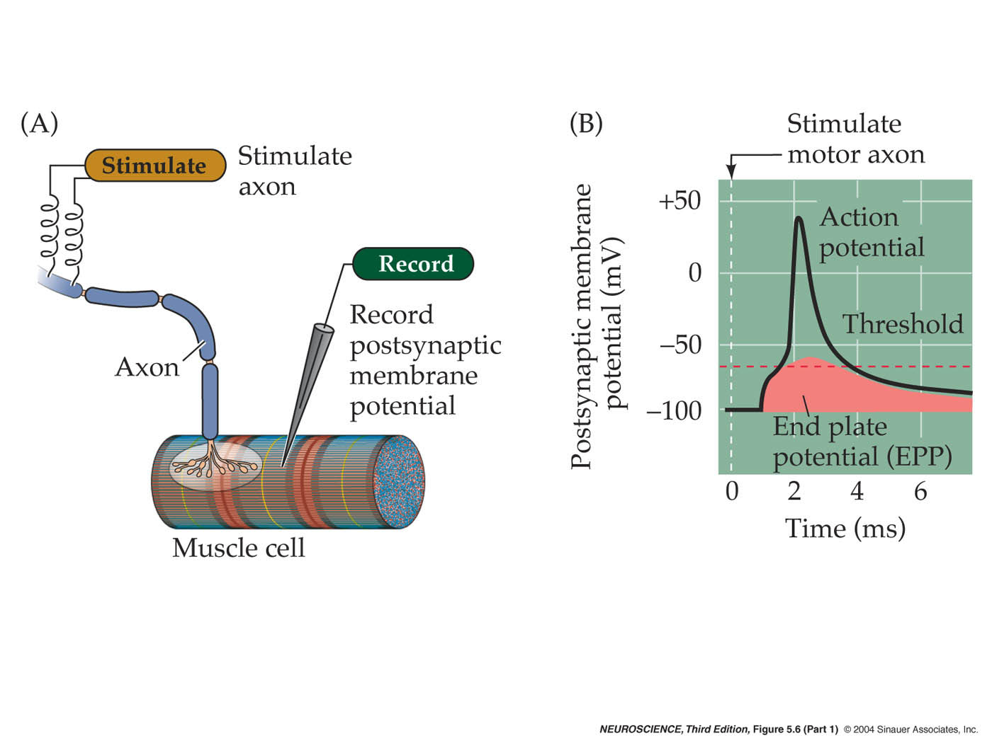

Slide 47
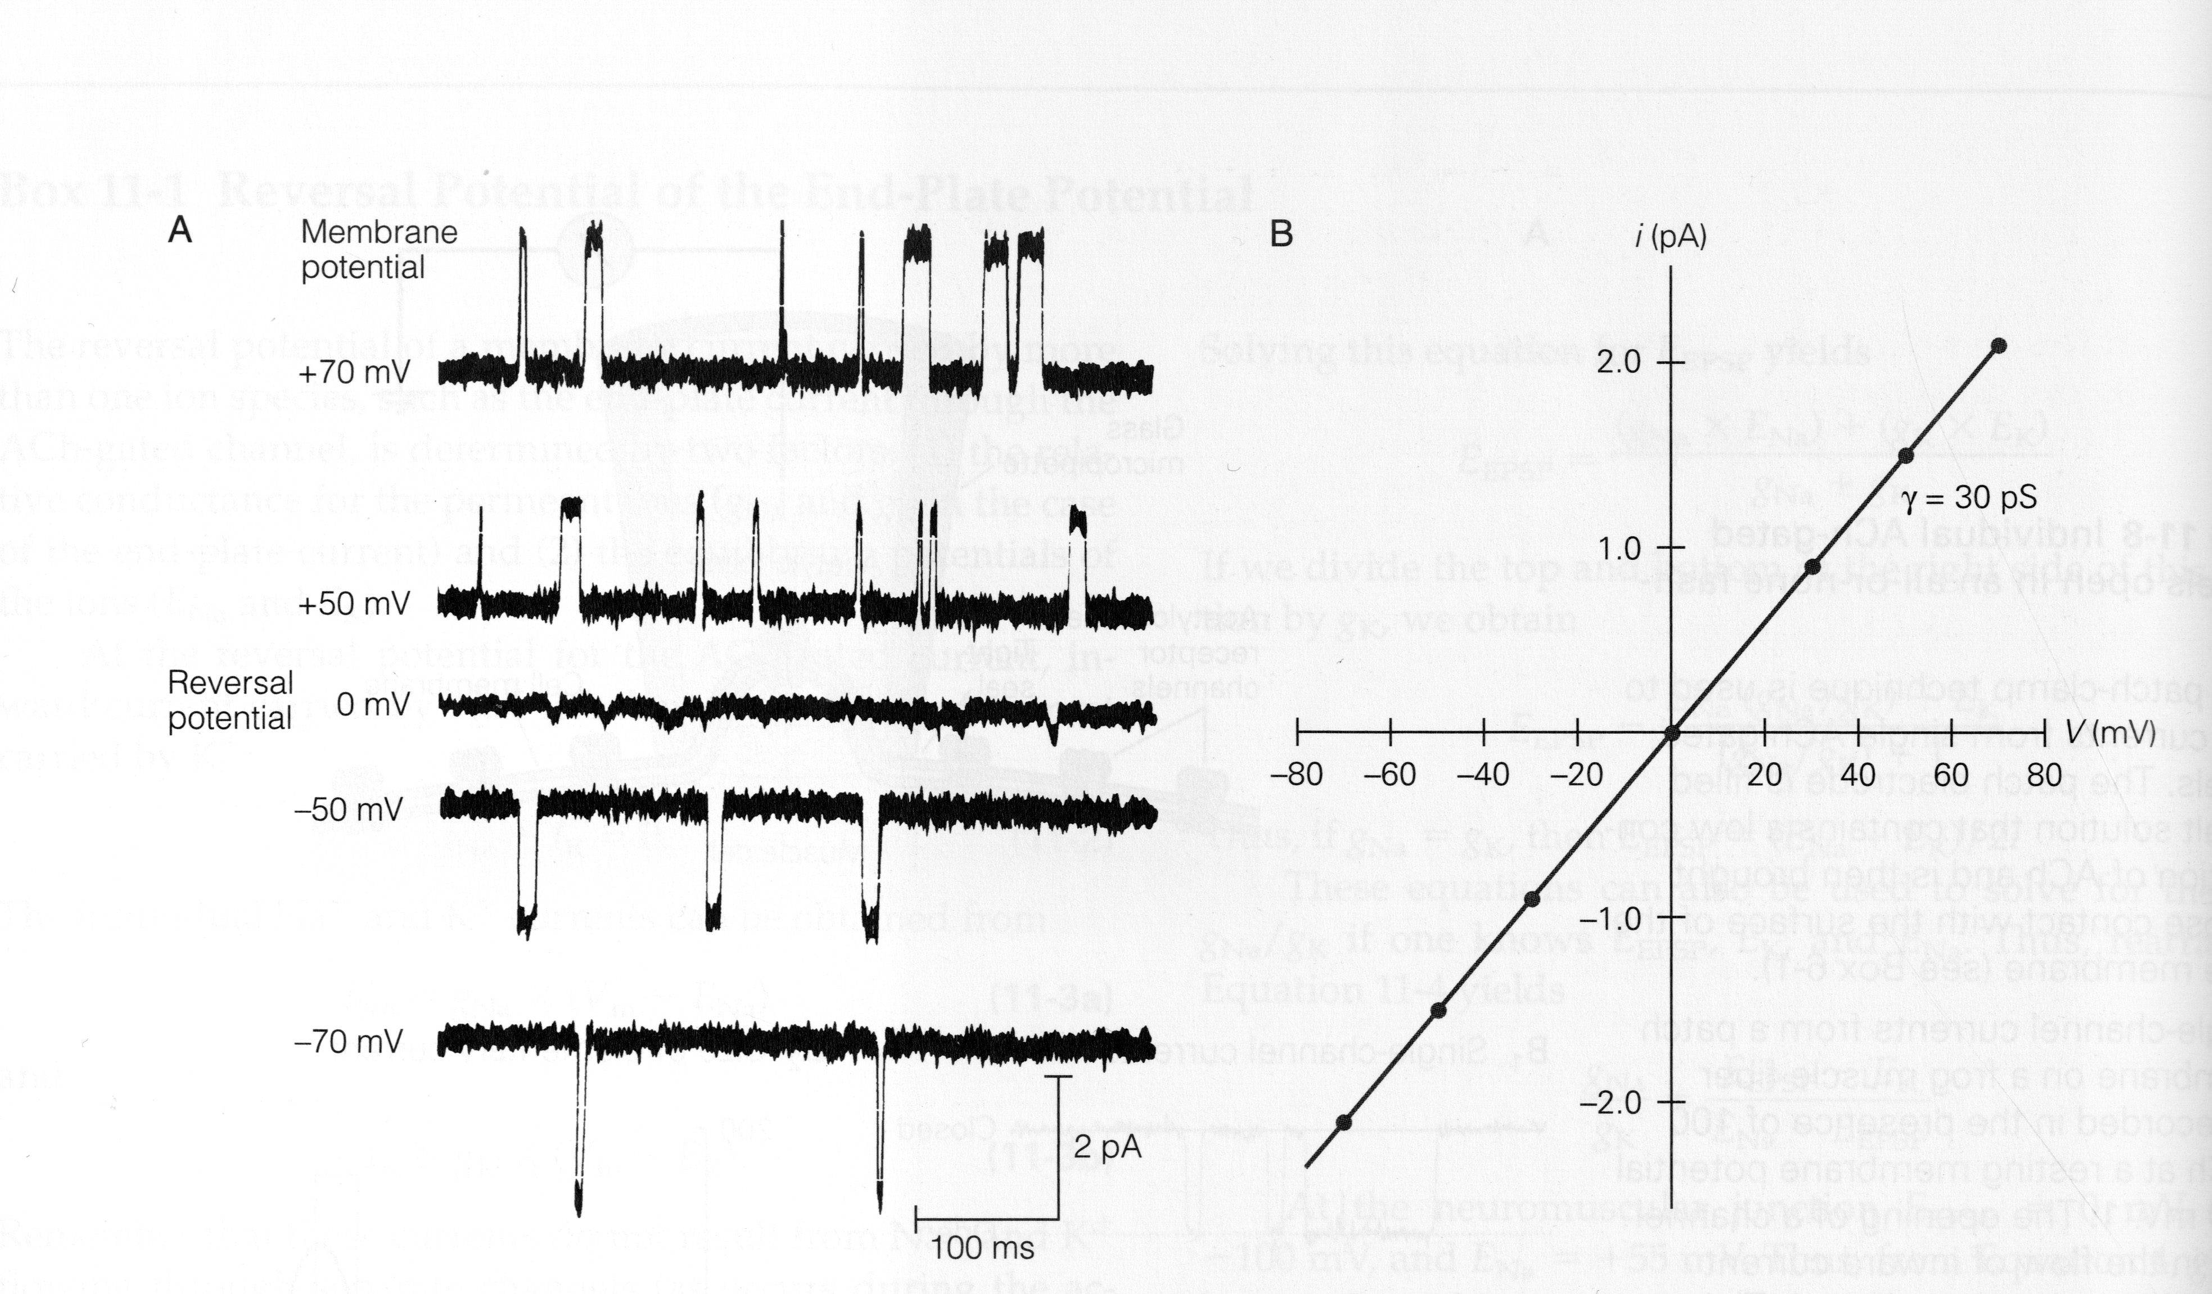
IV plot -
Equilibrium potential (ion species), conductance, voltage-dependence
what ions permeable -
NMJ - most studied synapse, receptor
Postsynaptic effects on muscle - elicit contraction with each AP
- safety factor
Myasthenia Gravis - “muscle weakness”
Especially deficit with sustained contractions – Why?
Treat - AChE inhibitors - reversible - physostigmine
What are other uses of anti-cholinesterase?

Slide 48
Other Disorders of Neuromuscular Transmission
Presynaptic targets
- Lambert Eaton Myasthenic Syndrome (LEMS)
- antibodies targeted to calcium channels in presynaptic
membrane, frequent complication of small cell lung carcinomas
- Botulinum toxin - produced by Clostridium bacteria
- protease that cleaves proteins essential for vesicle fusion in motor neuron terminals, causes muscle weakness, respiratory failure
- Tetanus toxin - also from Clostridium
- blocks release of inhibitory transmitter (glycine) in spinal cord,
loss of inhibition → hyperexcitation and spastic (tetanic) contractions
Cholinesterase Inhibitors - sarin - nerve gas
Postsynaptic targets
- toxins in snail and snake venom - alpha-bungarotoxin - paralytic
- plant toxins - curare - nicotinic receptor antagonist (poison arrows)

Slide 49
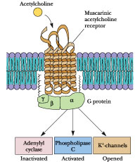
Muscarinic Cholinergic Receptors: M1, M2, and M3

Slide 50
Examples of modulatory effects of muscarinic receptor activation
Acetylcholine
“Accommodation” of firing due to activation of a slow, non-inactivating K⁺ conductance
ACh inhibits M-type K⁺ channels – leads to slow EPSP and blocks accommodation
M1 muscarinic receptor – coupled to G_{q} – ultimate effector may be Ca/calmodulin
- example of metabotropic action closing a channel
But what about ACh inhibition of heart rate?

Slide 51
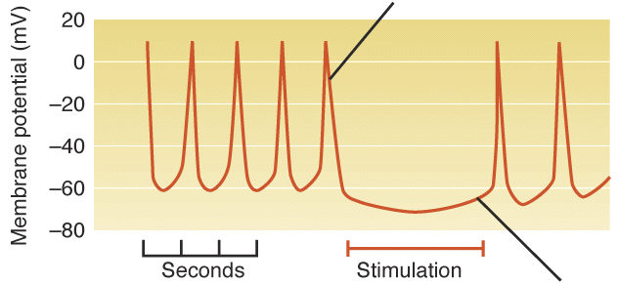
Examples of modulatory effects of muscarinic receptor activation
ACh activates a G protein-coupled inward-rectifying K⁺ (GIRK) channels
- opening the GIRK channel causes hyperpolarization and slows heart rate
M2 muscarinic receptor – coupled to G_{i}
- direct effect of beta/gamma G protein subunits on channel
not mediated by changes in AC – cAMP cascade
Muscarinic receptor - 5 subtypes M1-M5
M1,3,5 - Gq - stimulates PLC - DAG and IP3 -> PKC and Ca

Slide 52
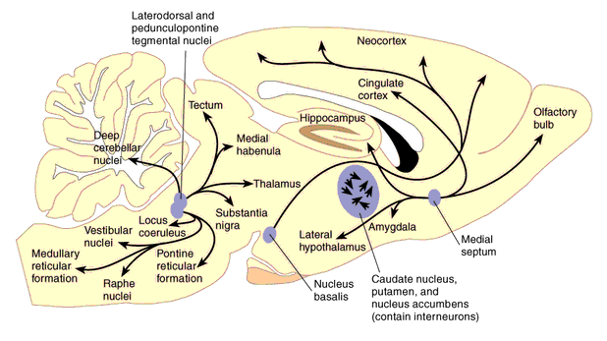
Cholinergic Pathways

Slide 53
Anatomical Pathways
NMJ
Parasympathetic postganglionic targets
Sympath and Parasympath preganglion - ganglion synpase
CNS
- projection vs local circuit neurons
2 major projection pathways:
Basal forebrain - BFCS - septal, diag band, n. basalis of meynert -> hi, ctx - learning and memory
degenerates in Alzheimer’s - how to treat - choline, reversible AChE inhibitors, NGF
Brainstem - pedunculopontine, laterodorsal tegmentum - thalamus, midbrain, basal ganglia
Local circuit - striatum - ACH blockers for Parkinson’s, Huntington’s loss of striatal interneurons
Behavior
Learning and memory/movement/mood
drug studies - importance of BBB because of periph effects on NMJ and autonomic nervous system

Slide 54
